Slide 1

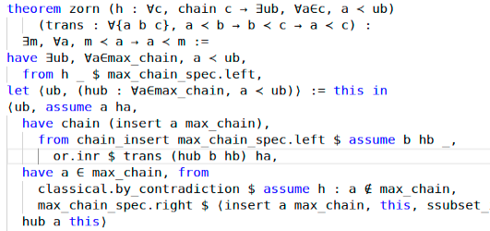
Theorem proving in Lean 3

Slide 2
What is covered in that presentation from Lean documentation
1. Introduction – the whole chapter
2. Dependent Type Theory – up to 2.7. Namespaces, without 2.8. Dependent Types, 2.9. Implicit Arguments and 2.10. Exercises

Slide 3
Introduction
Terminology

Slide 4
Formal verification
The use of logic and computational methods to check if the claim, written in a precise mathematical form, is true or false.
Example of a claim: (A∧B) ⇒ (B∧A)
Verification:
  A ∧ B
  A ∧ B ⇒ A
  A ∧ B ⇒ B
  A
  B
  B ⇒ (A ⇒ B ∧ A)
  A ⇒ B ∧ A
  B ∧ A
  (Resource of example: Y.Belov, V.Sokolov)

Slide 5
Two ways how we can make a program to provide a proof
A program can find a proof
A program can help verify that the given proof is correct

Slide 6
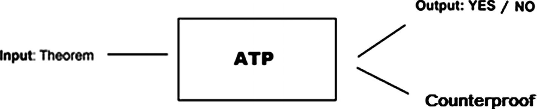
Automated theorem proving
A theorem proving, where a proof is realized by computer program. The process of proving is based on propositional and first-order logic
The process is “searching”
👍 powerful, efficient
👎 system can have bugs. Are the results correct?

Slide 7
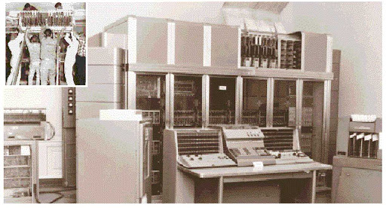
History of automated theorem proving
JOHNNIAC (1954, Martin Davis), proved that the sum of two even numbers is even
Logic Theory Machine (1956, Allen Newell, Herbert A. Simon and J. C. Shaw) – ran on JOHNNIAC, constructed proofs from a small set of propositional axioms and three deduction rules: modus ponens, (propositional) variable substitution, and the replacement of formulas by their definition. Managed to prove 38 of the first 52 theorems of the Principia
JOHNNIAC, photo from http://ed-thelen.org

Slide 8
What can we do using ATP
Check the validity of formulas in propositional and first-order logic:
Resolution theorem provers
Tableau theorem provers
Fast satisfiability solvers
Search and check the validity expression in specific languages or domains (e.g., of linear or nonlinear expressions over the integers or the real numbers)
Realize mathematical computations, establish mathematical bounds, find mathematical objects. Calculation equals to proof here.

Slide 9
Interactive theorem prover
A software, that assists the development of formal proofs
A human guides the search for proofs. Computer provides and stores the details of proof
The process is “verifying” – every claim should be supported by a proof in a suitable axiomatic foundation
👎 more input and interaction from user
👍 allow to obtain deeper and more complex proof

Slide 10
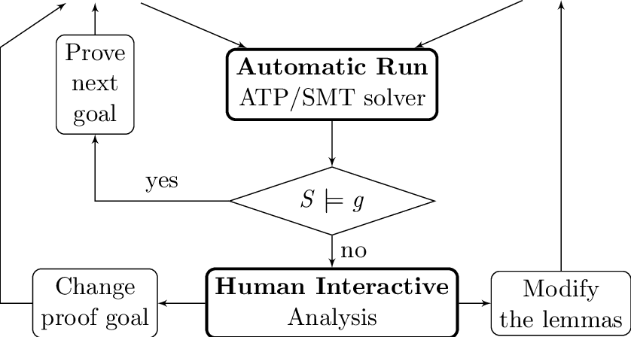
Interactive theorem proving
Resource: Tianxiang Lu on researchgate.net

Slide 11
The aim of Lean
To bridge the gap between interactive and automated theorem proving
It has automated tools and methods inside a framework
User interacts with that framework and constructs axiomatic proofs

Slide 12
The goal of Lean
“To support both mathematical reasoning and reasoning about complex systems, and to verify claims in both domains”
Programmaticaly speaking, “to prove things about the objects we define”
So, what can we verify in Lean:
Ordinary mathematical theorems
Claims about correctness of the programming code, hardware, software, network protocols, mechanical and hybrid systems...

Slide 13
WHY ON THE SAME LEVEL?
Ordinary mathematical theorems, claims about correctness of programming code, hardware, software, network protocols, mechanical and hybrid systems...

Slide 14
Curry–Howard isomorphism
There is a direct relationship between computer programs and mathematical proofs:
Hardware and software systems are described in mathematical terms, the check of its correctness is a theorem proving
A theorem proof is basically computations, a program. The formula it proves is the type for the program
Proofs can be represented as programs, proofs can be run

Slide 15
How Lean can be used?
As a programming language, as a system for writing programs with a precise semantics and for reasoning about the functions that the programs compute
As a metaprogramming language – we can extend the functionality of Lean using the Lean itself

Slide 16
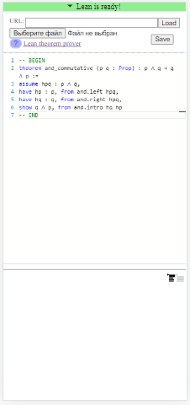
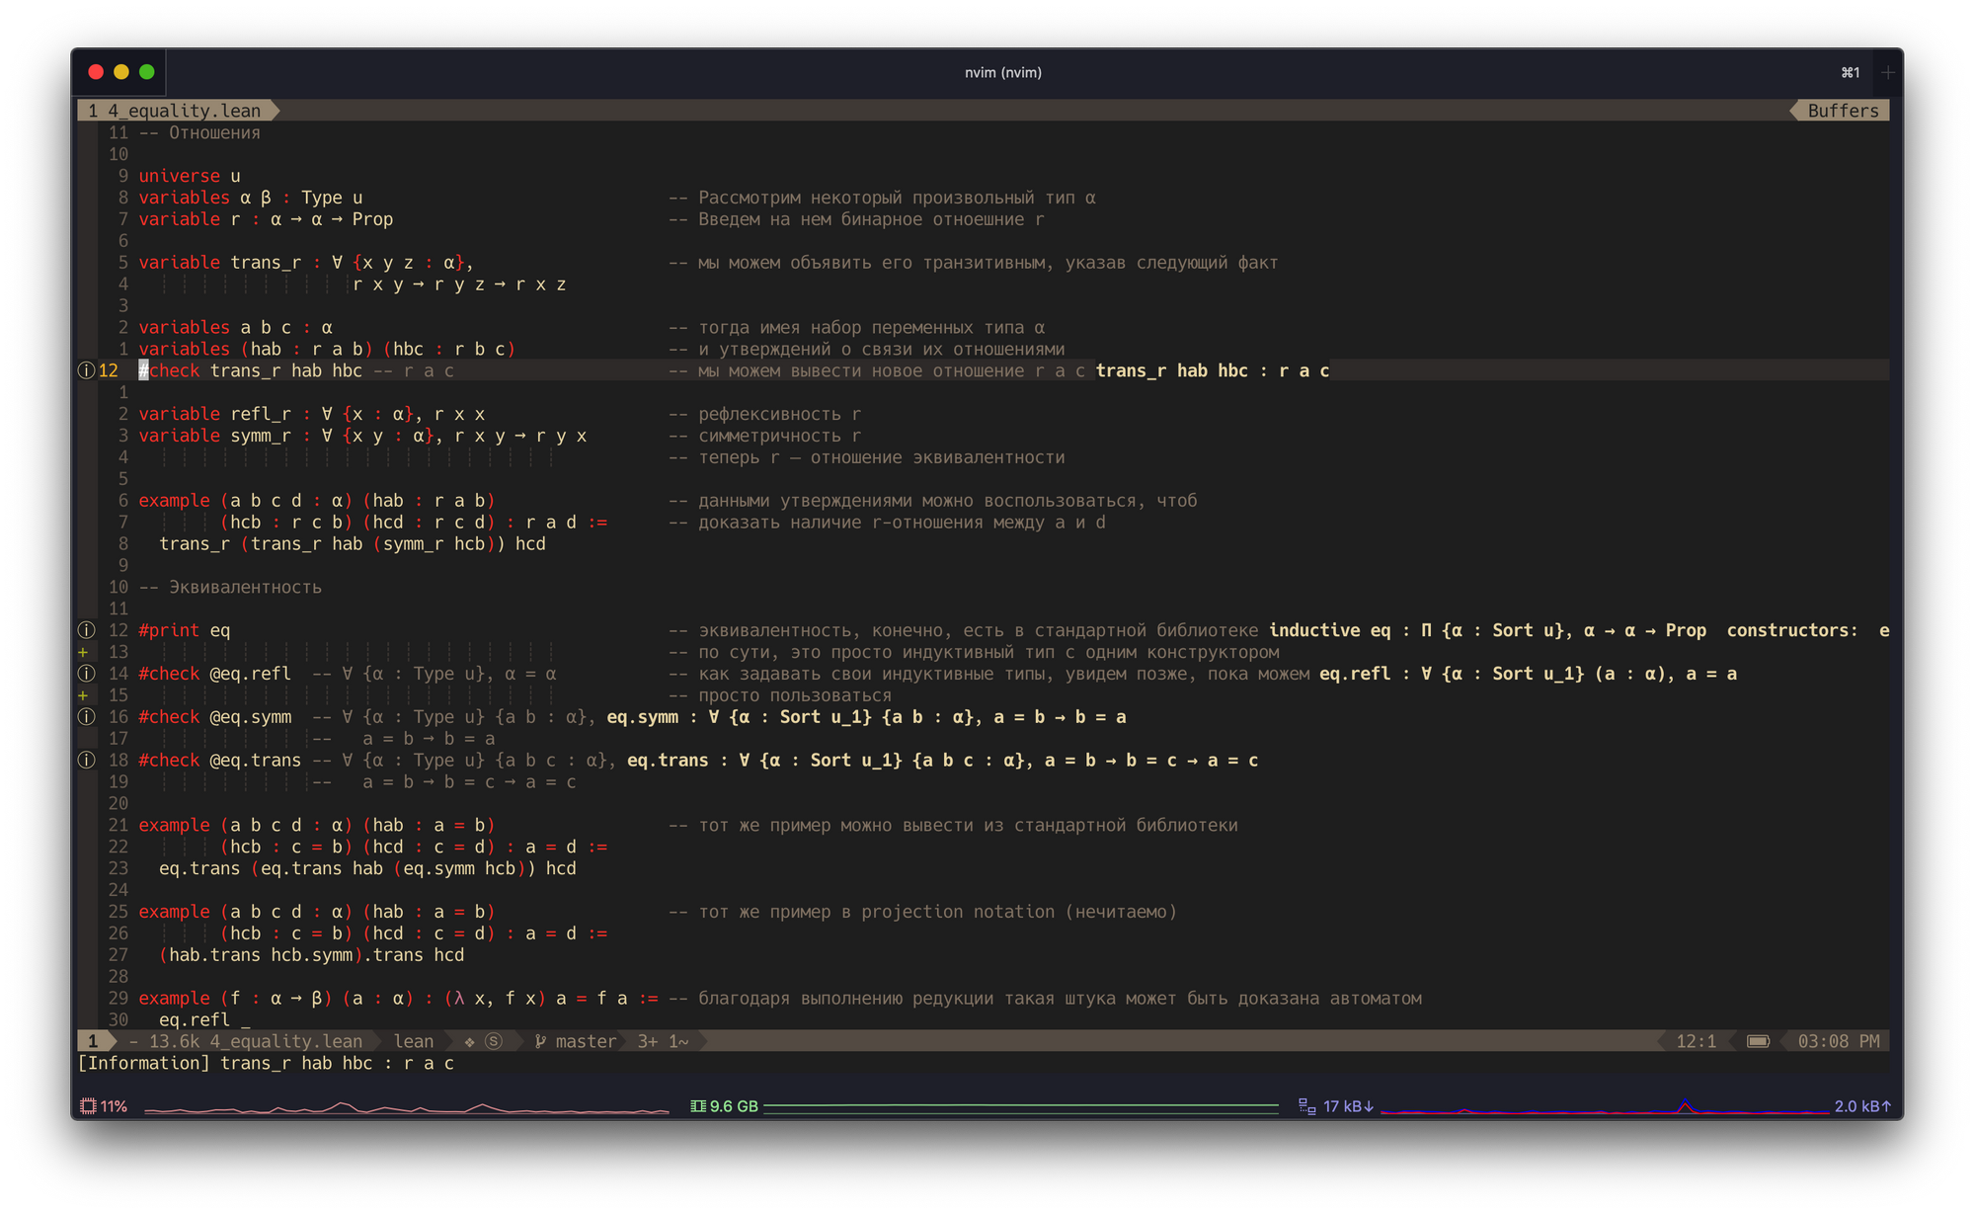
How to use Lean?
In browser
Install a program, which is faster and more flexible, than Lean in browser
Lean in VIM editor (download e.g. VS Code if you are a Windows’ user)
Resource: yakovlev.me

Slide 17
2. Dependent Type Theory

Slide 18
Dependent type theory
Powerful, expressive
Provides a natural and uniform expressions of complex mathematical assertions, hardware and software specifications
Every term has a computational behavior (they can be computed)
Lean is based on a version of dependent type theory Calculus of Constructions

Slide 19
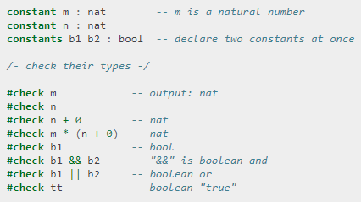
Why to use type theory in provers?
We can track various kinds of mathematical objects: natural numbers, functions on a natural numbers, booleans…
We can build new types

Slide 20
Lean commands
constant, constants – to declare constants, which then available everywhere in code
variable, variables – to declare constants, that are available inside a block of code (?? ask)
section – to define a block of code, can be nested (sections inside sections). Use it to declare variables for insertion in theorems. It is not necessary to give a name to section, but if you do, it is necessary to close it using the same name
namespace – for grouping definitions, can be nested (namespaces inside namespaces). Use it to organize data.
namespace foo
def a : ℕ := 5
end foo
-- we call it outside like `foo.a`
def – to define an object in a form def foo : α := bar
universe – to declare a universe variable
constant a : bool constants m n : nat
section useful variable x : α -- more computations here end useful
namespace foo def a : ℕ := 5 end foo -- we call it outside like `foo.a`
def double : ℕ → ℕ := λ x, x + x def double (x : ℕ) : ℕ := x + x
universe u constant α : Type u

Slide 21
Lean commands
# - the beginning for commands
#check – to check the type of a constant or the type of operation
#check (λ x : α, x) a
#print – to print something on a screen
#print “here I declare constants”
#reduce – to evaluate an expression by reducing it to normal form (by carrying out all the computational reductions that are sanctioned by the underlying logic)
  constant n : nat
  #reduce n + 0 -- n
  #reduce n + 2 -- nat.succ (nat.succ n)
  #reduce 2 + 3 -- 5
  #eval – the other command to evaluate an expression, less trustworthy, more efficient
-- comments, /- also comments -/
#check (λ x : α, x) a
#print “here I declare constants”
constant n : nat #reduce n + 0 -- n #reduce n + 2 -- nat.succ (nat.succ n) #reduce 2 + 3 -- 5

Slide 22
Typing helper
To type → type \to, \r or ->
To type ℕ type nat or \nat
To type × type \times
To type letters like α, β, and γ, type \a, \b, \g

Slide 23
Type
In type theory, every expression has an associated type – natural number, Boolean, function…
In Lean everything is a type. Types also have a type of Type, and Type has a type of Type in an infinite hierarchy of types.
You can define your own types in Lean

Slide 24
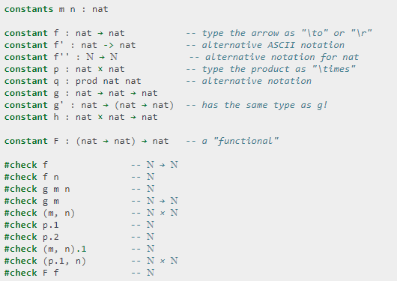
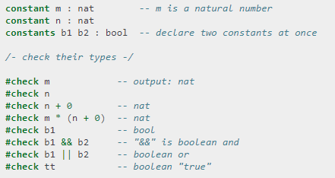
Let’s look at types in Lean closer

Slide 25
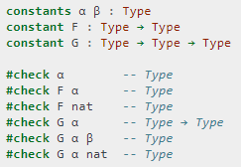
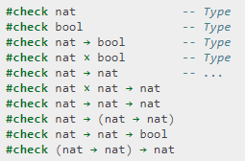



Let’s look at types in Lean closer – 2
Declaring a universe type variable
We declared new types α and β
Types have a type of Type
Declaring a type variable without creating a universe
An infinite hierarchy of types lies in foundation of Lean: Type 0 (or Type) is a universe of "small" or "ordinary" types. Type 1 is a larger universe of types, which contains Type 0 as an element. Type 2 is a larger universe of types, which contains Type 1 as an element, etc.

Slide 26
Functions in Lean
nat → nat denotes the type of functions that take a natural number as input and return a natural number as output
constant f : nat → nat
(m, n) denotes the ordered pair of m and n, and if p is a pair, p.1 and p.2 denote the two projections
constants m n : nat
constant p : nat × nat
#check p.1 -- ℕ
#check (m, n) -- ℕ × ℕ
#check (p.1, n) -- ℕ × ℕ
The application of a function f to a value x is denoted f x
#check f x -- ℕ
When writing type expressions, arrows associate to the right; for example, in code constant g : nat → nat → nat, the type of g is nat → (nat → nat)
g is a function that takes natural numbers and returns another function that takes a natural number and returns a natural number – at the end, the number is returned
This process is called currying
constant f : nat → nat
constants m n : nat constant p : nat × nat #check p.1 -- ℕ #check (m, n) -- ℕ × ℕ #check (p.1, n) -- ℕ × ℕ
#check f x -- ℕ

Slide 27
Creating a function from another expression
We need a lambda abstraction process here (we need to turn terms and parts of terms into a variable)
We temporarily postulate a variable x : α, and then we can construct an expression t : β
The expression fun x : α, t, or, equivalently, λ x : α, t, is an object of type α → β
It is a function from α to β which maps any value x to the value t, which depends on x
“Let f be the function which maps any natural number x to x + 5”
#check fun x : nat, x + 5 #check λ x : nat, x + 5

Slide 28
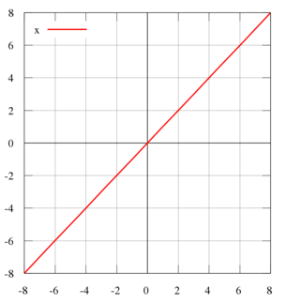
Some terminology…
Bound variable – a placeholder with the given scope
λ x : α, t - x is a placeholder, whose "scope" doesn't extend beyond t
Alpha equivalent expressions – the expressions that are the same up to a renaming of bound variables, they are considered “the same.”
λ (b : β) (x : α), x is equal to λ (u : β) (z : α), z
Identity function – a function that always returns the same value that was used as its argument
Graph of the identity function on the real numbers, Resource: Wikipedia

Slide 29
Some terminology – 2
Constant function – a function whose (output) value is the same for every input value, e.g., f(x) = 4 is a constant function
Function composition – applying one function to the results of another

Slide 30
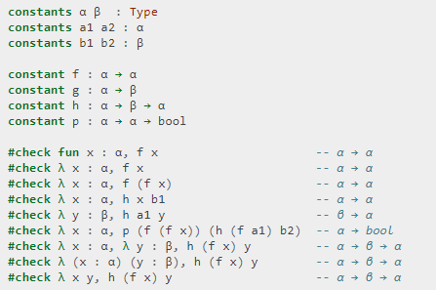
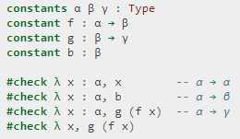

The expression λ x : α, x denotes the identity function on α, the expression λ x : α, b denotes the constant function that always returns b, and λ x : α, g (f x), denotes the composition of f and g
Lean interprets the final three examples as the same expression; in the last expression, Lean infers the type of x and y from the types of f and h
We can abstract over any of the constants in the previous definitions
We can even abstract over the type
The function that takes three types, α, β, and γ, and two functions, g : β → γ and f : α → β, and returns the composition of g and f

Slide 31
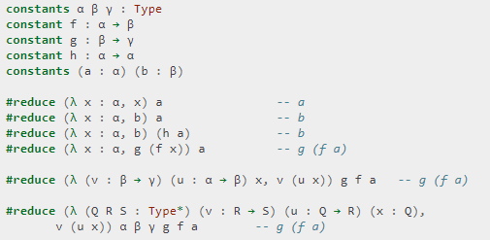
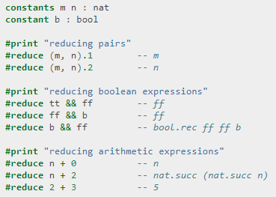
#reduce
Beta reduction - the process of simplifying an expression. E.g., simplifying (λ x, t)s to t[s/x] - t with s substituted for the variable x
Beta equivalent terms - terms that beta reduce to a common term
Definitionally equal term – two terms that reduce to the same value
In dependent type theory every term has a computational behavior, and supports a notion of reduction, or normalization

Slide 32
How we are working in Lean most of the time?
We define objects and prove things about them
def double : ℕ → ℕ := λ x, x + x def square : ℕ → ℕ := λ x, x * x def do_twice : (ℕ → ℕ) → ℕ → ℕ := λ f x, f (f x)
def double (x : ℕ) : ℕ := x + x def square (x : ℕ) := x * x def do_twice (f : ℕ → ℕ) (x : ℕ) : ℕ := f (f x)
def do_twice (α : Type*) (h : α → α) (x : α) : α := h (h x) def do_twice (h : α → α) (x : α) : α := h (h x)
variables (α β γ : Type*) variables (g : β → γ) (f : α → β) (h : α → α) variable x : α def do_twice := h (h x)

Slide 33
Local definitions using let
let a := t1 in t2 means – all a in t2 will be replaced by t1
#reduce let y := 2 + 2, z := y + y in z * z -- 64 - all z are replaced by y + y, which are 4+4, so z * z equals to 64
def t (x : ℕ) : ℕ := let y := x + x in y * y #reduce t 2 -- 16

Slide 34
Namespaces
Like sections, nested namespaces have to be closed in the order they are opened
Namespaces cannot be declared inside a section
namespace foo def a : ℕ := 5 #print "inside foo" #check a end foo #print "outside the namespace" -- #check a -- error open foo #print "opened foo" #check a

Slide 35
Resources
https://en.wikipedia.org/wiki/Curry%E2%80%93Howard_correspondence
https://yakovlev.me/lean-intro/
https://leanprover.github.io/theorem_proving_in_lean/
https://commons.wikimedia.org/w/index.php?curid=66273005
https://ru.wikipedia.org/wiki/%D0%90%D0%B2%D1%82%D0%BE%D0%BC%D0%B0%D1%82%D0%B8%D1%87%D0%B5%D1%81%D0%BA%D0%BE%D0%B5_%D0%B4%D0%BE%D0%BA%D0%B0%D0%B7%D0%B0%D1%82%D0%B5%D0%BB%D1%8C%D1%81%D1%82%D0%B2%D0%BE#cite_note-1

