Slide 1
Avoiding Synchronization in Geometric Multigrid
Erin C. Carson¹
Samuel Williams², Michael Lijewski², Nicholas Knight¹, Ann S. Almgren², James Demmel¹, and Brian Van Straalen^{1,2}
¹University of California, Berkeley, USA
²Lawrence Berkeley National Laboratory, USA
SIAM Parallel Processing, Wednesday, February 19, 2014

Slide 2
Talk Summary
Implement, evaluate, and optimize a communication-avoiding formulation of the Krylov method BICGSTAB (CA-BICGSTAB) as a high-performance, distributed-memory bottom solve routine for geometric multigrid solvers
  Synthetic benchmark (miniGMG) for detailed analysis
  Best implementation integrated into BoxLib to evaluate benefits in two real-world applications
First use of communication-avoiding Krylov subspace methods for improving multigrid bottom solve performance.

Slide 3
Geometric Multigrid
Numerical simulations in a wide array of scientific disciplines require solving elliptic/parabolic PDEs on a hierarchy of adaptively refined meshes
Geometric Multigrid (GMG) is a good choice for many problems/problem sizes
  Consists of a series of V-cycles (“U-cycles”)
  Coarsening terminates when each local subdomain size reaches 2-4 cells
  Uniform meshes: agglomerate subdomains, further coarsen, solve on subset of processors
interpolation
restriction
bottom-solve
  Geometry of non-rectangular domains / irregular boundaries may prohibit use of this technique, thus bottom-solve required
    Krylov subspace methods commonly used for this purpose
  GMG + Krylov method available as solver option (or default) in many available software packages (e.g., BoxLib, Chombo, PETSc, hypre)
Notes:
Other ways of solving include direct solvers, Krylov subspace methods, fast multipole methods

Slide 4
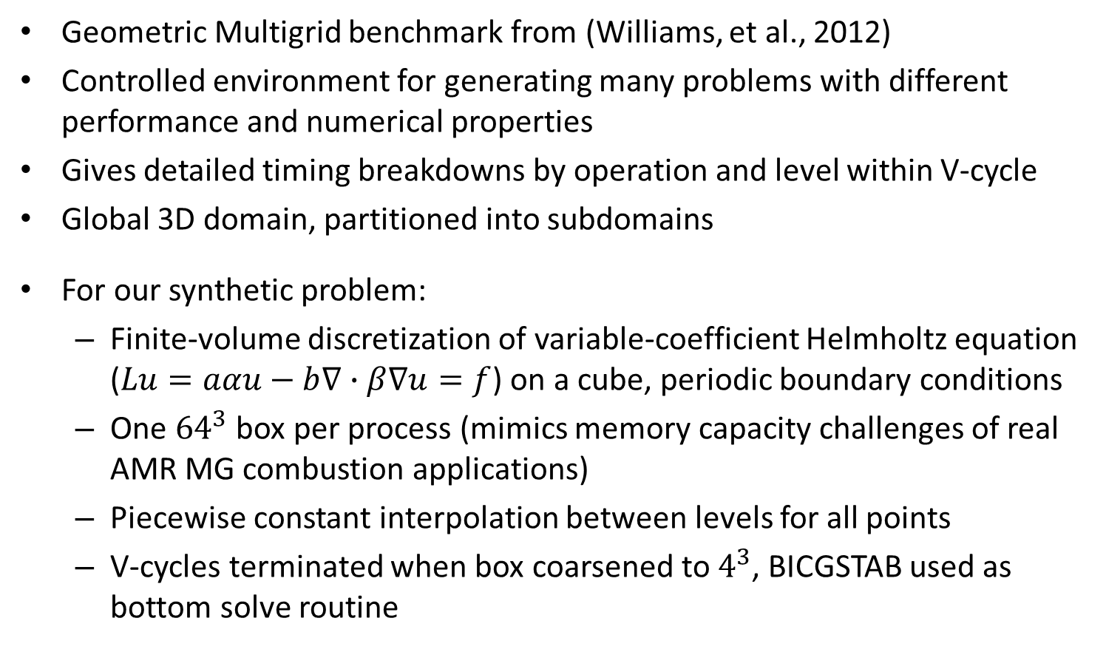
The miniGMG Benchmark
Geometric Multigrid benchmark from (Williams, et al., 2012)
Controlled environment for generating many problems with different performance and numerical properties
Gives detailed timing breakdowns by operation and level within V-cycle
Global 3D domain, partitioned into subdomains
For our synthetic problem:
  Finite-volume discretization of variable-coefficient Helmholtz equation ($Lu=aαu−b∇∙β∇u=f$) on a cube, periodic boundary conditions
  One ${64}^{3}$ box per process (mimics memory capacity challenges of real AMR MG combustion applications)
  Piecewise constant interpolation between levels for all points
  V-cycles terminated when box coarsened to $4^{3}$, BICGSTAB used as bottom solve routine
Notes:
RHS is a 3D triangle wave whose period spans the entire domain, $α=β=1.0, a=b=0.9$
Neither SIMD optimizations nor communication-avoiding smoothers are used

Slide 5
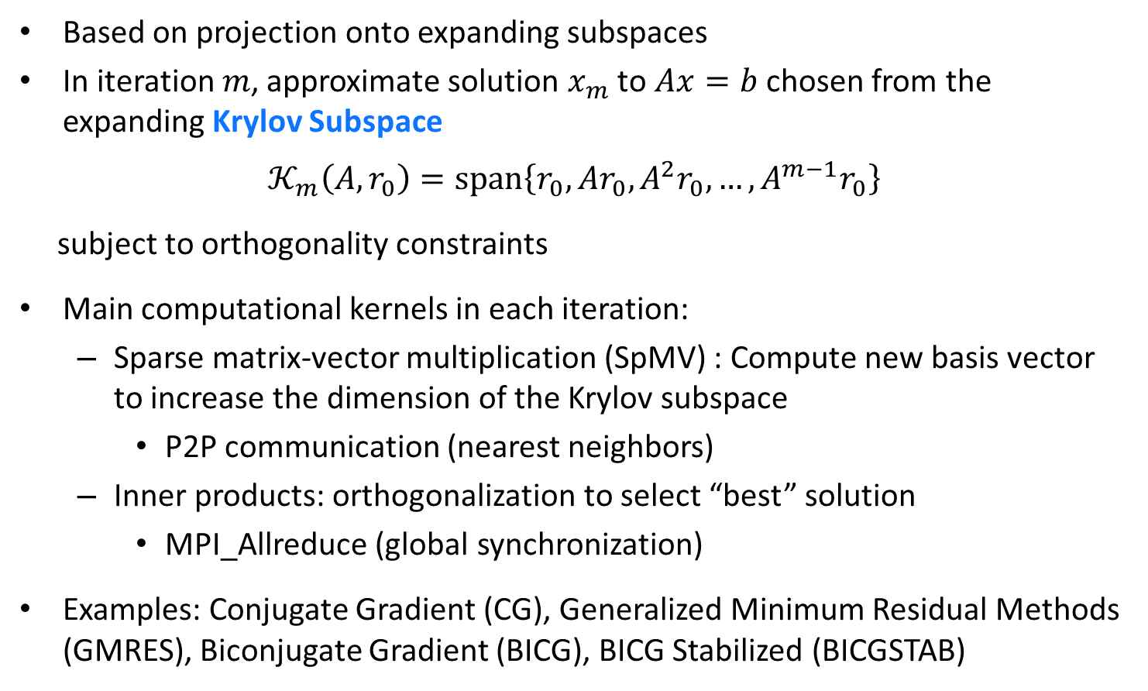
Krylov Subspace Methods
Based on projection onto expanding subspaces
In iteration $m$, approximate solution $x_{m}$ to $Ax=b$ chosen from the expanding Krylov Subspace
$$𝒦_{m}\left(A,r_{0}\right)=\text{span}\left\{r_{0}, Ar_{0}, A^{2}r_{0}, …, A^{m−1}r_{0}\right\}$$
subject to orthogonality constraints
Main computational kernels in each iteration:
  Sparse matrix-vector multiplication (SpMV) : Compute new basis vector to increase the dimension of the Krylov subspace
    P2P communication (nearest neighbors)
  Inner products: orthogonalization to select “best” solution
    MPI_Allreduce (global synchronization)
Examples: Conjugate Gradient (CG), Generalized Minimum Residual Methods (GMRES), Biconjugate Gradient (BICG), BICG Stabilized (BICGSTAB)
Notes:
(b-Ax_m) \perp L_m
Since b-Ax_m=b-Ax_0 –A\delta = r_0 – A\delta

Slide 6

The BICGSTAB Method
Given: Initial guess $x_{0}$ for solving $Ax=b$
Initialize $p_{0}=r_{0}=b−Ax_{0}$
Pick arbitrary $\tilde{r}$ such that $(\tilde{r},r_{0})≠0$
For $j=0,1,…,$ until convergence do
$α_{j}=(\tilde{r},r_{j})/(\tilde{r}, Ap_{j})$
$x_{j+1}=x_{j}+α_{j}p_{j}$
$q_{j}=r_{j}−α_{j}Ap_{j}$
Check ${\left\|q_{j}\right\|}_{2}={\left(q_{j}, q_{j}\right)}^{1/2}$ for convergence
$ω_{j}=(q_{j},Aq_{j})/(Aq_{j},Aq_{j})$
$x_{j+1}=x_{j+1}+ω_{j}q_{j}$
$r_{j+1}=q_{j}−ω_{j}Aq_{j}$
Check ${\left\|r_{j+1}\right\|}_{2}={\left(r_{j+1}, r_{j+1}\right)}^{1/2}$ for convergence
$β_{j}=({α_{j}}/{ω_{j}})(\tilde{r},r_{j+1})/(\tilde{r},r_{j})$
$p_{j+1}=r_{j+1}+β_{j}(p_{j}−ω_{j}Ap_{j})$
End For
Inner products in each iteration require global synchronization (MPI_AllReduce)
Multiplication by A requires nearest neighbor communication (P2P)

Slide 7
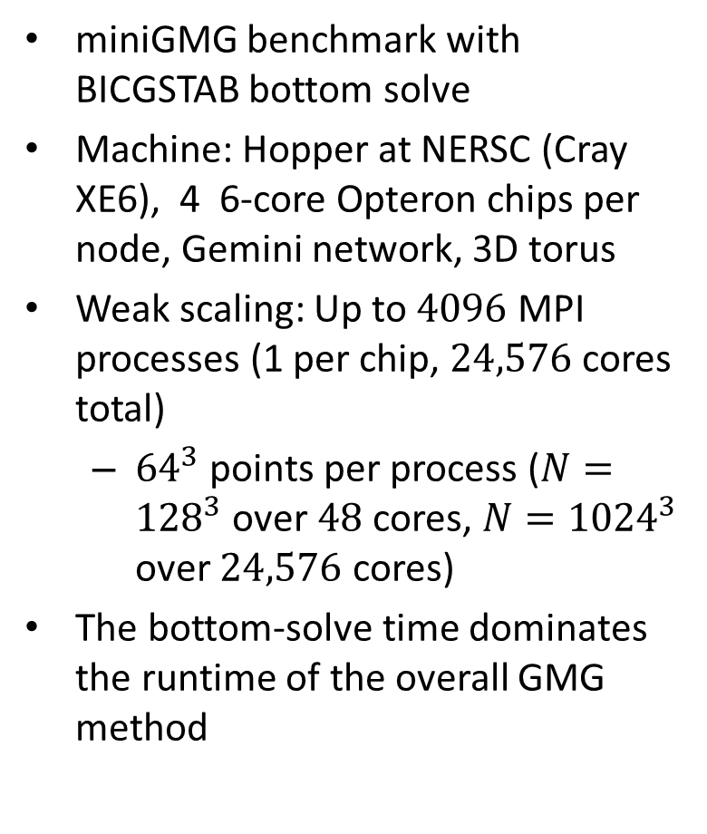
miniGMG Benchmark Results
miniGMG benchmark with BICGSTAB bottom solve
Machine: Hopper at NERSC (Cray XE6), 4 6-core Opteron chips per node, Gemini network, 3D torus
Weak scaling: Up to $4096$ MPI processes (1 per chip, $24,576$ cores total)
  ${64}^{3}$ points per process ($N={128}^{3}$ over $48$ cores, $N={1024}^{3}$ over $24,576$ cores)
The bottom-solve time dominates the runtime of the overall GMG method
Scales poorly compared to other parts of the V-cycle
Notes:
Convergence criteria: reduce residual to ${10}^{−10}$

Slide 8
The Communication Bottleneck
Same miniGMG benchmark with BICGSTAB on Hopper
Top: MPI_AllReduce clearly dominates bottom solve time
Bottom: Increase in MPI_AllReduce time due to two effects:
  # iterations required by solver increases with problem size
  MPI_AllReduce time increases with machine scale (no guarantee of compact subtorus)
Poor scalability: Increasing number of increasingly slower iterations!

Slide 9
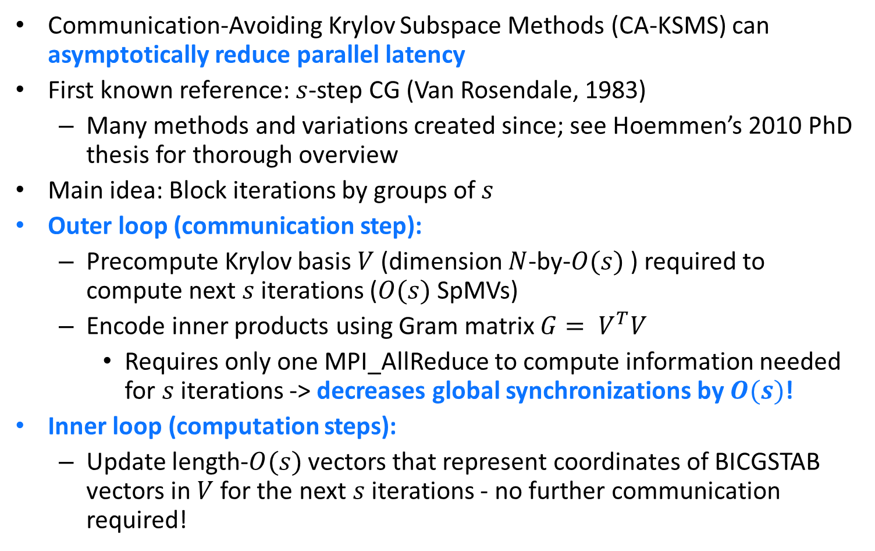
Communication-Avoiding KSMs
Communication-Avoiding Krylov Subspace Methods (CA-KSMS) can asymptotically reduce parallel latency
First known reference: $s$-step CG (Van Rosendale, 1983)
  Many methods and variations created since; see Hoemmen’s 2010 PhD thesis for thorough overview
Main idea: Block iterations by groups of $s$
Outer loop (communication step):
  Precompute Krylov basis $V$ (dimension $N$-by-$O(s)$ ) required to compute next $s$ iterations ($O(s)$SpMVs)
  Encode inner products using Gram matrix $G= V^{T}V$
    Requires only one MPI_AllReduce to compute information needed for $s$ iterations -> decreases global synchronizations by $O(s)$!
Inner loop (computation steps):
  Update length-$O(s)$ vectors that represent coordinates of BICGSTAB vectors in$V$ for the next $s$ iterations - no further communication required!
Notes:
Latency reduced by O(s) in parallel case, but bandwidth+flops might actually increase
Latency and bandwidth reduced by O(s) in sequential case, assuming that nnz > o(n) …which means that reading A is the dominant cost (more expensive than reading/writing the length n basis vector outputs. If nnz(A) is o(n), then need the streaming version to reduce BW asymptotically, otherwise just avoids latency.

Slide 10


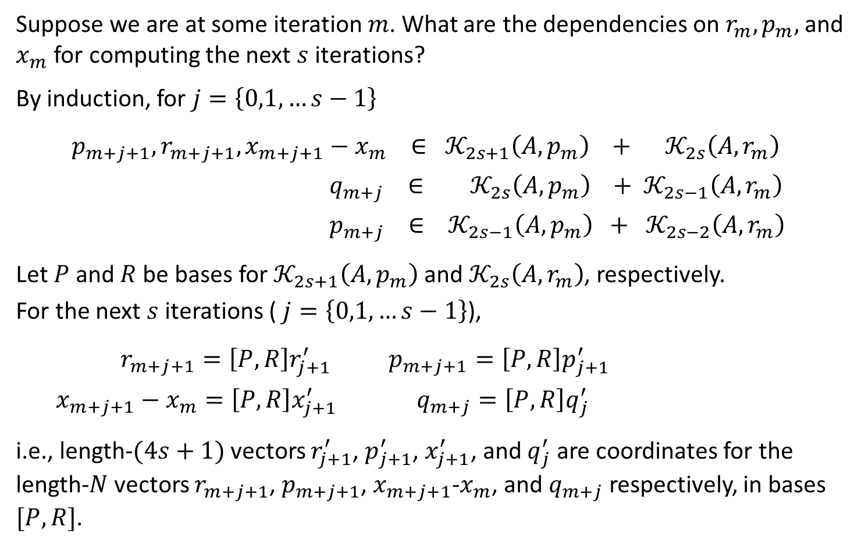
CA-BICGSTAB Derivation: Basis Change
Suppose we are at some iteration $m$. What are the dependencies on $r_{m}, p_{m},$ and $x_{m}$ for computing the next $s$ iterations?
By induction, for $j=\left\{0,1,…s−1\right\}$
  $p_{m+j+1}, r_{m+j+1}, x_{m+j+1}−x_{m} ∈ 𝒦_{2s+1}\left(A,p_{m}\right) + 𝒦_{2s}\left(A,r_{m}\right)$
  $q_{m+j} ∈ 𝒦_{2s}\left(A,p_{m}\right) + 𝒦_{2s−1}\left(A,r_{m}\right)$
  $p_{m+j} ∈ 𝒦_{2s−1}\left(A,p_{m}\right) + 𝒦_{2s−2}\left(A,r_{m}\right)$
Let $P$ and $R$be bases for $𝒦_{2s+1}\left(A,p_{m}\right)$ and $𝒦_{2s}\left(A,r_{m}\right)$, respectively.
For the next $s$ iterations ( $j=\left\{0,1,…s−1\right\}$),
$r_{m+j+1}=\left[P,R\right]r_{j+1}^{′}$ $p_{m+j+1}=\left[P,R\right]p_{j+1}^{′}$
$x_{m+j+1}−x_{m}=\left[P,R\right]x_{j+1}^{′}$ $q_{m+j}=\left[P,R\right]q_{j}^{′}$
i.e., length-$(4s+1)$vectors $r_{j+1}^{′}$, $p_{j+1}^{′}$, $x_{j+1}^{′}$, and $q_{j}^{′}$ are coordinates for the length-$N$ vectors $r_{m+j+1}$, $p_{m+j+1}$, $x_{m+j+1}$-$x_{m}$, and $q_{m+j}$ respectively, in bases $[P,R]$.
$$=$$
$$×$$

Slide 11



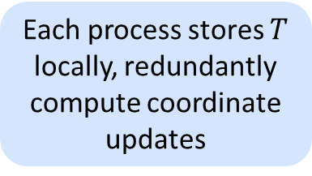





CA-BICGSTAB Derivation: Coordinate Updates
The bases $P,R$ are generated by polynomials satisfying 3-term recurrence represented by $(4s+1)$-by-$(4s+1)$tridiagonal matrix $T$ satisfying
$A\left[\underline{P}, 0_{N,1}, \underline{R}, 0_{N,1}\right]=\left[P,R\right]T$
where $\underline{P},\underline{R}$ are $P,R$ resp. with last columns omitted
Multiplications by $A$ can then be written:
$A\left[q_{m+j},p_{m+j}\right]=A\left[P,R\right]\left[q_{j}^{′}, p_{j}^{′}\right]=\left[P,R\right]T\left[q_{j}^{′}, p_{j}^{′}\right]$
Update BICGSTAB vectors by updating their coordinates in $[P,R]$:
$x_{j+1}^{′}=x_{j}^{′}+α_{m+j }p_{j}^{′}$
$q_{j}^{′}=r_{j}^{′}−α_{m+j }Tp_{j}^{′}$
$x_{j+1}^{′}=x_{j+1}^{′}+ω_{m+j }q_{j}^{′}$
$r_{j+1}^{′}=r_{j}^{′}−ω_{m+j }Tq_{j}^{′}$
$p_{j+1}^{′}=r_{j+1}^{′}+β_{m+j }(p_{j}^{′}−ω_{m+j }Tp_{j}^{′})$
$$×$$
$$×$$
$$=$$
$$×$$
$$×$$
$$×$$
$$=$$
Each process stores $T$ locally, redundantly compute coordinate updates

Slide 12






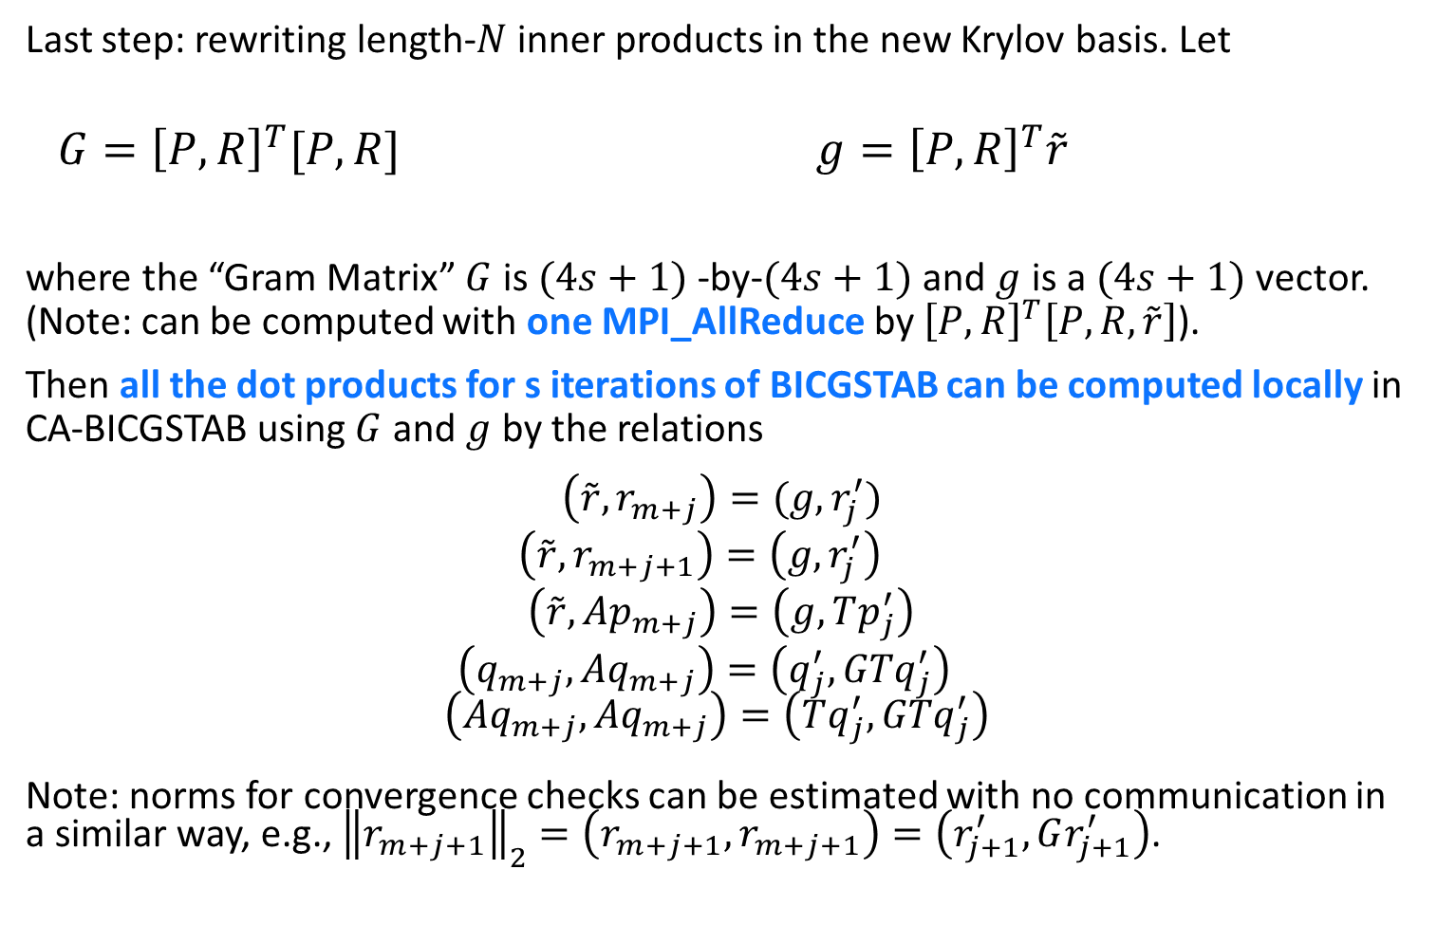


CA-BICGSTAB Derivation: Dot Products
Last step: rewriting length-$N$ inner products in the new Krylov basis. Let
$G={\left[P,R\right]}^{T}[P,R]$ $g={\left[P,R\right]}^{T}\tilde{r}$
where the “Gram Matrix” $G$ is $(4s+1)$-by-$(4s+1)$and $g$ is a $(4s+1)$ vector. (Note: can be computed with one MPI_AllReduce by ${\left[P,R\right]}^{T}\left[P,R,\tilde{r}\right]$).
Then all the dot products for s iterations of BICGSTAB can be computed locally in CA-BICGSTAB using $G$ and $g$ by the relations
          $\left(\tilde{r},r_{m+j}\right)=(g,r_{j}^{′})$
          $\left(\tilde{r},r_{m+j+1}\right)=\left(g,r_{j}^{′}\right)$
          $\left(\tilde{r},Ap_{m+j}\right)=\left(g,Tp_{j}^{′}\right)$
          $\left(q_{m+j},Aq_{m+j}\right)=\left(q_{j}^{′}, GTq_{j}^{′}\right)$
$$\left(Aq_{m+j}, Aq_{m+j}\right)=\left(Tq_{j}^{′},GTq_{j}^{′}\right)$$
Note: norms for convergence checks can be estimated with no communication in a similar way, e.g., ${\left\|r_{m+j+1}\right\|}_{2}=\left(r_{m+j+1}, r_{m+j+1}\right)=\left(r_{j+1}^{′}, Gr_{j+1}^{′}\right)$.
$$=$$
$$×$$
$$=$$
$$×$$
$$×$$
$$×$$
$$×$$
$$×$$

Slide 13


The CA-BICGSTAB Method
Given: Initial guess $x_{0}$ for solving $Ax=b$
Initialize $p_{0}=r_{0}=b−Ax_{0}$, pick arbitrary $\tilde{r}$ such that $(\tilde{r},r_{0})≠0$
Construct $(4s+1)$-by-$(4s+1)$matrix $T$
for $m=0,s,2s,…,$ until convergence do
Compute $P$, $R$, bases for $𝒦_{2s+1}\left(A,p_{m}\right),𝒦_{2s}\left(A,r_{m}\right)$, resp.
Compute $\left[G,g\right]={\left[P,R\right]}^{T}[P,R,\tilde{r}]$
for $j=0,1,…,s−1$ do
    $α_{m+j}=(g,r_{j}^{′})/(\tilde{r}, Tp_{j}^{′})$
    $x_{j+1}^{′}=x_{j}^{′}+α_{m+j}p_{j}^{′}$
    $q_{j}^{′}=r_{j}^{′}−α_{m+j}Tp_{j}^{′}$
    Check ${\left\|q_{j}\right\|}_{2}={\left(q_{j}^{′}, Gq_{j}^{′}\right)}^{1/2}$ for convergence
    $ω_{m+j}=(q_{j}^{′},GTq_{j}^{′})/(Tq_{j}^{′},Tq_{j}^{′})$
    $x_{j+1}^{′}=x_{j+1}^{′}+ω_{m+j}q_{j}^{′}$
    $r_{j+1}^{′}=q_{j}^{′}−ω_{m+j}Tq_{j}^{′}$
    Check ${\left\|r_{j+1}\right\|}_{2}={\left(r_{j+1}^{′}, Gr_{j+1}^{′}\right)}^{1/2}$ for convergence
    $β_{m+j}=({α_{m+j}}/{ω_{m+j}})(g,r_{j+1}^{′})/(g,r_{j}^{′})$
    $p_{j+1}^{′}=r_{j+1}^{′}+β_{m+j}(p_{j}^{′}−ω_{m+j}Tp_{j}^{′})$
end For
${[p}_{m+s}, r_{m+s}, x_{m+s}−x_{m}]=\left[P,R\right][p_{s}^{′}, r_{s}^{′}, x_{s}^{′}]$
end For
P2P communication
One MPI_AllReduce
Vector updates for $s$ iterations computed locally

Slide 14
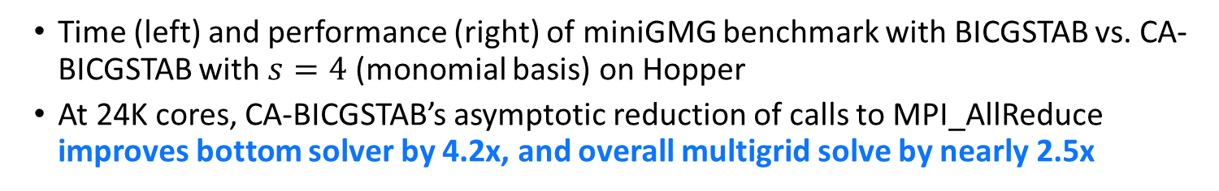
Speedups for Synthetic Benchmark
Time (left) and performance (right) of miniGMG benchmark with BICGSTAB vs. CA-BICGSTAB with $s=4$ (monomial basis) on Hopper
At 24K cores, CA-BICGSTAB’s asymptotic reduction of calls to MPI_AllReduce improves bottom solver by 4.2x, and overall multigrid solve by nearly 2.5x
CA-BICGSTAB improves aggregate performance - degrees of freedom solved per second close to linear

Slide 15
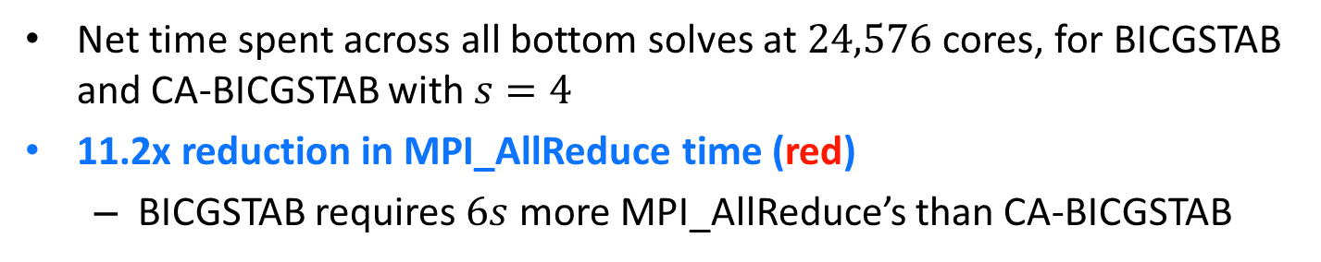
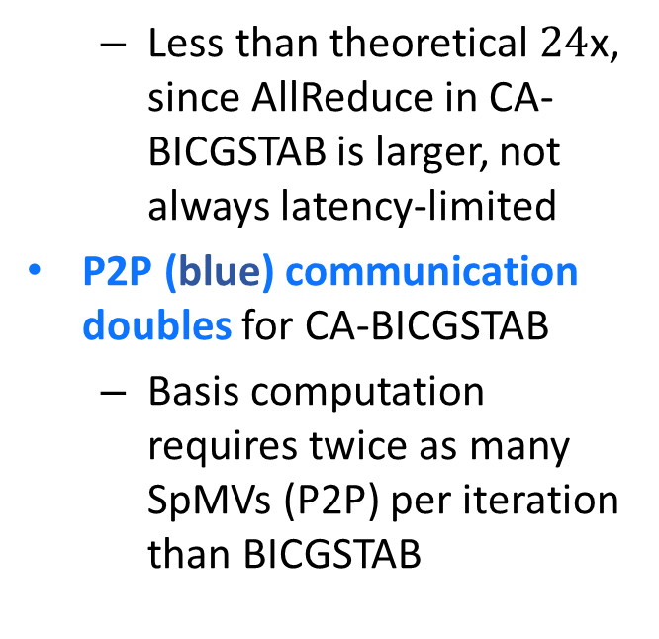
Benchmark Timing Breakdown
Net time spent across all bottom solves at $24,576$ cores, for BICGSTAB and CA-BICGSTAB with $s=4$
11.2x reduction in MPI_AllReduce time (red)
  BICGSTAB requires $6s$ more MPI_AllReduce’s than CA-BICGSTAB
  Less than theoretical $24$x, since AllReduce in CA-BICGSTAB is larger, not always latency-limited
P2P (blue) communication doubles for CA-BICGSTAB
  Basis computation requires twice as many SpMVs (P2P) per iteration than BICGSTAB

Slide 16
Speedups for Real Applications
CA-BICGSTAB bottom-solver implemented in BoxLib (AMR framework from LBL)
Compared GMG with BICGSTAB vs. GMG with CA-BICGSTAB for two different applications:
Low Mach Number Combustion Code (LMC): gas-phase combustion simulation
Up to 2.5x speedup in bottom solve; up to 1.5x in MG solve
Nyx: 3D N-body and gas dynamics code for cosmological simulations of dark matter particles
Up to 2x speedup in bottom solve, 1.15x in MG solve
Notes:
In 3D, stencil uses a 7-point variable coefficient stencil with a GSRB smoother
Figure numbers obtained by using total time spent in mac_project solve over 5 time steps
In all cases, CA method required exactly the same number of V-cycles to converge as the classical solver

Slide 17
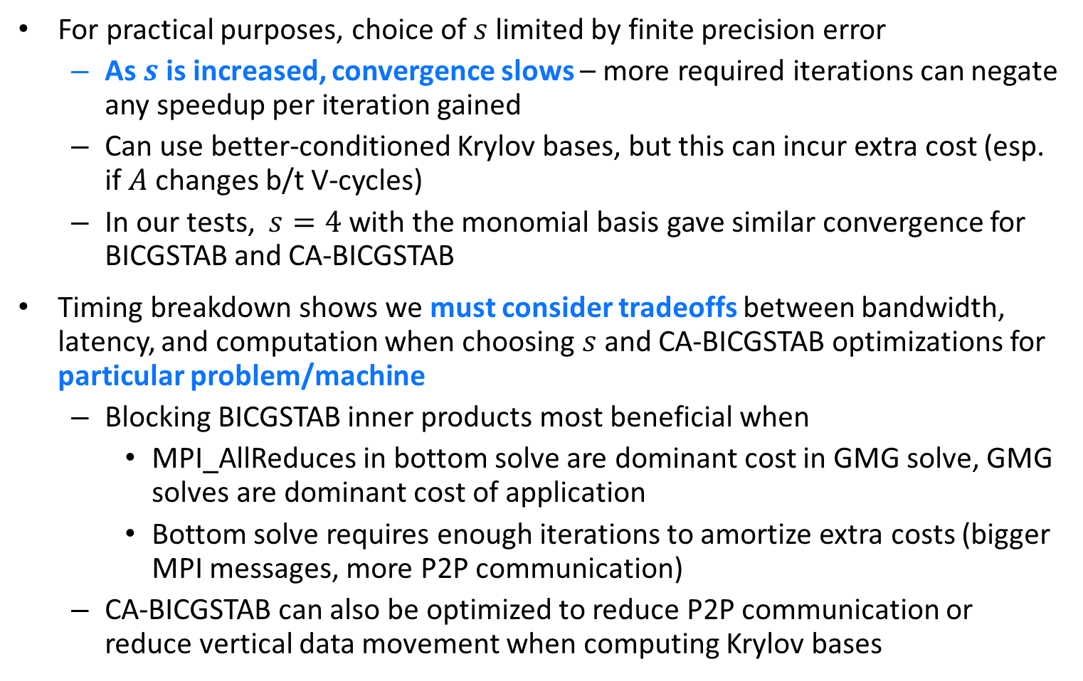
Discussion and Challenges
For practical purposes, choice of $s$ limited by finite precision error
  As $s$ is increased, convergence slows – more required iterations can negate any speedup per iteration gained
  Can use better-conditioned Krylov bases, but this can incur extra cost (esp. if $A$ changes b/t V-cycles)
  In our tests, $s=4$ with the monomial basis gave similar convergence for BICGSTAB and CA-BICGSTAB
Timing breakdown shows we must consider tradeoffs between bandwidth, latency, and computation when choosing $s$ and CA-BICGSTAB optimizations for particular problem/machine
  Blocking BICGSTAB inner products most beneficial when
    MPI_AllReduces in bottom solve are dominant cost in GMG solve, GMG solves are dominant cost of application
    Bottom solve requires enough iterations to amortize extra costs (bigger MPI messages, more P2P communication)
  CA-BICGSTAB can also be optimized to reduce P2P communication or reduce vertical data movement when computing Krylov bases

Slide 18
Related Approaches
Other approaches to reducing synchronization cost in Krylov subspace methods
  Overlap nonblocking reductions with matrix-vector multiplications. See, e.g., (Ghysels et al., 2013).
  Overlap global synchronization points with SpMV and preconditioner application. See (Gropp, 2010).
  Delayed reorthogonalization: mixes work from current, previous, and subsequent iterations to avoid extra synchronization due to reorthogonalization (ADR method in SLEPc). See (Hernandez et al., 2007).

Slide 19
Summary and Future Work
Implemented, evaluated, and optimized CA-BICGSTAB as a high-performance, distributed-memory bottom solve routine for geometric multigrid solvers
  First use of CA-KSMs for improving geometric multigrid performance
  Speedups: 2.5x for GMG solve in synthetic benchmark, 1.5x in combustion application
Future work:
  Exploration of design space for other Krylov solvers, other machines, other applications
  Implementation of different polynomial bases for Krylov subspace to improve convergence
  Improve accessibility of CA-Krylov methods through scientific computing libraries

Slide 20
Thank you!
Email: erin@cs.berkeley.edu

Slide 21
References

Slide 22
Extra Slides

Slide 23
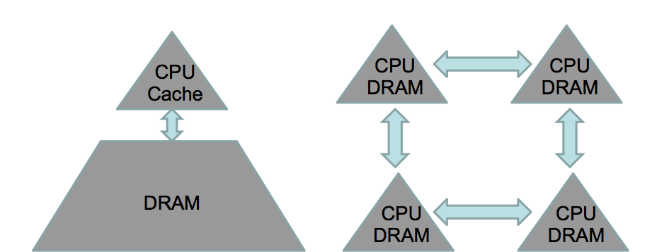
Communication is Expensive!
Algorithms have two costs: communication and computation
  Communication : moving data between levels of memory hierarchy (sequential), between processors (parallel)
sequential comm.
parallel comm.
On modern computers, communication is expensive, computation is cheap
  Flop time << 1/bandwidth << latency
  Communication bottleneck a barrier to achieving scalability
  Communication is also expensive in terms of energy cost
To achieve exascale, we must redesign algorithms to avoid communication
Notes:
“Also, data movement will cost more than flops (even on the chip). Limited amounts of memory and low memory/flop ratios will make processing virtually free. In fact, the amount of memory is relatively decreasing, scaling far worse than computation. This is a challenge that’s not being addressed and it’s not going to get less expensive by 2018.”
-Horst Simon, Interview with HPCWire, May 15, 2013

Slide 24
Current: Multigrid Bottom-Solve Application
AMR applications that use geometric multigrid method
  Issues with coarsening require switch from MG to BICGSTAB at bottom of V-cycle
At scale, MPI_AllReduce() can dominate the runtime; required BICGSTAB iterations grows quickly, causing bottleneck
Proposed: replace with CA-BICGSTAB to improve performance
Collaboration w/ Nick Knight and Sam Williams (FTG at LBL)
interpolation
restriction
bottom-solve
CA-BICGSTAB
Currently ported to BoxLib, next: CHOMBO (both LBL AMR projects)
BoxLib applications: combustion (LMC), astrophysics (supernovae/black hole formation), cosmology (dark matter simulations), etc.

Slide 25
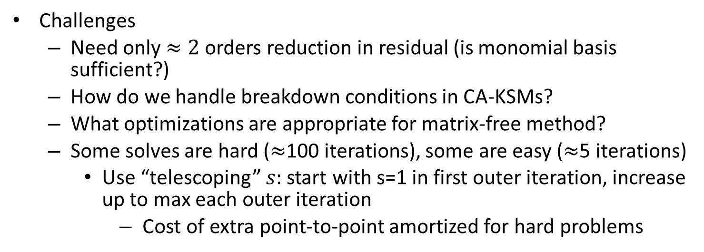
Current: Multigrid Bottom-Solve Application
Challenges
  Need only $≈2$ orders reduction in residual (is monomial basis sufficient?)
  How do we handle breakdown conditions in CA-KSMs?
  What optimizations are appropriate for matrix-free method?
  Some solves are hard ($≈$100 iterations), some are easy ($≈$5 iterations)
    Use “telescoping” $s:$ start with s=1 in first outer iteration, increase up to max each outer iteration
      Cost of extra point-to-point amortized for hard problems
Preliminary results:
Hopper (1K^3, 24K cores): 3.5x in bottom-solve (1.3x total)
Edison (512^3, 4K cores): 1.6x bottom-solve (1.1x total)
Proposed:
Demonstrate CA-KSM speedups in other 2+ other HPC applications
Want apps which demonstrate successful use of strategies for stability, convergence, and performance derived in this thesis

Slide 27

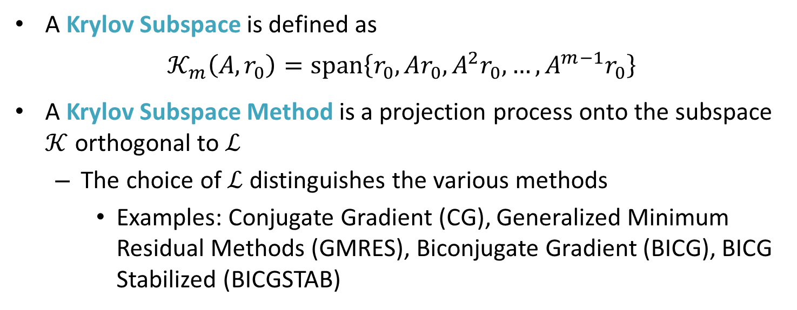



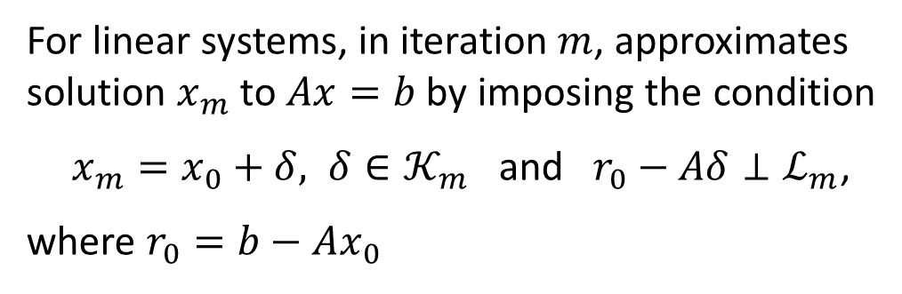

Krylov Subspace Methods
A Krylov Subspace is defined as
$$𝒦_{m}\left(A,r_{0}\right)=\text{span}\left\{r_{0}, Ar_{0}, A^{2}r_{0}, …, A^{m−1}r_{0}\right\}$$
A Krylov Subspace Method is a projection process onto the subspace $𝒦$ orthogonal to $ℒ$
  The choice of $ℒ$distinguishes the various methods
    Examples: Conjugate Gradient (CG), Generalized Minimum Residual Methods (GMRES), Biconjugate Gradient (BICG), BICG Stabilized (BICGSTAB)
$$Aδ$$
For linear systems, in iteration $m$, approximates solution $x_{m}$ to $Ax=b$ by imposing the condition
$x_{m}=x_{0}+δ, δ∈𝒦_{m}$ and $r_{0}−Aδ⊥ℒ_{m}$,
where $r_{0}=b−Ax_{0}$
$$r_{\text{new}}$$
$$r_{0}$$
$$0$$
$$ℒ$$
Notes:
(b-Ax_m) \perp L_m
Since b-Ax_m=b-Ax_0 –A\delta = r_0 – A\delta

Slide 28
Hopper
Cray XE6 MPP at NERSC
Each compute node that four 6-core Opteron chips each with two DDR3-1333 mem controllers
Each superscalar out-of-order core: 64KB L1, 512KB L2. One 6MB L3 cache per chip
Pairs of compute nodes connected via HyperTransport to a high-speed Gemini network chip
Gemini network chips connected to form high-BW low-latency 3D torus
  Some asymmetry in torus
  No control over job placement
  Latency can be as low as 1.5 microseconds, but typically longer in practice

Slide 30

Related Work: $s$-step methods
Authors | KSM | Basis | Precond? | Mtx Pwrs? | TSQR?
Van Rosendale, 1983 | CG | Monomial | Polynomial | No | No
Leland, 1989 | CG | Monomial | Polynomial | No | No
Walker, 1988 | GMRES | Monomial | None | No | No
Chronopoulos and Gear, 1989 | CG | Monomial | None | No | No
Chronopoulos and Kim, 1990 | Orthomin, GMRES | Monomial | None | No | No
Chronopoulos, 1991 | MINRES | Monomial | None | No | No
Kim and Chronopoulos, 1991 | Symm. Lanczos, Arnoldi | Monomial | None | No | No
Sturler, 1991 | GMRES | Chebyshev | None | No | No

Slide 31
Related Work: $s$-step methods
Authors | KSM | Basis | Precond? | Mtx Pwrs? | TSQR?
Joubert and Carey, 1992 | GMRES | Chebyshev | No | Yes* | No
Chronopoulos and Kim, 1992 | Nonsymm. Lanczos | Monomial | No | No | No
Bai, Hu, and Reichel, 1991 | GMRES | Newton | No | No | No
Erhel, 1995 | GMRES | Newton | No | No | No
de Sturler and van der Vorst, 2005 | GMRES | Chebyshev | General | No | No
Toledo, 1995 | CG | Monomial | Polynomial | Yes* | No
Chronopoulos and Swanson, 1990 | CGR, Orthomin | Monomial | No | No | No
Chronopoulos and Kinkaid, 2001 | Orthodir | Monomial | No | No | No

Slide 32
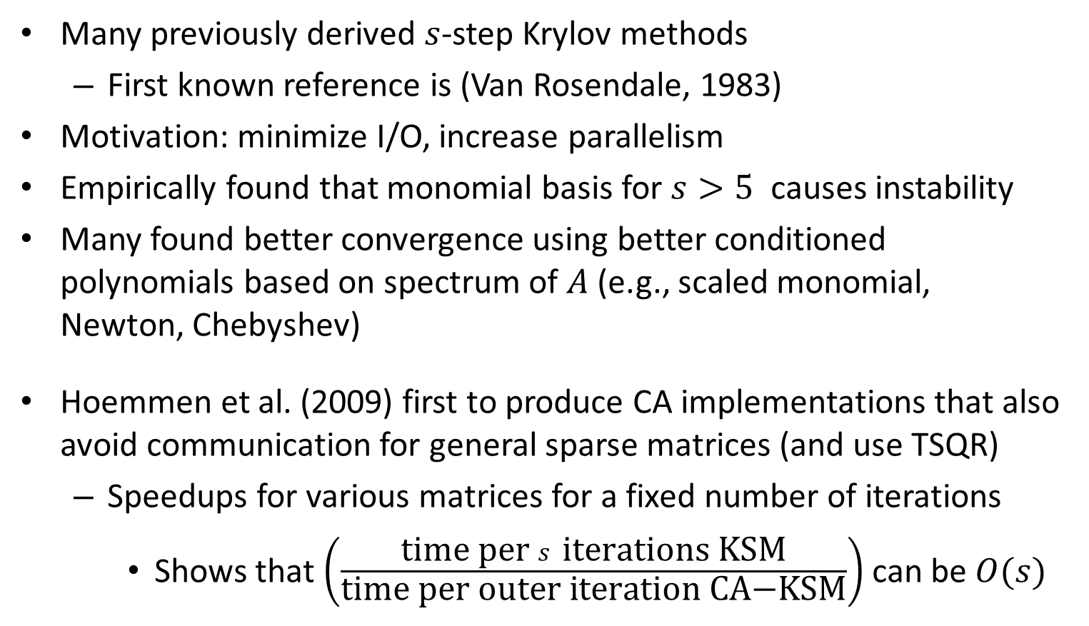
Related Work: $s$-step methods
Many previously derived $s$-step Krylov methods
  First known reference is (Van Rosendale, 1983)
Motivation: minimize I/O, increase parallelism
Empirically found that monomial basis for $s>5$ causes instability
Many found better convergence using better conditioned polynomials based on spectrum of $A$ (e.g., scaled monomial, Newton, Chebyshev)
Hoemmen et al. (2009) first to produce CA implementations that also avoid communication for general sparse matrices (and use TSQR)
  Speedups for various matrices for a fixed number of iterations
    Shows that $\left(\frac{\text{time} \text{per} s \text{iterations} \text{KSM}}{\text{time} \text{per} \text{outer} \text{iteration} \text{CA}\text{−}\text{KSM}}\right)$ can be $O(s)$
Notes:
Remember: hoemmen only showed speedup for fixed iterations…need to also look at communication step ratio and make sure ~s (comm step ratio = # iters KSM/# outer iters CAKSM)

