Slide 1
Exploiting Low-Rank Structure in Computing Matrix Powers with Applications to Preconditioning
Erin C. Carson
Nicholas Knight, James Demmel, Ming Gu
U.C. Berkeley

Slide 2
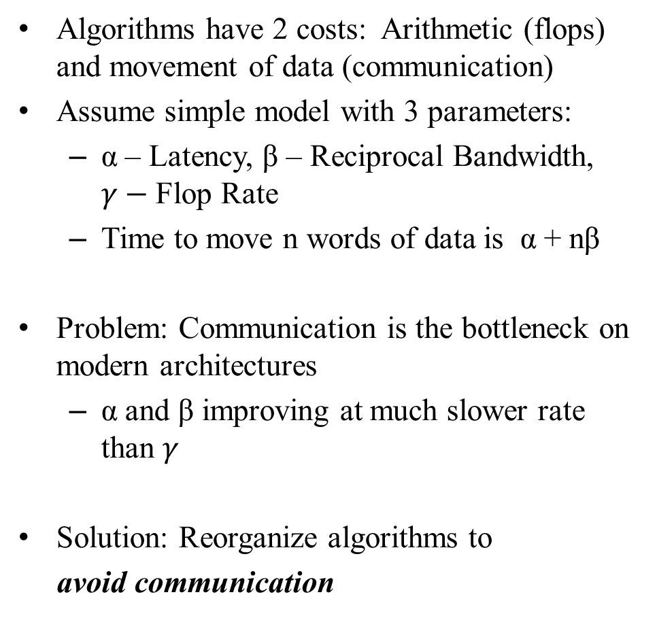
Motivation: The Cost of an Algorithm
Algorithms have 2 costs: Arithmetic (flops) and movement of data (communication)
Assume simple model with 3 parameters:
  α – Latency, β – Reciprocal Bandwidth, $γ−$Flop Rate
  Time to move n words of data is α + nβ
Problem: Communication is the bottleneck on modern architectures
  α and β improving at much slower rate than $γ$
Solution: Reorganize algorithms to
avoid communication
CPU
Cache
DRAM
Sequential
CPU
DRAM
CPU
DRAM
CPU
DRAM
CPU
DRAM
Parallel

Slide 3
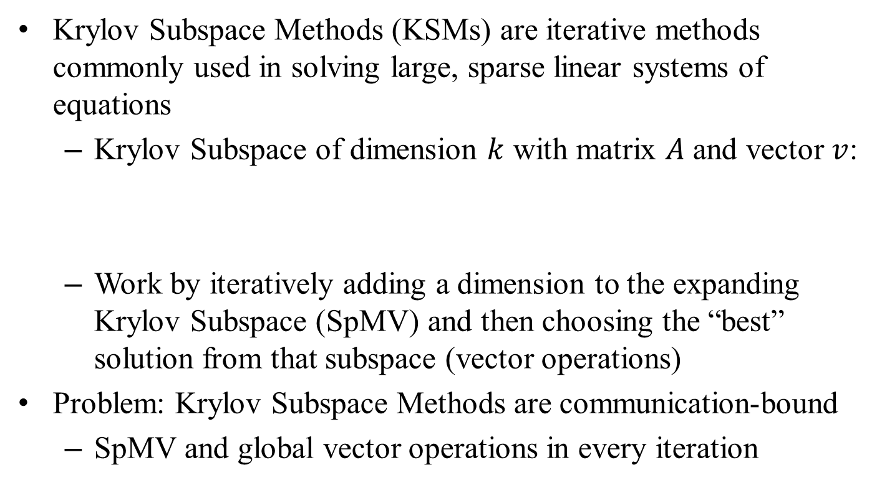
Motivation: Krylov Subspace Methods
Krylov Subspace Methods (KSMs) are iterative methods commonly used in solving large, sparse linear systems of equations
  Krylov Subspace of dimension $k$ with matrix $A$ and vector $v$:
  Work by iteratively adding a dimension to the expanding Krylov Subspace (SpMV) and then choosing the “best” solution from that subspace (vector operations)
Problem: Krylov Subspace Methods are communication-bound
  SpMV and global vector operations in every iteration

Slide 4
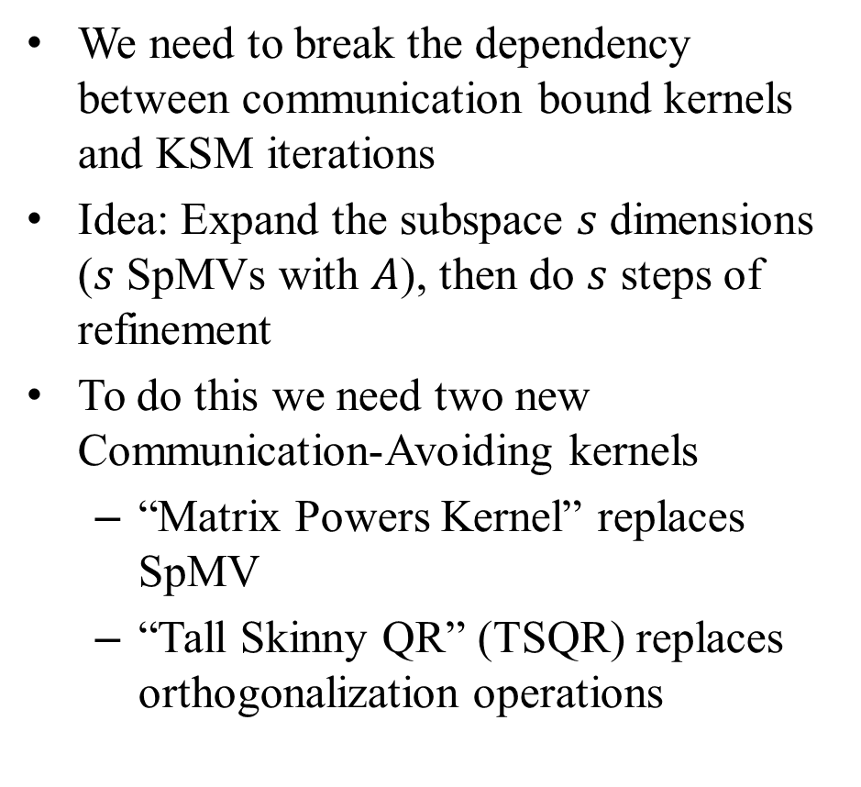
Avoiding Communication in Krylov Subspace Methods
We need to break the dependency between communication bound kernels and KSM iterations
Idea: Expand the subspace $s$ dimensions ($s$ SpMVs with $A$), then do $s$ steps of refinement
To do this we need two new Communication-Avoiding kernels
  “Matrix Powers Kernel” replaces SpMV
  “Tall Skinny QR” (TSQR) replaces orthogonalization operations
SpMV
v_{k+1}
Av_{k}
Orthogonalize

Slide 5
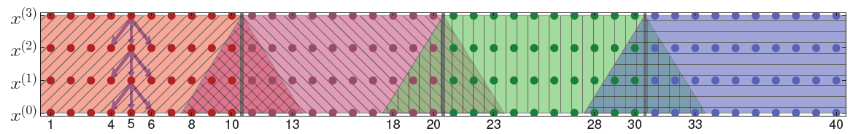
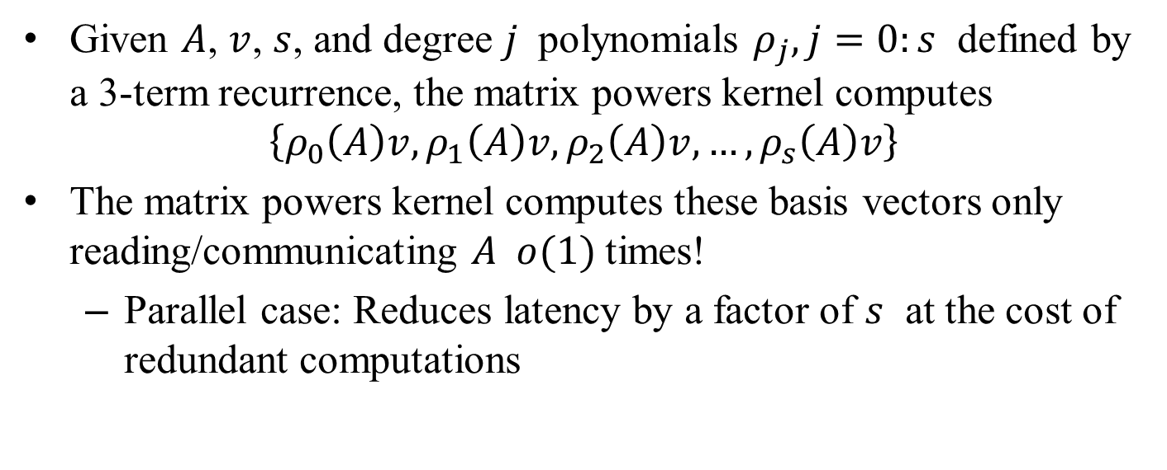
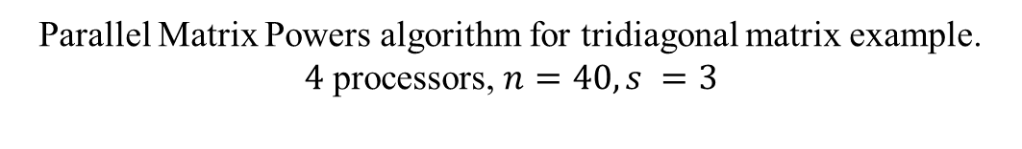
The Matrix Powers Kernel
Given $A$, $v$, $s$, and degree $j$ polynomials $ρ_{j}, j=0:s$ defined by a 3-term recurrence, the matrix powers kernel computes
$$\left\{ρ_{0}\left(A\right)v, ρ_{1}\left(A\right)v, ρ_{2}\left(A\right)v, …, ρ_{s}\left(A\right)v\right\}$$
The matrix powers kernel computes these basis vectors only reading/communicating $A o(1)$times!
  Parallel case: Reduces latency by a factor of $s$ at the cost of redundant computations
A³v
A²v
Av
v
Parallel Matrix Powers algorithm for tridiagonal matrix example.
$4$ processors, $n=40, s =3$

Slide 6
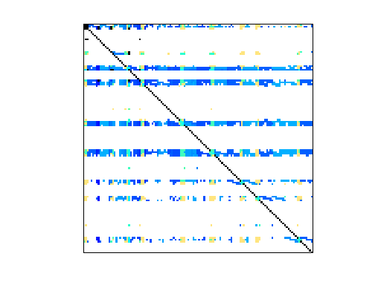
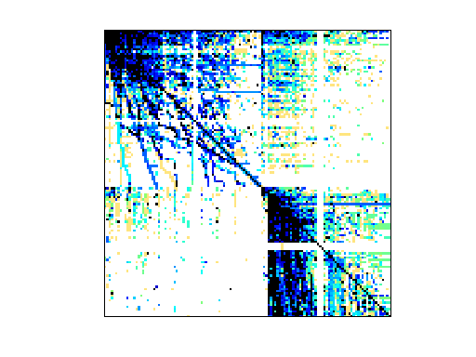
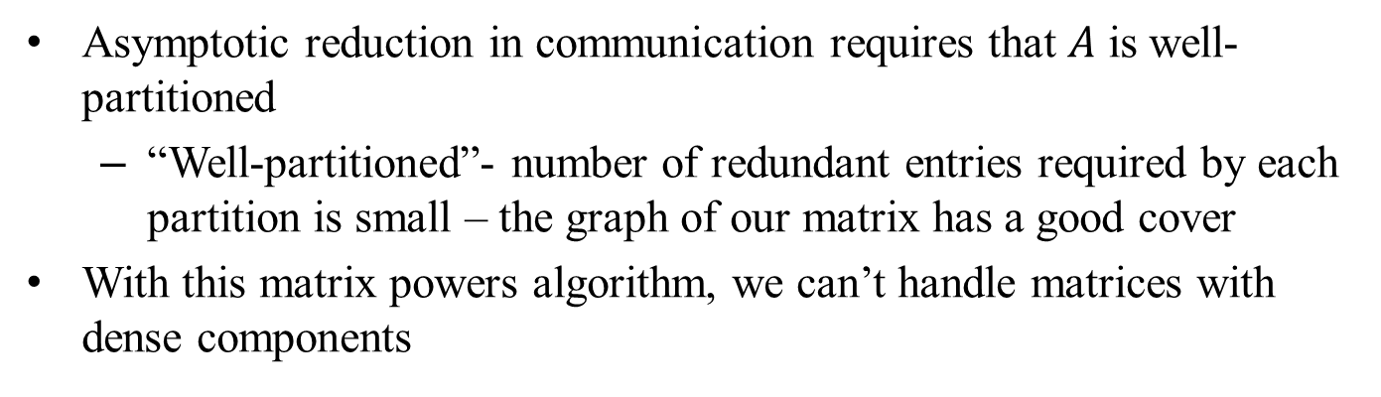
Matrix Powers Kernel Limitations
Asymptotic reduction in communication requires that $A$ is well-partitioned
  “Well-partitioned”- number of redundant entries required by each partition is small – the graph of our matrix has a good cover
With this matrix powers algorithm, we can’t handle matrices with dense components
  Matrices with dense low-rank components appear in many linear systems (e.g., circuit simulations, power law graphs), as well as preconditioners (e.g., Hierarchical Semiseparable (HSS) matrices)
  Can we exploit low-rank structure to avoid communication in the matrix powers algorithm?
ASIC_680k: circuit simulation matrix. Sandia.
webbase: web connectivity matrix. Williams et al.

Slide 7
Blocking Covers Approach to Increasing Temporal Locality
Relevant work:
  Leiserson, C.E. and Rao, S. and Toledo, S. Efficient out-of-core algorithms for linear relaxation using blocking covers. Journal of Computer and System Sciences, 1997.
Blocking Covers Idea:
  According to Hong and Kung’s Red-Blue Pebble game, we can’t avoid data movement if we can’t find a good graph cover
  What if we could find a good cover by removing a subset of vertices from the graph? (i.e., connections are locally dense but globally sparse)
  Relax the assumption that the DAG must be executed in order
  Artificially restrict information from passing through removed vertices (“blockers”) by treating their state variables symbolically, maintain dependencies among symbolic variables as matrix

Slide 8
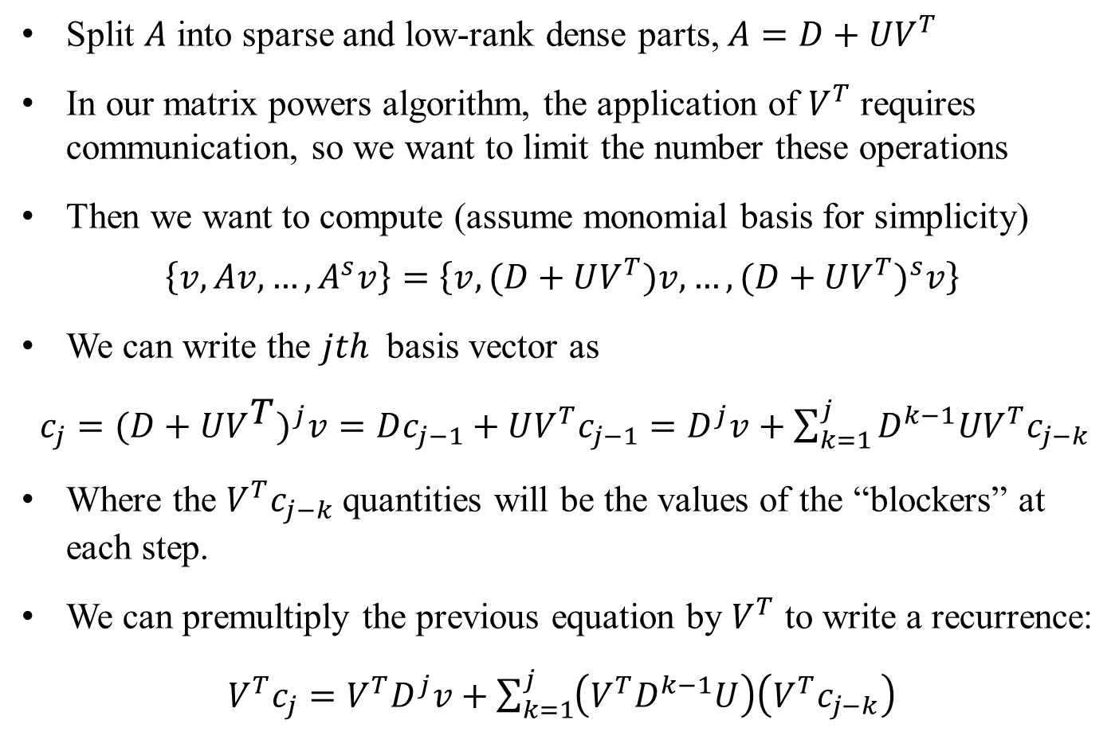
Blocking Covers Matrix Powers Algorithm
Split $A$ into sparse and low-rank dense parts, $A=D+UV^{T}$
In our matrix powers algorithm, the application of $V^{T}$ requires communication, so we want to limit the number these operations
Then we want to compute (assume monomial basis for simplicity)
$$\left\{v,Av,…,A^{s}v\right\}=\left\{v,(D+UV^{T})v,…,{(D+UV^{T})}^{s}v\right\}$$
We can write the $jth$ basis vector as
$c_{j}={(D+UV_{}^{T})}^{j}v=Dc_{j−1}+UV^{T}c_{j−1}=D^{j}v+\sum_{k=1}^{j}{D^{k−1}UV^{T}c_{j−k}}$
Where the $V^{T}c_{j−k}$ quantities will be the values of the “blockers” at each step.
We can premultiply the previous equation by $V^{T}$ to write a recurrence:
$V^{T}c_{j}=V^{T}D^{j}v+\sum_{k=1}^{j}{\left(V^{T}D^{k−1}U\right)\left(V^{T}c_{j−k}\right)}$

Slide 9
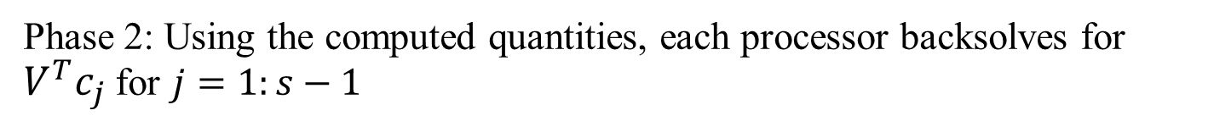
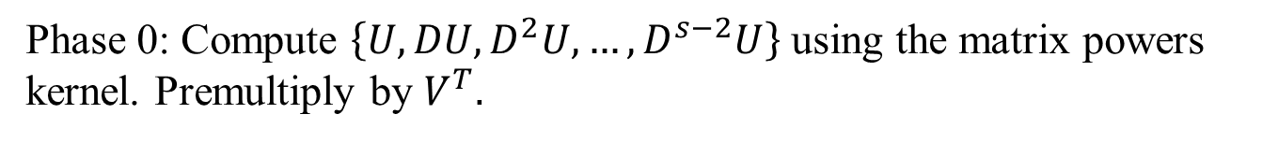
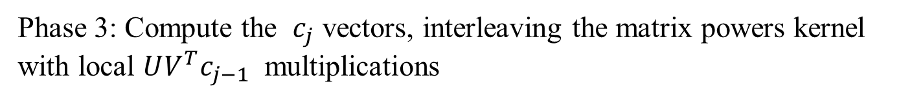

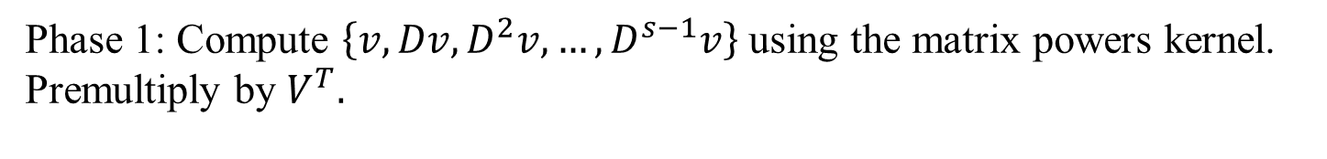
Blocking Covers Matrix Powers Algorithm
Phase 0: Compute $\left\{U,DU,D^{2}U,…,D^{s−2}U\right\}$ using the matrix powers kernel. Premultiply by $V^{T}.$
Phase 1: Compute $\left\{v,Dv,D^{2}v,…,D^{s−1}v\right\}$ using the matrix powers kernel. Premultiply by $V^{T}.$
Phase 2: Using the computed quantities, each processor backsolves for $V^{T}c_{j}$ for $j=1:s−1$
Phase 3: Compute the $c_{j}$ vectors, interleaving the matrix powers kernel with local $UV^{T}c_{j−1}$ multiplications
$V^{T}c_{j}=V^{T}D^{j}v+\sum_{k=1}^{j}{\left(V^{T}D^{k−1}U\right)\left(V^{T}c_{j−k}\right)}$
$c_{j}=Dc_{j−1}+UV^{T}c_{j−1}$

Slide 10
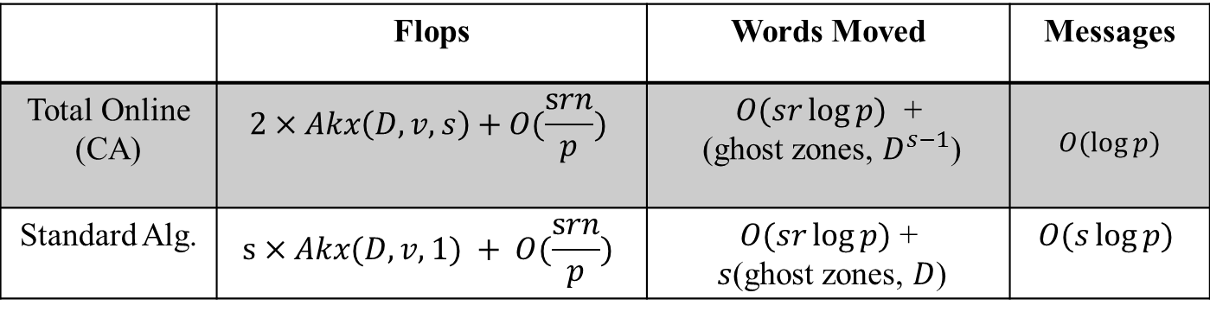
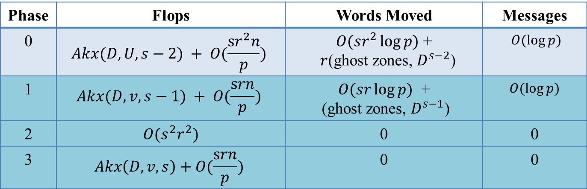
Asymptotic Costs
Phase | Flops | Words Moved | Messages
0 | $$Akx(D, U, s−2) + O(\frac{sr^{2}n}{p})$$ | $O(sr^{2}\log{p})$ + $r$(ghost zones, $D^{s−2}$) | $O(\log{p})$
1 | $$Akx(D, v, s−1) + O(\frac{srn}{p})$$ | $O(sr\log{p})$ + (ghost zones, $D^{s−1}$) | $O(\log{p})$
2 | $O(s^{2}r^{2})$ | 0 | 0
3 | $$Akx\left(D, v, s\right)+O(\frac{srn}{p})$$ | 0 | 0
 | Flops | Words Moved | Messages
Total Online (CA) | $$2×Akx\left(D, v, s\right)+O(\frac{srn}{p})$$ | $O(sr\log{p})$ + (ghost zones, $D^{s−1}$) | $O(\log{p})$
Standard Alg. | $$s×Akx(D, v, 1) + O(\frac{srn}{p})$$ | $O(sr\log{p})$ + $s$(ghost zones, $D$) | $$O(s\log{p})$$

Slide 11
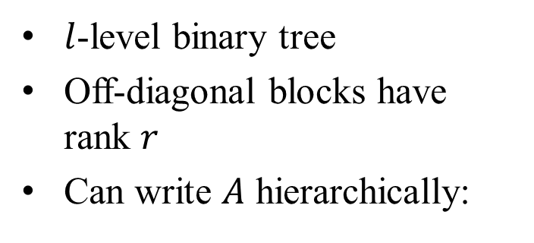
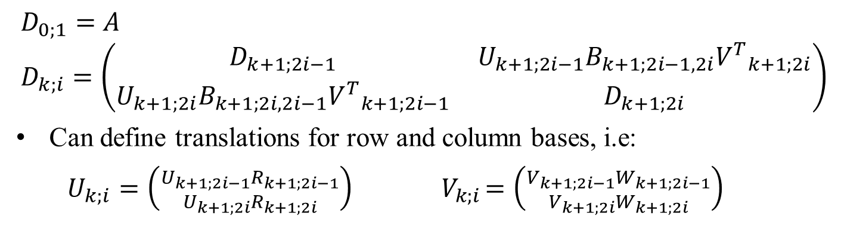
HSS Structure:
Extending the Blocking Covers Matrix Powers Algorithm to HSS Matrices
$l$-level binary tree
Off-diagonal blocks have rank $r$
Can write $A$ hierarchically:
$$D_{0;1}=A \\ D_{k;i}=\left(\begin{matrix}D_{k+1;2i−1} & U_{k+1;2i−1}B_{k+1;2i−1,2i}{V^{T}}_{k+1;2i} \\ U_{k+1;2i}B_{k+1;2i,2i−1}{V^{T}}_{k+1;2i−1} & D_{k+1;2i}\end{matrix}\right)$$
Can define translations for row and column bases, i.e:
  $U_{k;i}=\left({U_{k+1;2i−1}R_{k+1;2i−1} \atop U_{k+1;2i}R_{k+1;2i}}\right){ V}_{k;i}=\left({V_{k+1;2i−1}W_{k+1;2i−1} \atop V_{k+1;2i}W_{k+1;2i}}\right)$

Slide 12

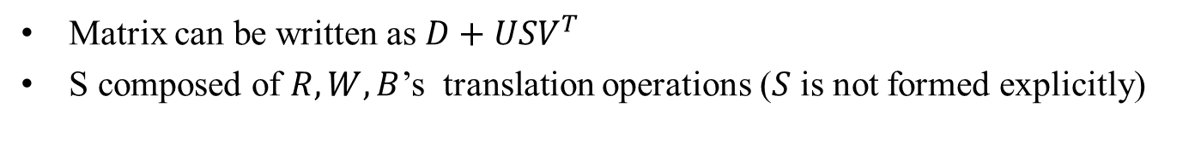



Exploiting Low-Rank Structure
Matrix can be written as $D+USV^{T}$
S composed of $R,W,B$’s translation operations ($S$ is not formed explicitly)
+
$$S$$
$$V^{T}$$
$$D$$
$$U$$

Slide 13
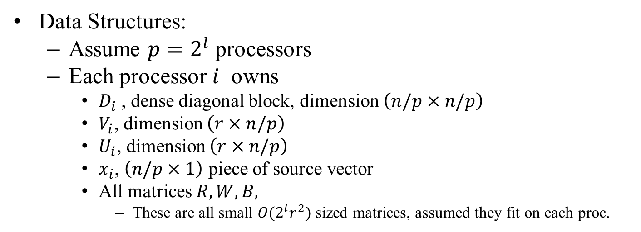
Parallel HSS Akx Algorithm
Data Structures:
  Assume $p=2^{l}$ processors
  Each processor $i$ owns
    $D_{i}$ , dense diagonal block, dimension $\left(n/p×n/p\right)$
    $V_{i}$, dimension $\left(r×n/p\right)$
    $U_{i}$, dimension $\left(r×n/p\right)$
    $x_{i}$, $\left(n/p×1\right)$ piece of source vector
    All matrices$R, W,B,$
      These are all small $O({2^{l}r}^{2})$sized matrices, assumed they fit on each proc.
+

Slide 14
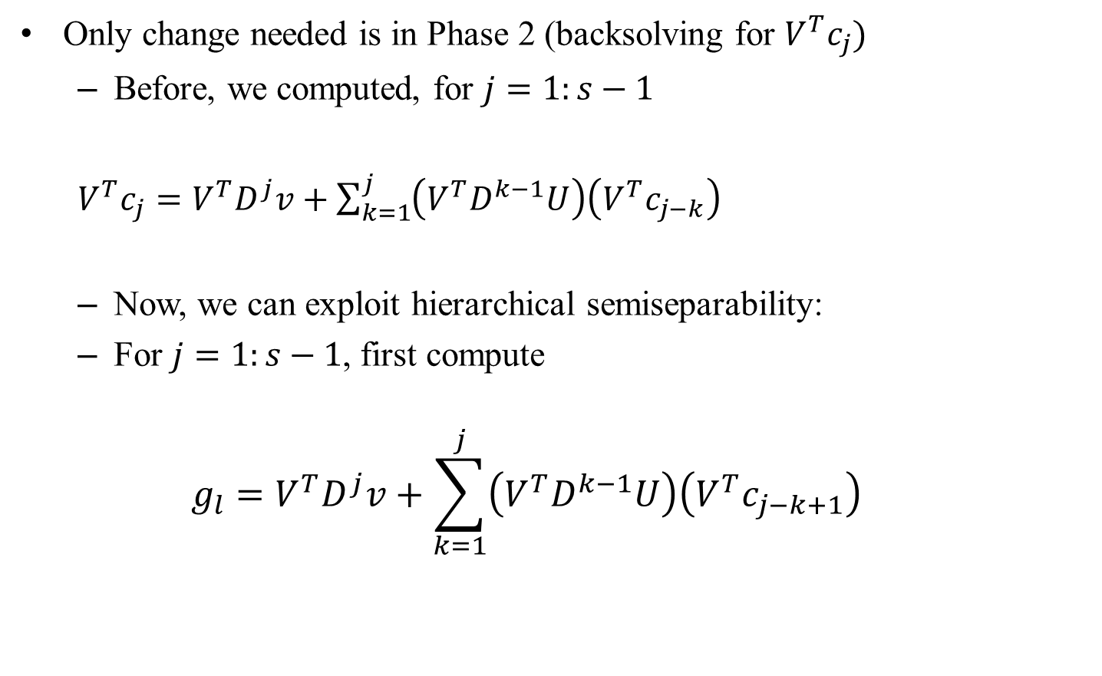
Extending the Algorithm
Only change needed is in Phase 2 (backsolving for $V^{T}c_{j}$)
  Before, we computed, for $j=1:s−1$
  $V^{T}c_{j}=V^{T}D^{j}v+\sum_{k=1}^{j}{\left(V^{T}D^{k−1}U\right)\left(V^{T}c_{j−k}\right)}$
  Now, we can exploit hierarchical semiseparability:
  For $j=1:s−1$, first compute
  $$g_{l}=V^{T}D^{j}v+\sum_{k=1}^{j}{\left(V^{T}D^{k−1}U\right)\left(V^{T}c_{j−k+1}\right)}$$

Slide 15

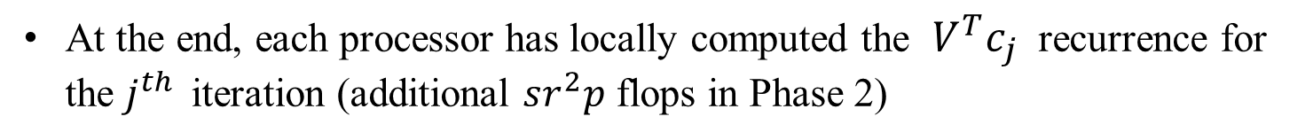
Extending the Algorithm
Then each processor locally performs upsweep and downsweep:
for $y=l−1:1$
$g_{y}= \left[\begin{matrix}\left[\begin{matrix}{W^{T}}_{y+1;1} & {W^{T}}_{y+1;2}\end{matrix}\right] & & \\ & ⋱ & \\ & & \left[\begin{matrix}{W^{T}}_{y+1;2\left(2_{}^{y}\right)−1} & {W^{T}}_{y+1;2\left(2^{y}\right)}\end{matrix}\right]\end{matrix}\right]g_{y+1}$
$f_{0}=(0)$
for $y=0:l−1$
$$f_{y+1}=\left[\begin{matrix}B_{y+1;1,2} & & \\ & ⋱ & \\ & & B_{y+1;2^{y+1},2^{y+1}−1}\end{matrix}\right]g_{y}+\left[\begin{matrix}\left[\begin{matrix}R_{y+1;1} \\ R_{y+1;2}\end{matrix}\right] & & \\ & ⋱ & \\ & & {\left[\begin{matrix}R_{y+1;2^{y+1} −1} \\ R_{y+1;2^{y+1}}\end{matrix}\right]}_{ }\end{matrix}\right]f_{y}$$
$V^{T}c_{j}=f_{l}$
At the end, each processor has locally computed the $V^{T}c_{j}$ recurrence for the $j^{th }$ iteration (additional $sr^{2}p$ flops in Phase 2)

Slide 16
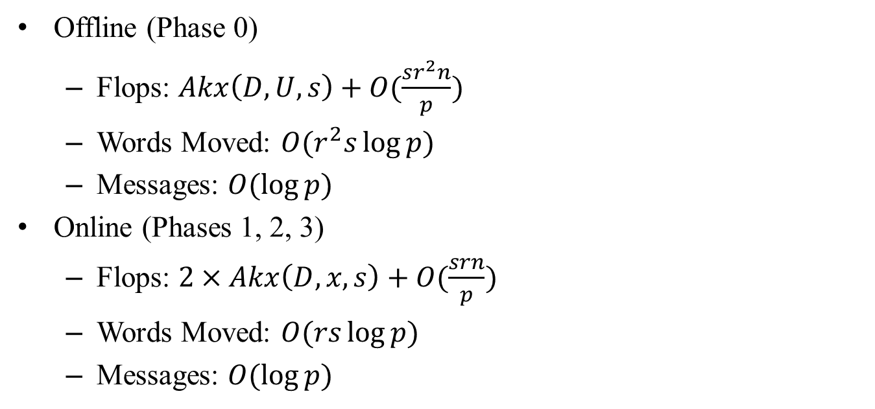
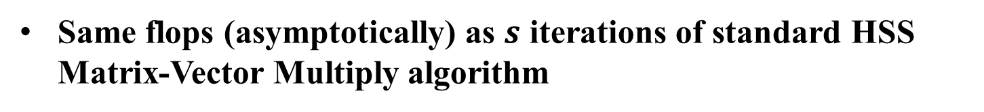
HSS Matrix Powers Communication and Computation Cost
Offline (Phase 0)
  Flops: $Akx\left(D,U,s\right)+O(\frac{sr^{2}n}{p})$
  Words Moved: $O(r^{2}s\log{p)}$
  Messages: $O(\log{p)}$
Online (Phases 1, 2, 3)
  Flops: $2×Akx\left(D,x,s\right)+O(\frac{srn}{p})$
  Words Moved: $O(rs\log{p)}$
  Messages: $O(\log{p)}$
Same flops (asymptotically) as $s$ iterations of standard HSS Matrix-Vector Multiply algorithm
Asymptotically reduces messages by factor of $s$!

Slide 17
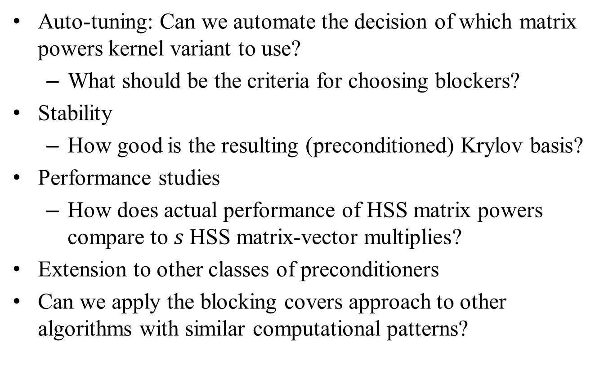
Future Work
Auto-tuning: Can we automate the decision of which matrix powers kernel variant to use?
  What should be the criteria for choosing blockers?
Stability
  How good is the resulting (preconditioned) Krylov basis?
Performance studies
  How does actual performance of HSS matrix powers compare to $s$HSS matrix-vector multiplies?
Extension to other classes of preconditioners
Can we apply the blocking covers approach to other algorithms with similar computational patterns?

Slide 19
EXTRA SLIDES

Slide 20
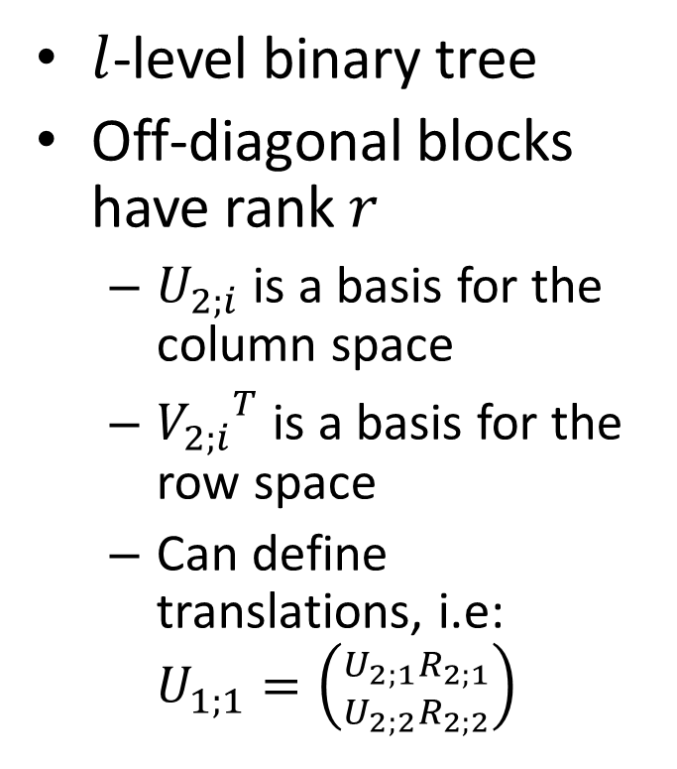
HSS Structure
$l$-level binary tree
Off-diagonal blocks have rank $r$
  $U_{2;i}$ is a basis for the column space
  ${V_{2;i}}^{T}$ is a basis for the row space
  Can define translations, i.e: $U_{1;1}=\left({U_{2;1}R_{2;1} \atop U_{2;2}R_{2;2}}\right)$

Slide 21

Exploiting Low-Rank Structure
Matrix can be written as $D+UV^{T}$
+

Slide 22
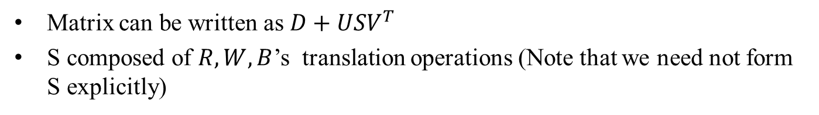
Parallel HSS Akx Algorithm
Data Structures:
  Assume $p=O(2^{l})$ processors
  Each processor owns
    $D_{i}$ , dense diagonal block, dimension $\left(n/p×n/p\right)$
    $V_{i}$, dimension $\left(r×n/p\right)$
    $U_{i}$, dimension $\left(r×n/p\right)$
    $c_{i}$, dimension $\left(r×pr\right)$, defining scalar multiples for U’s in the same column
    $x_{i}$, $\left(n/p×1\right)$ piece of source vector
+

Slide 23















Parallel HSS Akx Algorithm
0. Phase 0: Preprocessing
  Compute $K=\left[U,DU,D^{2}U,…,D^{s−2}U\right]$
    Flops:$Akx(D,U,s−2)$, Words: 0, Mess.: 0
  Premultiply by $V^{T}$
    Flops: $O(\frac{{sr}^{2}n}{p})$, Words: 0, Mess.: 0
$$n/2^{l}$$
$$r$$
$$D_{i}$$
$$U_{i}$$
$$n/p$$
$$×$$
$$n/2^{l}$$
$$n/p$$
$$rs$$
$$r$$
$${V_{i}}^{T}$$
$$×$$
$$K_{i}$$
$$n/p$$

Slide 24

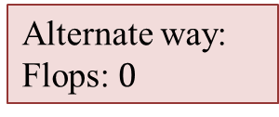


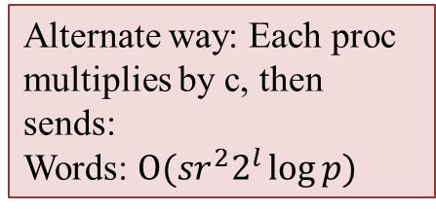
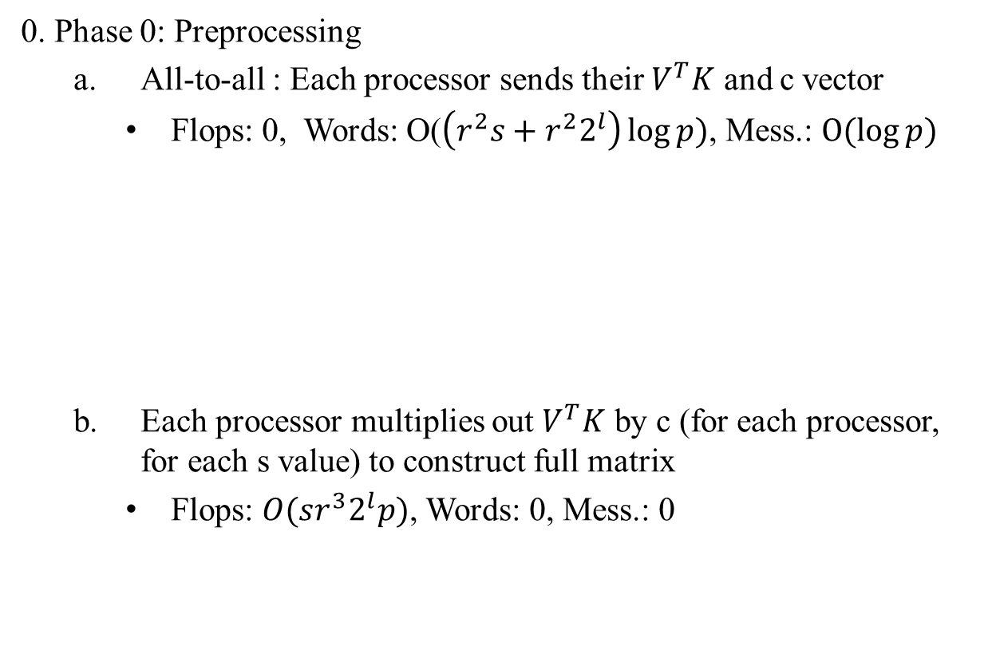






Parallel HSS Akx Algorithm
0. Phase 0: Preprocessing
  All-to-all : Each processor sends their $V^{T}K$ and c vector
    Flops: 0, Words: O($\left(r^{2}s+r^{2}2^{l}\right)\log{p})$, Mess.: $O(\log{p)}$
  Each processor multiplies out $V^{T}K$ by c (for each processor, for each s value) to construct full matrix
    Flops: $O(sr^{3}2^{l}p)$, Words: 0, Mess.: 0
$$sr$$
$$r$$
$${V_{i}}^{T}K_{i}$$
Alternate way: Each proc multiplies by c, then sends:
Words: $O(sr^{2}2^{l}\log{p)}$
$$2^{l}r$$
$$r$$
$$c_{i}$$
Alternate way:
Flops: $0$
$$2^{l}sr$$
One row block from each processor
$$pr$$
$$V^{T}K$$

Slide 25


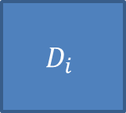



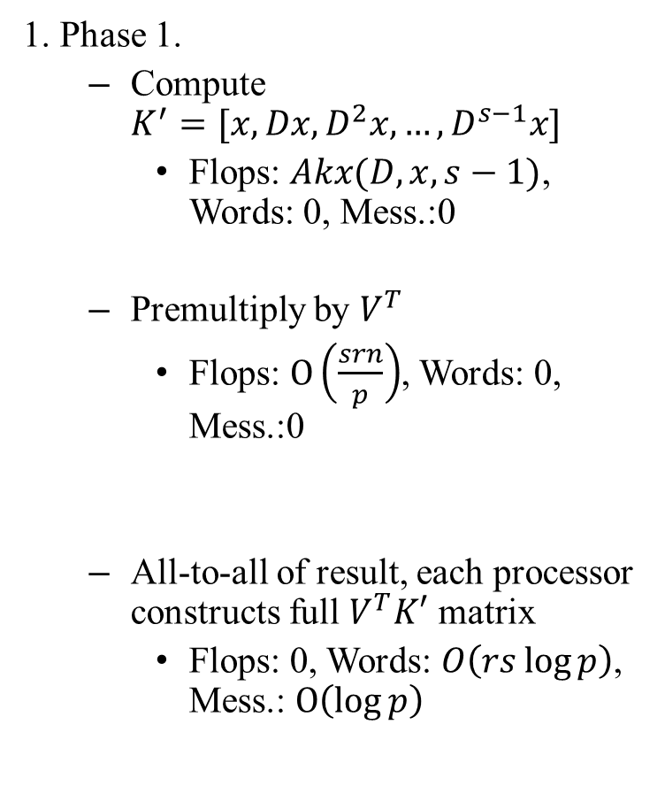


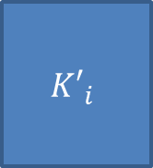






Parallel HSS Akx Algorithm
1. Phase 1.
  Compute $K^{′}=[x,Dx,D^{2}x,…,D^{s−1}x]$
    Flops: $Akx(D,x,s−1)$, Words: 0, Mess.:0
  Premultiply by $V^{T}$
    Flops: $O\left(\frac{srn}{p}\right)$, Words: 0, Mess.:0
  All-to-all of result, each processor constructs full $V^{T}K′$ matrix
    Flops: 0, Words: $O\left(rs\log{p}\right)$, Mess.: $O\left(\log{p}\right)$
$$n/2^{l}$$
$$1$$
$$D_{i}$$
$$x_{i}$$
$$n/p$$
$$×$$
$$n/2^{l}$$
$$n/p$$
$$s$$
$$r$$
$${V_{i}}^{T}$$
$$×$$
$${K′}_{i}$$
$$n/p$$
$$s$$
One row block from each processor
$$pr$$
$$V^{T}K′$$

Slide 26





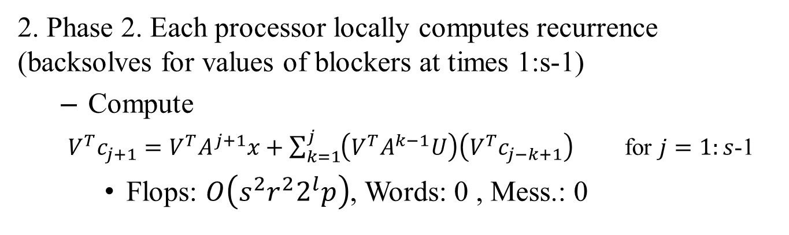






Parallel HSS Akx Algorithm
2. Phase 2. Each processor locally computes recurrence (backsolves for values of blockers at times 1:s-1)
  Compute
  $V^{T}c_{j+1}=V^{T}A^{j+1}x+\sum_{k=1}^{j}{\left(V^{T}A^{k−1}U\right)\left(V^{T}c_{j−k+1}\right)}$ for $j=1:s$-1
    Flops: $O\left(s^{2}r^{2}2^{l}p\right)$, Words: 0 , Mess.: 0
$$1$$
$$1$$
$$2^{l}r$$
$$1$$
$$pr$$
$$=$$
$$pr$$
$$+$$
$$s$$
$$pr$$
$$×$$
$$2^{l}r$$
Computed in Phase 0
Computed in Phase 1

Slide 27







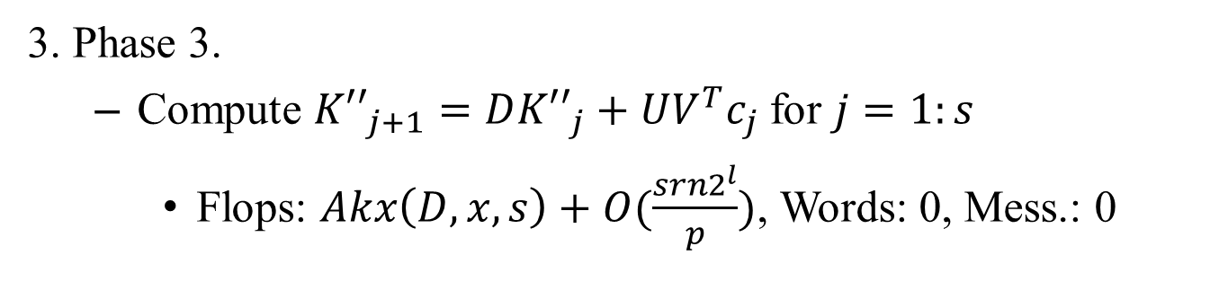

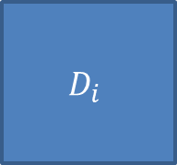







Parallel HSS Akx Algorithm
3. Phase 3.
  Compute ${K′′}_{j+1}=D{K′′}_{j}+UV^{T}c_{j}$ for $j=1:s$
    Flops: $Akx\left(D,x,s\right)+O(\frac{srn2^{l}}{p})$, Words: 0, Mess.: 0
$$1$$
$$n/2^{l}$$
$$1$$
$$2^{l}r$$
$$1$$
$$D_{i}$$
$$U_{i}$$
$$2^{l}r$$
$$n/p$$
$$=$$
$$n/p$$
$$×$$
$$n/2^{l}$$
$$+$$
$$n/p$$
$$×$$
$${V^{T}c}_{j}$$
$${K′′}_{j+1}$$
$${K′′}_{j}$$

Slide 28
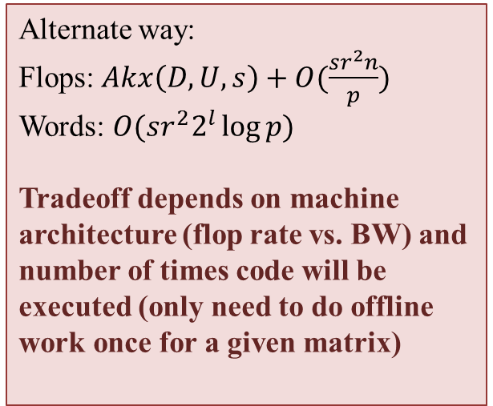
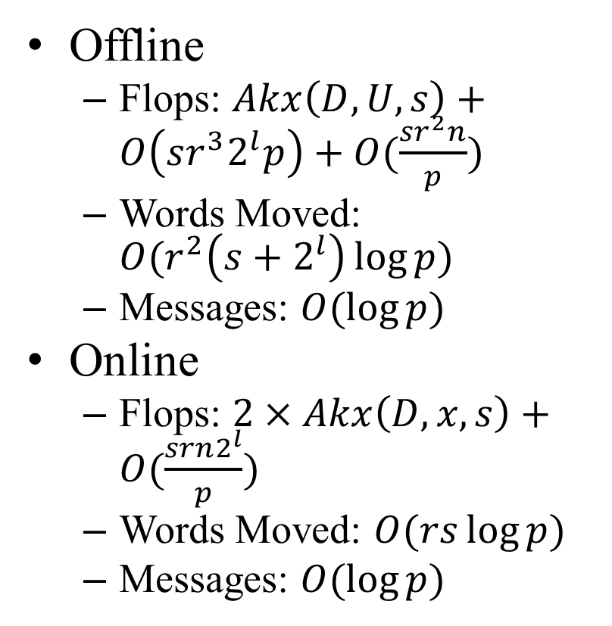
Total Communication and Computation
  Alternate way:
  Flops: $Akx\left(D,U,s\right)+O(\frac{sr^{2}n}{p})$
  Words: $O(sr^{2}2^{l}\log{p)}$
  Tradeoff depends on machine architecture (flop rate vs. BW) and number of times code will be executed (only need to do offline work once for a given matrix)
Offline
  Flops: $Akx\left(D,U,s\right)+O\left(sr^{3}2^{l}p\right)+O(\frac{sr^{2}n}{p})$
  Words Moved: $O(r^{2}\left(s+2^{l}\right)\log{p)}$
  Messages: $O(\log{p)}$
Online
  Flops: $2×Akx\left(D,x,s\right)+O(\frac{srn2^{l}}{p})$
  Words Moved: $O(rs\log{p)}$
  Messages: $O(\log{p)}$
-Same flops (asymptotically) as s-steps of “naïve” HSS Mat-Vec algorithm
-Asymptotically reduces messages by factor of s

Slide 29
What is “Communication”?
Algorithms have 2 costs:
  Arithmetic (FLOPS)
  Movement of data
    Two parameters: α – Latency, β – Reciprocal Bandwidth
      Time to move n words of data is α + nβ
CPU
Cache
CPU
DRAM
CPU
DRAM
DRAM
CPU
DRAM
CPU
DRAM
Sequential Parallel

Slide 30
Communication in the future…
Gaps growing exponentially…
  Floating point time << 1/Network BW << Network Latency
    Improving 59%/year vs. 26%/year vs. 15%/year
  Floating point time << 1/Memory BW << Memory Latency
    Improving 59%/year vs. 23%/year vs. 5.5%/year
We want more than just “hiding” communication
  Arbitrary speedups possible, vs. at most 2x speedup

Slide 31
How do Krylov Subspace Methods Work?
A Krylov Subspace is defined as:
In each iteration,
  Sparse matrix-vector multiplication (SpMV) with A to create new basis vector
    Adds a dimension to the Krylov Subspace
  Use vector operations to choose the “best” approximation of the solution in the expanding Krylov Subspace (projection of a vector onto a subspace)
    How “best” is defined distinguishes different methods
r
proj_{K}(r)
0
K
Examples: Conjugate Gradient (CG), Generalized Minimum Residual Methods (GMRES), Biconjugate Gradient (BiCG)

Slide 32
Krylov Subspace Methods are Communication-Bound
Problem: Calls to communication-bound kernels every iteration
  SpMV (computing A*v)
    Parallel: share/communicate source vector with neighbors
    Sequential: read A (and vectors) from slow memory
  Vector operations
      Orthogonalization
        Dot products
        Vector addition and scalar multiplication
Solution:
  Replace Communication-bound kernels by Communication-Avoiding ones
  Reformulate KSMs to use these kernels
x
=

Slide 33
Communication-Avoiding KSMs
We need to break the dependency between communication bound kernels and KSM iterations
Idea: Expand the subspace s dimensions (s SpMVs with A), then do s steps of refinement
  unrolling the loop s times
To do this we need two new Communication-Avoiding kernels
  “Matrix Powers Kernel” replaces SpMV
  “Tall Skinny QR” (TSQR) replaces orthogonalization operations
SpMV
v_{k+1}
Av_{k}
Orthogonalize

Slide 34
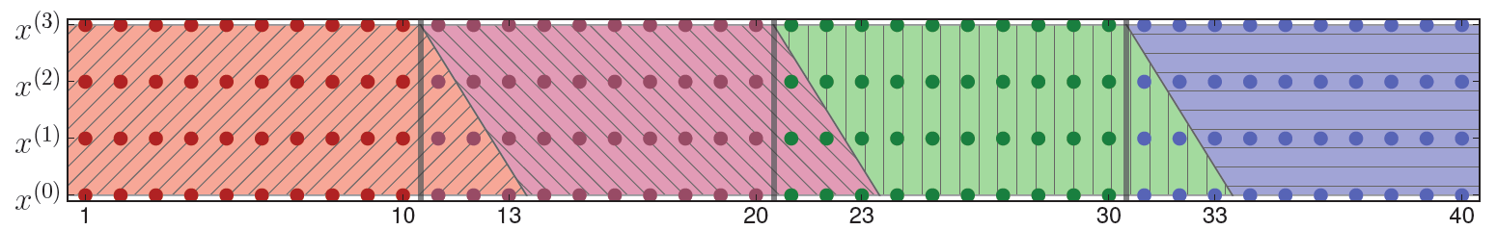
The Matrix Powers Kernel
Given A, v, and s, Matrix powers kernel computes
{v, Av, A²v, …, A^{s-1}v}
If we figure out dependencies beforehand, we can do all the communication for s steps of the algorithm only reading/communicating A o(1) times!
  Parallel case: Reduces latency by a factor of s at the cost of redundant computations
  Sequential case: reduces latency and bandwidth by a factor of s, no redundant computation
Simple example: a tridiagonal matrix
A³v
A²v
Av
v
Sequential
Parallel
A³v
A²v
Av
v

Slide 35
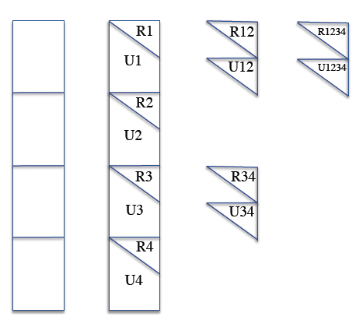
Communication Avoiding Kernels: TSQR
TSQR = Tall Skinny QR (#rows >> #cols)
  QR: factors a matrix A into the product of
    An orthogonal matrix (Q)
    An upper triangular matrix (R)
  Here, A is the matrix of the Krylov Subspace Basis Vectors
    output of the matrix powers kernel
  Q and R allow us to easily expand the dimension of the Krylov Subspace
Usual Algorithm
  Compute Householder vector for each column O(n log P) messages
Communication Avoiding Algorithm
  Reduction operation, with QR as operator O(log P) messages
Shape of reduction tree depends on architecture
  Parallel: use “deep” tree, saves messages/latency
  Sequential: use flat tree, saves words/bandwidth
  Multicore: use mixture
Figure: [ABDK10]

Slide 36
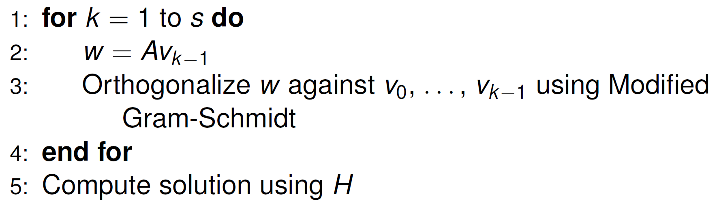
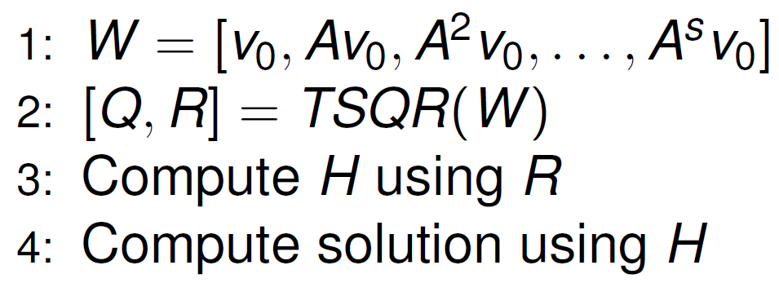
Example: CA-GMRES
s steps of original algorithm:
s steps of CA algorithm:
s powers of A for no extra latency cost
s steps of QR for one step of latency

Slide 37
Background
Relevant work:
  Toledo, S. Quantitative performance modeling of scientific computations and creating locality in numerical algorithms. PhD Thesis, 1995.
  Leiserson, C.E. and Rao, S. and Toledo, S. Efficient out-of-core algorithms for linear relaxation using blocking covers. Journal of Computer and System Sciences, 1997.
Motivation: Reorganize out-of-core algorithms to minimize I/O
Contribution: Method for reorganizing computational graph to avoid communication (and proving lower bounds!)

Slide 38
Definition: $τ−$neighborhood cover
$τ−$ neighborhood
  Given a directed graph $G=(V,E)$, a vertex $v∈V$, and a constant $τ≥0$, define $N^{\left(τ\right)}(v)$ to be the set of vertices in $V$ such that $u∈N^{\left(τ\right)}\left(v\right)$ implies that there is a path of length at most $τ$ from $u$ to $v$.
$τ−$ neighborhood cover
  A $τ−$ neighborhood cover of $G$ is a sequence of subgraphs $𝒢=<G_{1}=\left(V_{1},E_{1}\right),…,G_{k}=\left(V_{k},E_{k}\right)>$, such that for all $v∈V$, there exists a $G_{i}∈𝒢$ for which $N^{\left(τ\right)}(v)⊆V_{i}$
Hong and Kung’s result:
  If $G$ has a $τ−$ neighborhood cover with $O\left(E/M\right)$ subgraphs, each with $O(M)$ edges, a covering technique can reduce I/O by a factor of $τ$ over the naïve method.

Slide 39
Motivation for Blocking Covers
Idea:
  What if we could find a good cover by removing a subset of vertices from the graph? (i.e., connections are locally dense but globally sparse)
  Artificially restrict information from passing through these vertices by treating their state variables symbolically, maintain dependencies among symbolic variables as matrix
  Relax constraint that dependencies in DAG must be respected – Red/Blue pebble game lower bounds no longer apply!
According to “Red-Blue Pebble Game” assumptions, we can not avoid data movement if we can’t find a good cover for a graph
  Need to have subgraphs with high diameter
  Low diameter indicates that information travels too quickly – we can not increase temporal locality (“ghost zones” include all vertices!)
$$=$$
$$+$$

Slide 40
Preliminaries: Blocking Vertices
Blocking Set
  We select a subset $B⊆V$ of vertices to form a blocking set. We call these vertices blocking vertices or blockers
$τ−$ neighborhood cover
  The $τ−$ neighborhood cover of $v$ with respect to a blocking set $B⊆V$ is ${N_{B}}^{\left(τ\right)}\left(v\right)=\{u∈V: ∃ a path u→u_{1}→…→u_{t}→v,where u_{i}∈V−B for i=1, 2,…,t<τ\}$
  Describes vertices which can reach $v$ with paths of length at most $τ$ from whose internal vertices are not blockers in any subgraph
3-neighborhood cover (green vertices) WRT blocker B for yellow vertex
$$B$$
$$v$$

Slide 41
Preliminaries: Blocking Covers
A $\left(τ,r,M\right)−$blocking cover is a pair $(𝒢, ℬ)$, where $𝒢=<G_{1}=\left(V_{1}, E_{1}\right),…,G_{k}=\left(V_{k}, E_{k}\right)>$ is a sequence of subgraphs of $G$ and $ℬ=<B_{1},…,B_{k}>$ is a sequence of subsets of $V$ such that
  For all $i=1,…,k$, we have $M/2≤|E_{i}|≤M$
  For all $i=1,…,k$, we have $|B_{i}|≤r$
  $\sum_{i=1}^{k}{\left|E_{i}\right|=O(E)}$
  For all $v∈V$, there exists a $G_{i}∈G$ such that ${N_{B}}^{\left(τ\right)}⊆V_{i}$
  (one subgraph fits in main memory at a time)
  (restriction on the number of blockers in each subgraph)
  (we don’t do asymptotically more I/O or work than the original problem)
  (each vertex has a “home’, where its final value will be computed)

Slide 42
Definitions and Notation
How can we represent the effect that one initial state variable, ${x_{u}}^{(0)}$, has on another, ${x_{v}}^{(t)}$, at time $t$?
Start by defining the weight of a length $r$ path $p=v_{0}→v_{1}→…→v_{r}$ in $G$:
  $$w\left(p\right)=\prod_{k−1}^{r}{A_{v_{k−1} , v_{k}}}$$
For two vertices $u, v∈V$, we define the sum of all length $r$ paths from $u$ to $v$:
$$w\left(r;u,v\right)=\sum_{p∈P(r)}{w\left(p\right)}$$
where $P\left(r\right)=\{p∈G:p is a length r path from u to v\}$
Corresponds to $A^{r}(v,u)$

Slide 43
Definitions and Notation
Given these definitions we can write the influence of one vertex on another:
$${x_{v}}^{(t)}=\sum_{u∈V}{w(t;u,v){x_{u}}^{(0)}}$$
Note: for a single SpMV, we would have $w\left(1;u,v\right)=A(v,u)$, which gives us the familiar expression
$${x_{v}}^{(1)}=\sum_{u∈V}{A\left(v,u\right){x_{u}}^{(0)} }$$
The trick is that we can split this summation into two parts and write
$${x_{v}}^{(t)}=\sum_{u∈V}{w_{B_{i}}}\left(t;u,v\right){x_{u}}^{\left(0\right)}+\sum_{u∈B_{i}}{\sum_{s=1}^{t−1}{w_{B_{i}}(s;u,v){x_{u}}^{(t−s)}}}$$
where $w_{B_{i}}(p)$ is the weight of a length $r$ path $p=v_{0}→v_{1}→…→v_{r}$ such that $v_{j}∉B_{i}$

Slide 44
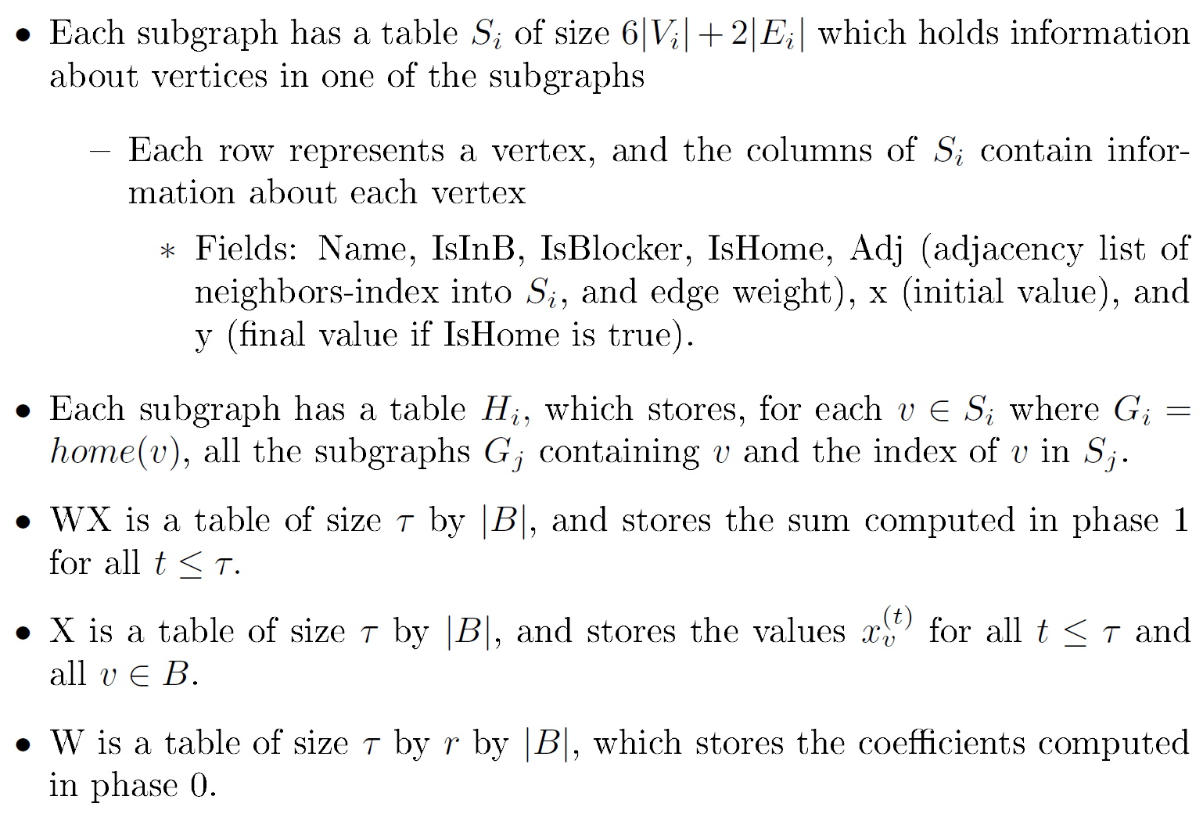
Data Structures

Slide 45
Phase 0 – in words
For each subgraph, for each timestep, compute the influence of blockers (coefficients) in that subgraph on vertices that are home and that are blockers in any subgraph
  Note: $B_{i}$ denotes the set of vertices in B that are blockers in subgraph $G_{i}$. B is the set of vertices that are blockers in any subgraph. A vertex can be in B but not $B_{i}$ for a subgraph.
Store these coefficients in table W
  Only need to be computed once for the entire computation

Slide 46
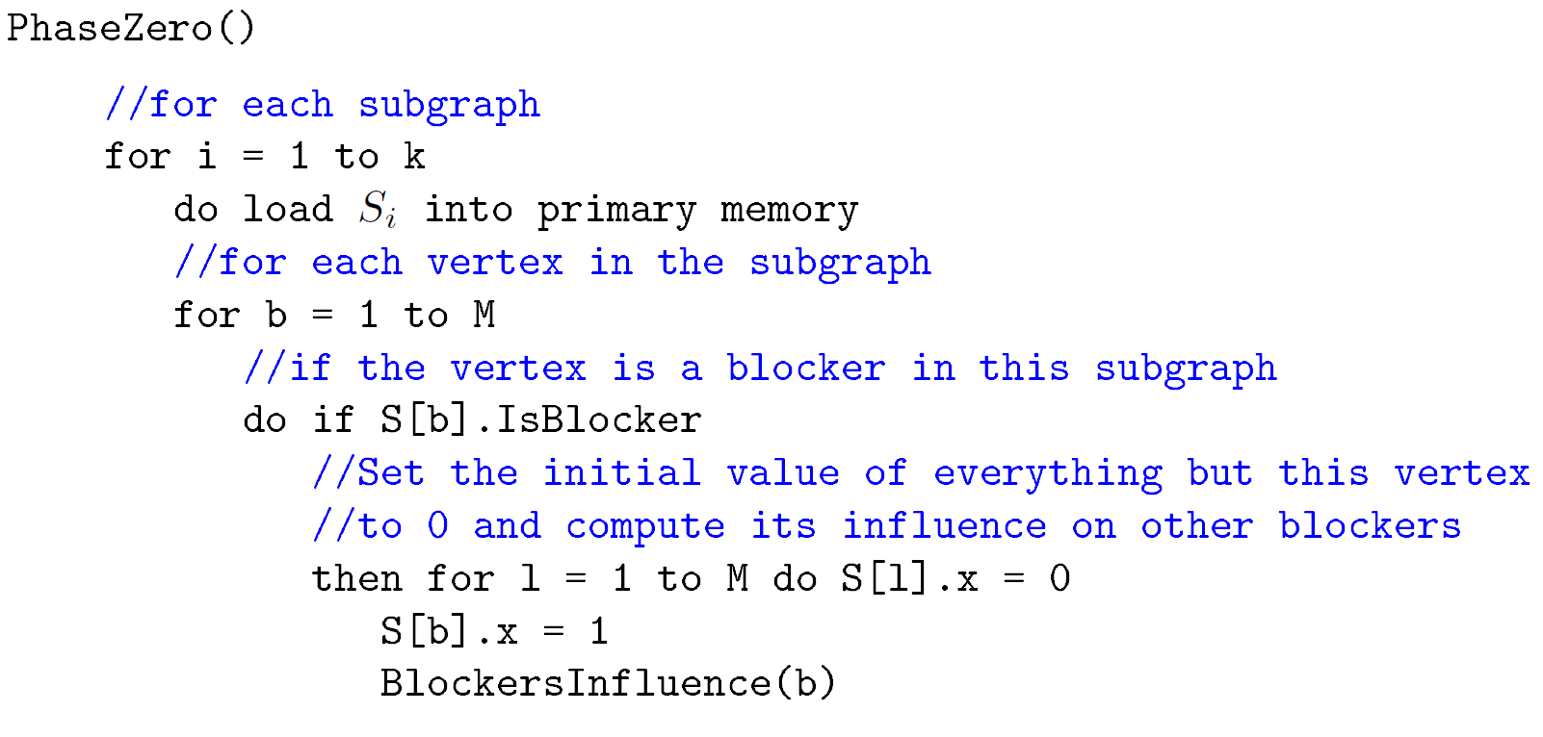
Phase 0 – in pseudocode

Slide 47
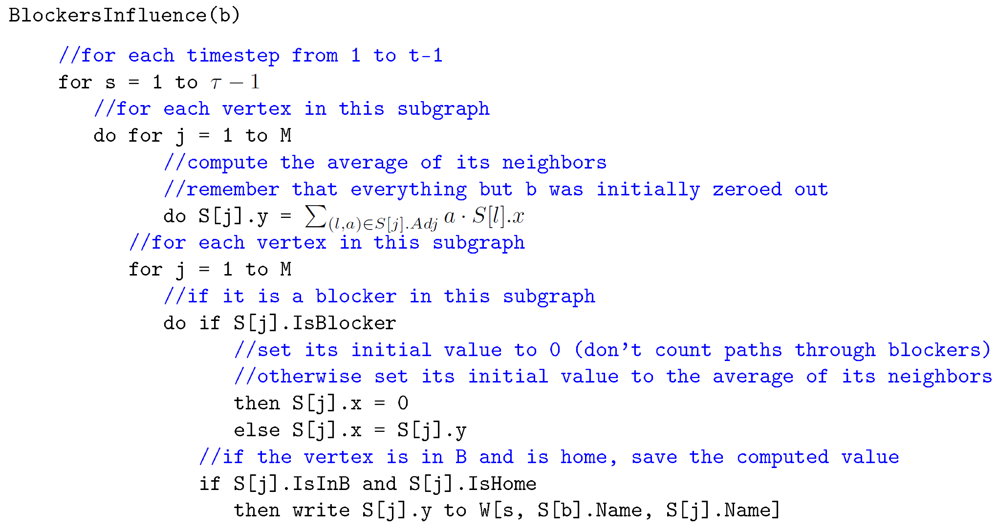
Phase 0 – in pseudocode

Slide 48

Phase 0 – in matrix notation
In matrix form, Phase 0 is:
  Compute $[U, AU, A^{2}U,…,A^{τ−1}U]$
    This performs the “zeroing out” of everything but the blocker, which is set to 1 and propagated through paths not involving blockers (A) for each step
  Premultiply to save entries for the blockers:
  Note: Since A is well partitioned, can compute matrix powers with U as input vector in a CA way
  Premultiplication by V_T is a global operation – we save communication by only doing this once
  $[V^{T}U,V^{T}AU,V^{T}A^{2}U,…,{V^{T}A}^{τ−1}U]$

Slide 49
Phase 0 Work and I/O
Total work: $O\left(rkτM\right)=O\left(rτE\right)$
  BlockersInfluence() called $O(rk)$ times (k subgraphs, r blockers each)
  Each call to BlockersInfluence() does $O\left(τM\right)$ work (each timestep, each vertex in the subgraph)
Total I/O: $O(E)$ to load all subgraphs, $\left|B\right|rτ≤kr^{2}τ=O(E)$ to store table W
 | Phase 0 | Phase 1 | Phase 2 | Phase 3
Work | $$O(rτE)$$
I/O | $$O(E)$$

Slide 50

Phase 1- in words
For each subgraph, compute the influence of non-blocker vertices (vertices not in $B_{i}$ on vertices that are blockers in any subgraph (vertices in $B$)
This is the first summation term below, computed for $u∈V_{i}, v∈B$, where $G_{i}=home(v)$.

Slide 51


Phase 1- in pseudocode

Slide 52
Phase 1 – in matrix notation
In matrix notation, Phase 1 is:
  Compute $[x, Ax, A^{2}x, …, A^{τ}x]$
    Influence of non-blocker vertices on blockers, only counting paths through non-blockers (A)
  Premultiply: $[V^{T}x,V^{T}Ax, {V^{T}A}^{2}x, …, {V^{T}A}^{τ}x]$
    Save the results for blocker vertices

Slide 53
Phase 1 Work and I/O
Total Work: $O\left(kτM\right)=O\left(τE\right)$
  Performed for each subgraph, for each timestep, and for each vertex
Total I/O: $O\left(E\right)$ to load all subgraphs, $\left|B\right|τ$ to store table WX
 | Phase 0 | Phase 1 | Phase 2 | Phase 3
Work | $$O(rτE)$$ | $$O(τE)$$
I/O | $$O(E)$$ | $$O(E)$$

Slide 54
Phase 2 – in words
Solve for the values of $v∈B,$ for times $s=0, …, τ−1$
Since we have the coefficients from Phase 0 and the values from Phase 1, can solve triangular system with back substitution
After this phase, we know the actual values of the blockers at all times $0, …, τ$

Slide 55

Phase 2 – in pseudocode

Slide 56


Phase 2 – in matrix notation
In matrix form:

Slide 57
Phase 2 Work and I/O
Total work: $O\left(r\left|B\right|τ^{2}\right)=O\left(kr^{2}τ^{2}\right)=O(E)$
  $τ|B|$ summations with at most $rτ$ terms in each sum
Total I/O: $O\left(r\left|B\right|τ^{2}\right)=O\left(kr^{2}τ^{2}\right)=O(E)$
 | Phase 0 | Phase 1 | Phase 2 | Phase 3
Work | $$O(rτE)$$ | $$O(τE)$$ | $$O(E)$$
I/O | $$O(E)$$ | $$O(E)$$ | $$O(E)$$

Slide 58
Phase 3 – in words
For each subgraph, for each timestep, perform linear relaxation, following paths that do not pass through blockers
  At the end of each timestep, fill in values of blockers computed in Phase 2 into the result vector
Notes:
v in V, not V-B

Slide 59


Phase 3 – in pseudocode

Slide 60

Phase 3 – in matrix notation
Compute the desired vectors:
  Multiplication by A is linear relaxation for all non-blocker vertices
  Precomputed $V^{T}\hat{c_{j}}$ terms for each step in Phase 2
    Multiplication by $U$ fills them into the right row in $c_{j+1}$ in each step

Slide 61
Phase 3 Work and I/O
Total work: $O\left(kτM\right)=O\left(τE\right)$
  Performed for each timestep, for each subgraph
Total I/O: $O\left(E+V\right)=O\left(E\right)$
  Load each subgraph, read each blocker
 | Phase 0 | Phase 1 | Phase 2 | Phase 3
Work | $$O(rτE)$$ | $$O(τE)$$ | $$O(E)$$ | $$O(τE)$$
I/O | $$O(E)$$ | $$O(E)$$ | $$O(E)$$ | $$O(E)$$

Slide 62
Total Work and I/O
Combining work and I/O counts from each of the phases, we can state the following result:
Theorem: Given a graph $G=(V, E)$ with a $\left(τ, r, M\right)−$ blocking cover such that $r^{2}τ^{2}≤M,$ a computer with $O\left(M\right)$ words of primary memory can perform $T≥τ$ steps of a simple linear relaxation on $G$ using at most $O(TE)$ work and $O(\frac{TE}{τ})$ I/Os. A precomputation phase requires $O(rτE)$ work and $O(E)$ I/Os.
For naïve approach: $O(TE)$ work, $O(TE)$ I/Os
  Blocking covers approach reduces I/O asymptotically by $τ$ for same asymptotic amount of work
 | Phase 0 | Phase 1 | Phase 2 | Phase 3
Work | $$O(rτE)$$ | $$O(τE)$$ | $$O(E)$$ | $$O(τE)$$
I/O | $$O(E)$$ | $$O(E)$$ | $$O(E)$$ | $$O(E)$$

Slide 63
Blocking Covers Approach to CA-Multigrid
Multigrid algorithms typically used in solving discretized PDEs
Consider the graph of a multigrid computation (multigrid graph)
  The $k^{th}$ level of a multigrid graph is a $\frac{\sqrt{n}}{2^{k}}×$ $\frac{\sqrt{n}}{2^{k}}$ mesh, for $k=0,1,…,\frac{\log{n}}{2}$ , whose $(i, j)$ vertex is connected to the $(2i, 2j)$ vertex on the ${(k−1)}^{st}$ level
  Computation proceeds from the finest mesh, to the coarsest (where the solution is computed), and then refined back to the finest mesh
Naïve implementation:
  Computation: $Θ(Tn)$ time (not $Θ(T\log{n)}$ ) time, since the number of vertices on each level decreases geometrically, even though there are $\log{n}$levels
  I/Os: also $Θ(Tn)$ for $T$ steps
Under Hong and Kung’s model, naïve implementation optimal
  Information propagates quickly due to increasingly small diameter

