Slide 1
Communication-avoiding
Krylov subspace methods in finite precision
Erin Carson, UC Berkeley
Advisor: James Demmel
ICME LA/Opt Seminar, Stanford University
December 4, 2014

Slide 2
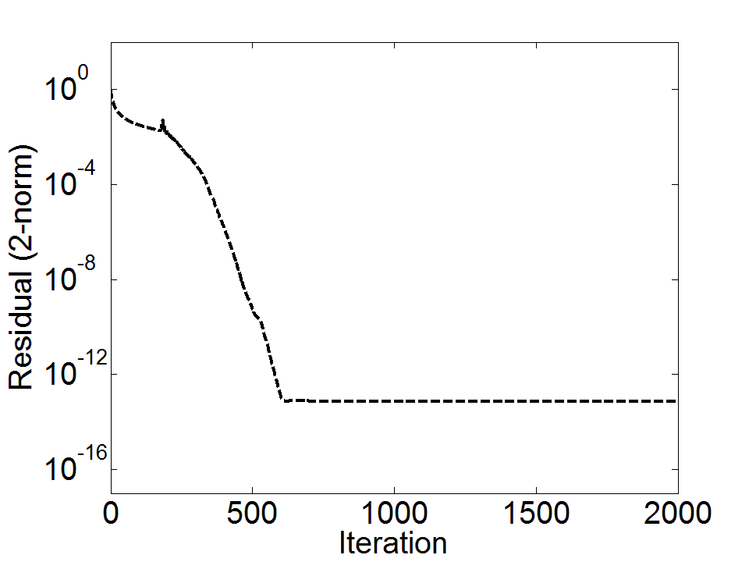
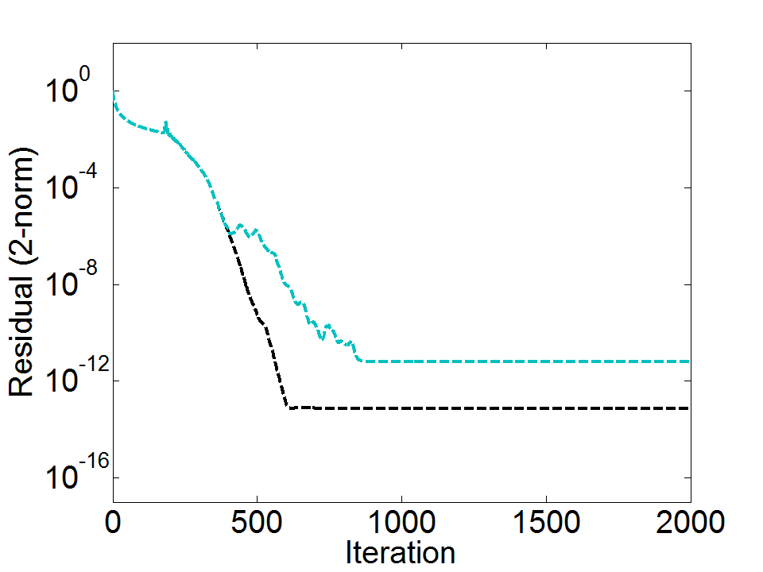
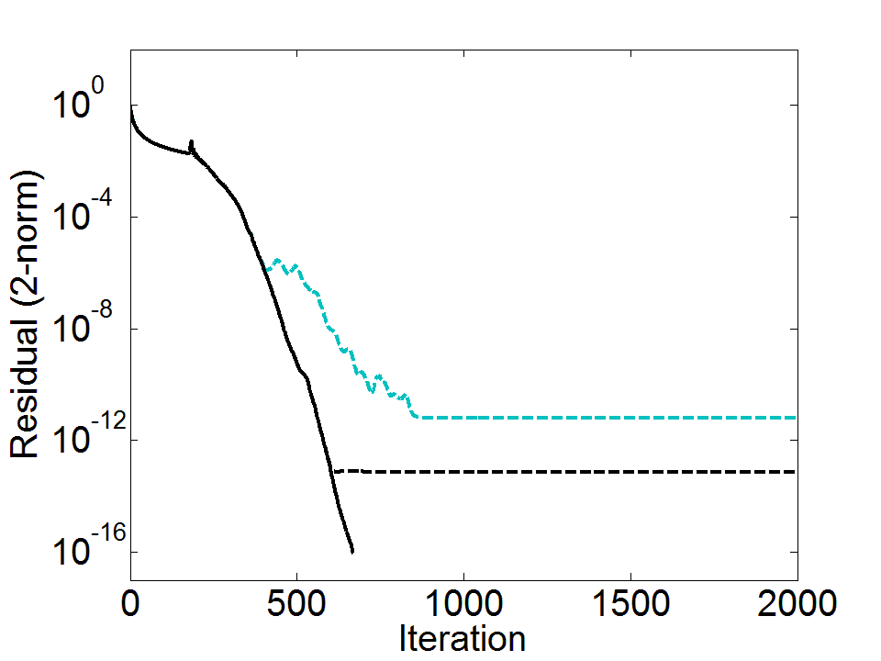
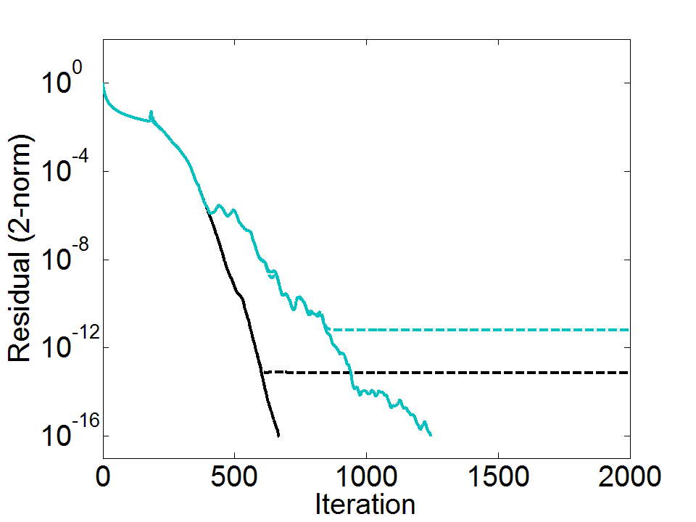
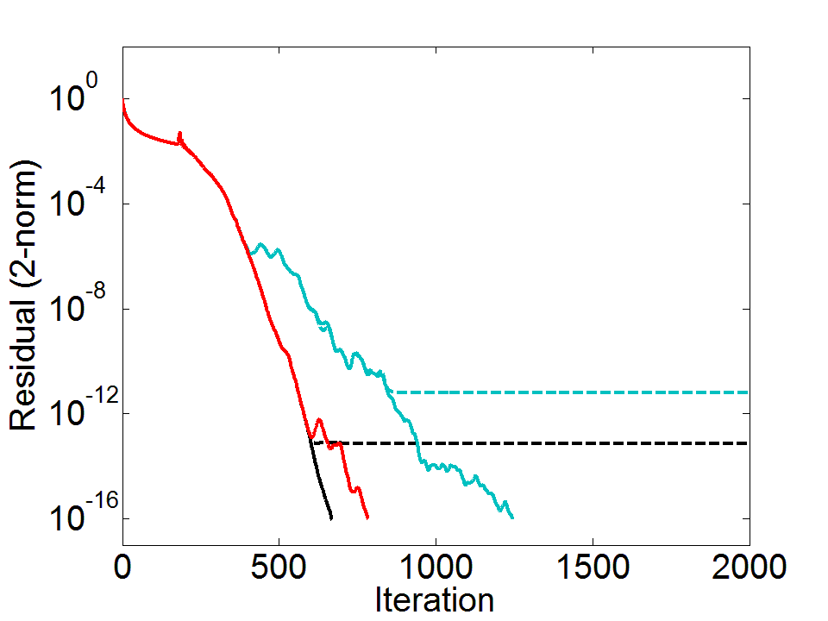
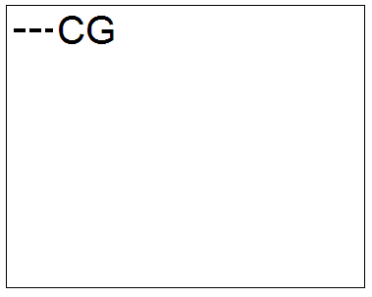
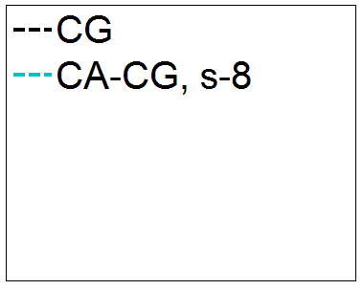
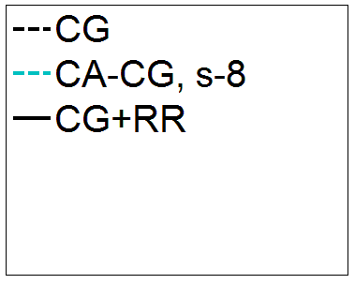
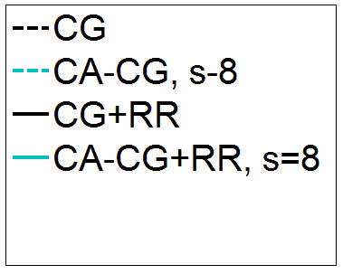
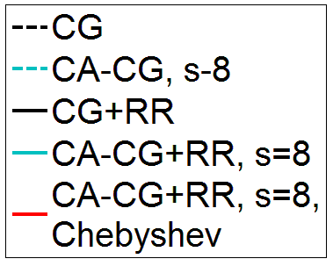

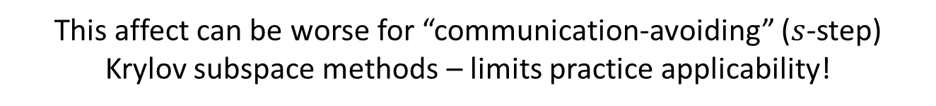
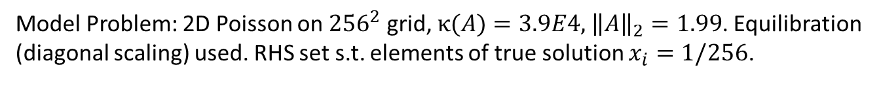
Model Problem: 2D Poisson on ${256}^{2}$ grid, $κ(A)=3.9E4,$ ${\left\|A\right\|}_{2}=1.99$. Equilibration (diagonal scaling) used. RHS set s.t. elements of true solution $x_{i}=1/256$.
Residual replacement strategy of van der Vorst and Ye (1999) improves attainable accuracy for classical Krylov methods
We can combine residual replacement with inexpensive techniques for maintaining convergence rate closer to that of the classical method!
We can extend this strategy to communication-avoiding variants. Accuracy can be improved for minimal performance cost!
Roundoff error can cause a decrease in attainable accuracy of Krylov subspace methods.
This affect can be worse for “communication-avoiding” ($s$-step) Krylov subspace methods – limits practice applicability!

Slide 3
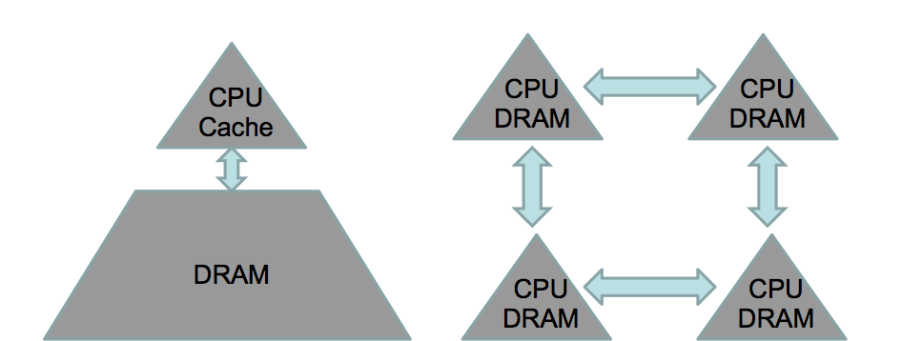
What is communication?
Algorithms have two costs: communication and computation
  Communication : moving data between levels of memory hierarchy (sequential), between processors (parallel)
sequential comm.
parallel comm.
On modern computers, communication is expensive, computation is cheap
  Flop time << 1/bandwidth << latency
  Communication bottleneck a barrier to achieving scalability
  Also expensive in terms of energy cost!
Towards exascale: we must redesign algorithms to avoid communication
Notes:
“Also, data movement will cost more than flops (even on the chip). Limited amounts of memory and low memory/flop ratios will make processing virtually free. In fact, the amount of memory is relatively decreasing, scaling far worse than computation. This is a challenge that’s not being addressed and it’s not going to get less expensive by 2018.”
-Horst Simon, Interview with HPCWire, May 15, 2013

Slide 4
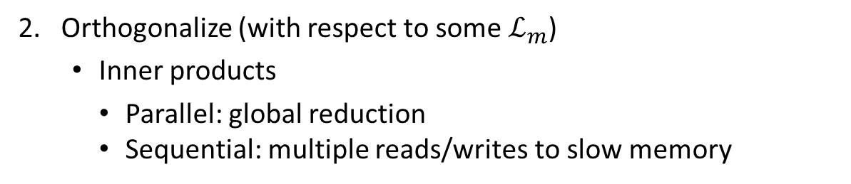
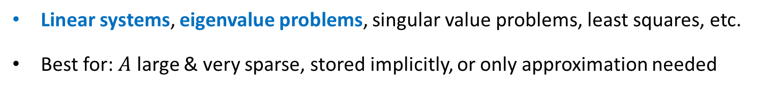
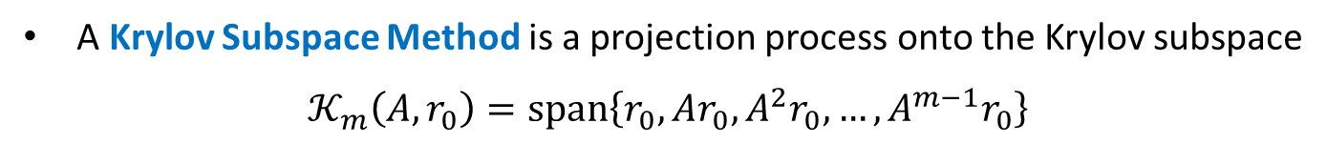
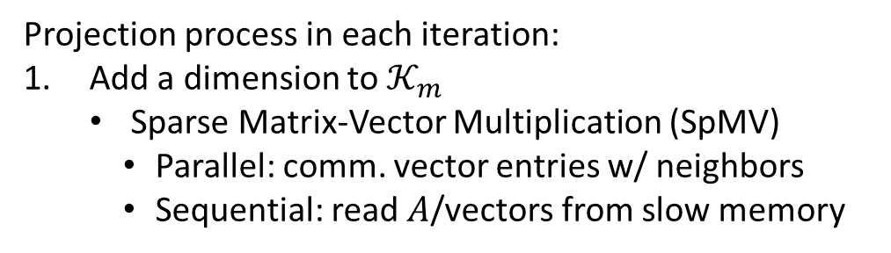
Communication bottleneck in KSMs
A Krylov Subspace Method is a projection process onto the Krylov subspace
$𝒦_{m}\left(A,r_{0}\right)=\text{span}\left\{r_{0}, Ar_{0}, A^{2}r_{0}, …, A^{m−1}r_{0}\right\}$
Linear systems, eigenvalue problems, singular value problems, least squares, etc.
Best for: $A$ large & very sparse, stored implicitly, or only approximation needed
Projection process in each iteration:
Add a dimension to $𝒦_{m}$
  Sparse Matrix-Vector Multiplication (SpMV)
    Parallel: comm. vector entries w/ neighbors
    Sequential: read $A$/vectors from slow memory
SpMV
orthogonalize
Dependencies between communication-bound kernels in each iteration limit performance!
2. Orthogonalize (with respect to some $ℒ_{m}$)
  Inner products
    Parallel: global reduction
    Sequential: multiple reads/writes to slow memory
Notes:
orthogonal to some $ℒ_{m}$.

Slide 5
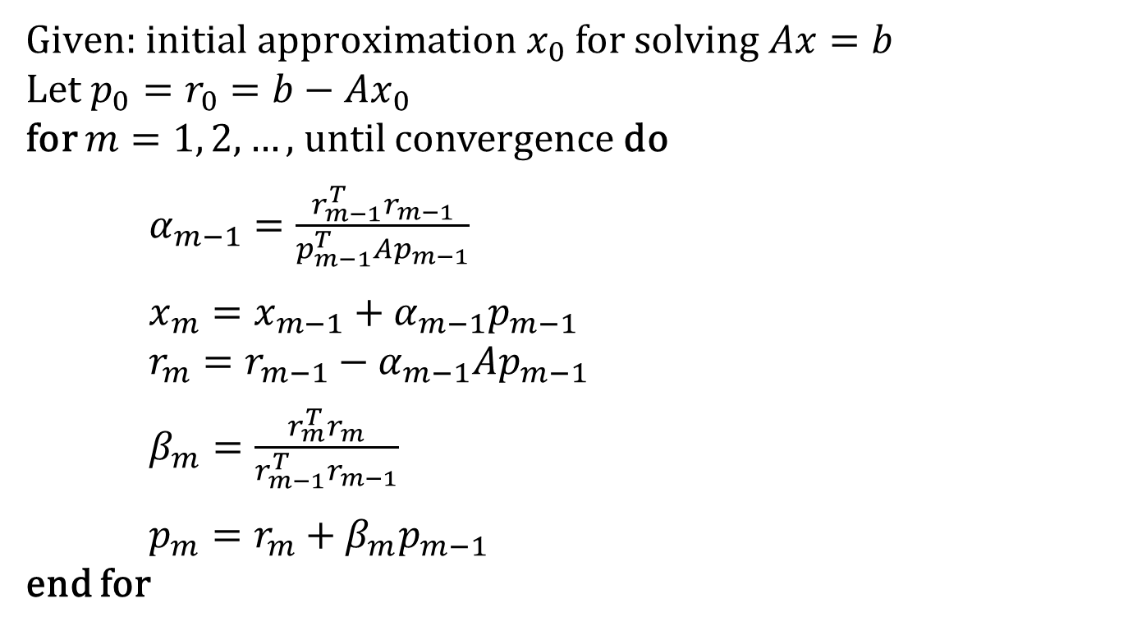
Example: Classical conjugate gradient (CG)
$\text{Given}\text{: }\text{initial} approximation x_{0}$ for solving $Ax=b$
Let $p_{0}=r_{0}=b−Ax_{0}$
for $m=1, 2,…,$ until convergence do
$α_{m−1}=\frac{r_{m−1}^{T}r_{m−1}}{p_{m−1}^{T}Ap_{m−1}}$
$x_{m}=x_{m−1}+α_{m−1}p_{m−1}$
$r_{m}=r_{m−1}−α_{m−1}Ap_{m−1}$
$β_{m}=\frac{r_{m}^{T}r_{m}}{r_{m−1}^{T}r_{m−1}}$
$p_{m}=r_{m}+β_{m}p_{m−1}$
end for
SpMVs and inner products require communication in each iteration!

Slide 6
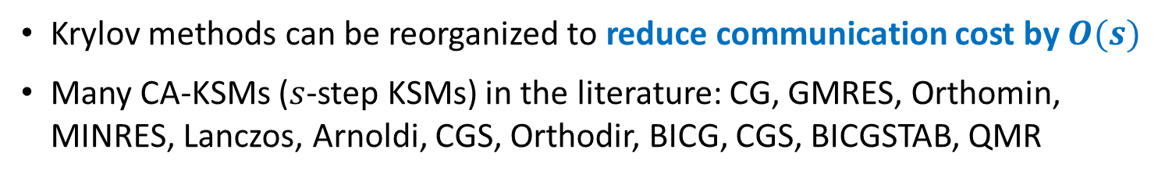
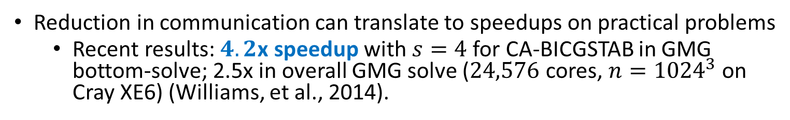
Communication-avoiding CA-KSMs
Krylov methods can be reorganized to reduce communication cost by $O(s)$
Many CA-KSMs ($s$-step KSMs) in the literature: CG, GMRES, Orthomin, MINRES, Lanczos, Arnoldi, CGS, Orthodir, BICG, CGS, BICGSTAB, QMR
Related references:
(Van Rosendale, 1983), (Walker, 1988), (Leland, 1989), (Chronopoulos and Gear, 1989), (Chronopoulos and Kim, 1990, 1992), (Chronopoulos, 1991), (Kim and Chronopoulos, 1991), (Joubert and Carey, 1992), (Bai, Hu, Reichel, 1991), (Erhel, 1995), GMRES (De Sturler, 1991), (De Sturler and Van der Vorst, 1995), (Toledo, 1995), (Chronopoulos and Kinkaid, 2001), (Hoemmen, 2010), (Philippe and Reichel, 2012), (C., Knight, Demmel, 2013), (Feuerriegel and Bücker, 2013).
Reduction in communication can translate to speedups on practical problems
  Recent results: $4.2$x speedup with $s=4$ for CA-BICGSTAB in GMG bottom-solve; 2.5x in overall GMG solve ($24,576$ cores, $n={1024}^{3}$ on Cray XE6) (Williams, et al., 2014).
Notes:
4096 processes, each process is 6 way multithreaded
Hopper is a Cray XE6
Mention also many other approaches which give speedups, like pipelined Krylov methods

Slide 7
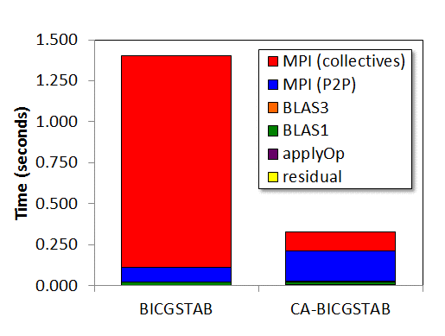
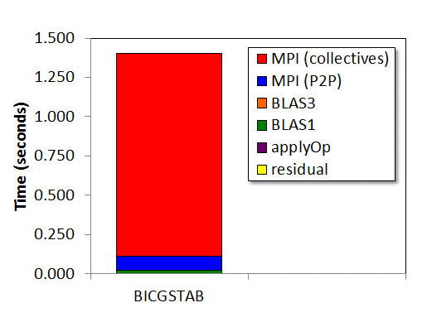
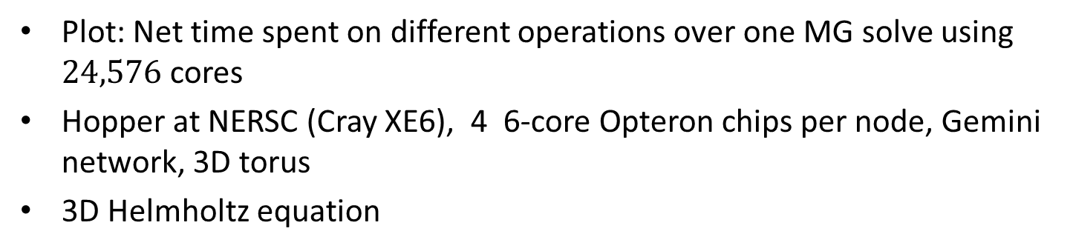

Benchmark timing breakdown
Plot: Net time spent on different operations over one MG solve using $24,576$ cores
Hopper at NERSC (Cray XE6), 4 6-core Opteron chips per node, Gemini network, 3D torus
3D Helmholtz equation
CS-BICGSTAB with $s=4$

Slide 8
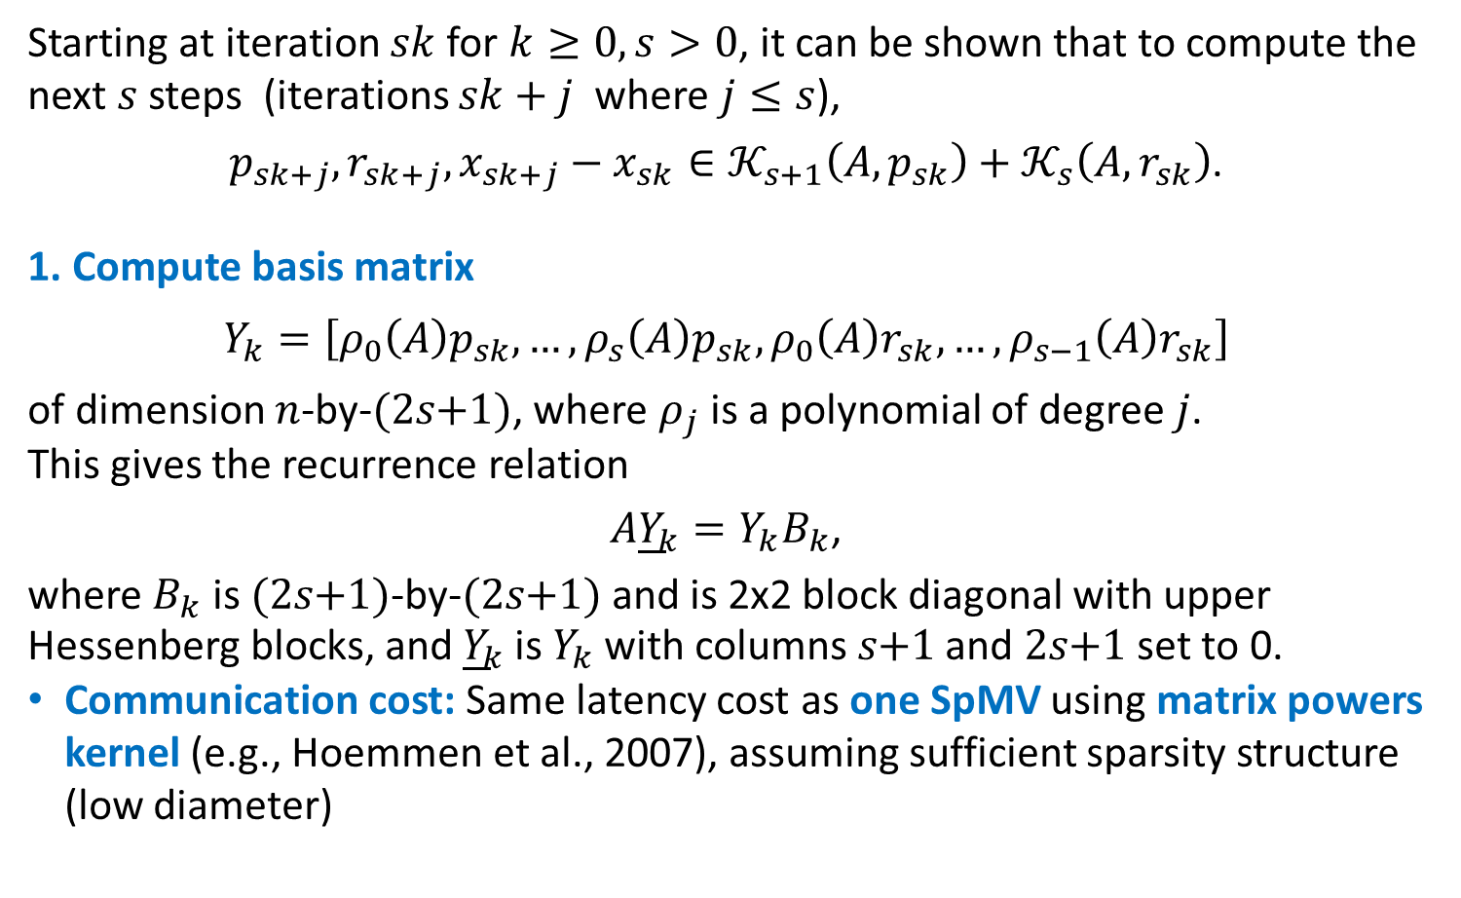
CA-CG overview
Starting at iteration $sk$ for $k≥0, s>0$, it can be shown that to compute the next $s$steps (iterations $sk+j$ where $j≤s$),
$p_{sk+j},r_{sk+j},x_{sk+j}−x_{sk}∈𝒦_{s+1}\left(A,p_{sk}\right)+𝒦_{s}\left(A,r_{sk}\right)$.
1. Compute basis matrix
$Y_{k}=\left[ρ_{0}\left(A\right)p_{sk},…, ρ_{s}\left(A\right)p_{sk},ρ_{0}\left(A\right)r_{sk},…, ρ_{s−1}\left(A\right)r_{sk}\right]$
of dimension $n$-by-$(2s\text{+}1)$, where $ρ_{j}$ is a polynomial of degree $j$.
This gives the recurrence relation
$A{\underline{Y}}_{k}=Y_{k}B_{k}$,
where $B_{k}$ is $(2s\text{+}1)$-by-$(2s\text{+}1)$ and is 2x2 block diagonal with upper Hessenberg blocks, and ${\underline{Y}}_{k}$ is $Y_{k}$ with columns $s\text{+}1$ and $2s\text{+}1$ set to 0.
Communication cost: Same latency cost as one SpMV using matrix powers kernel (e.g., Hoemmen et al., 2007), assuming sufficient sparsity structure (low diameter)

Slide 9
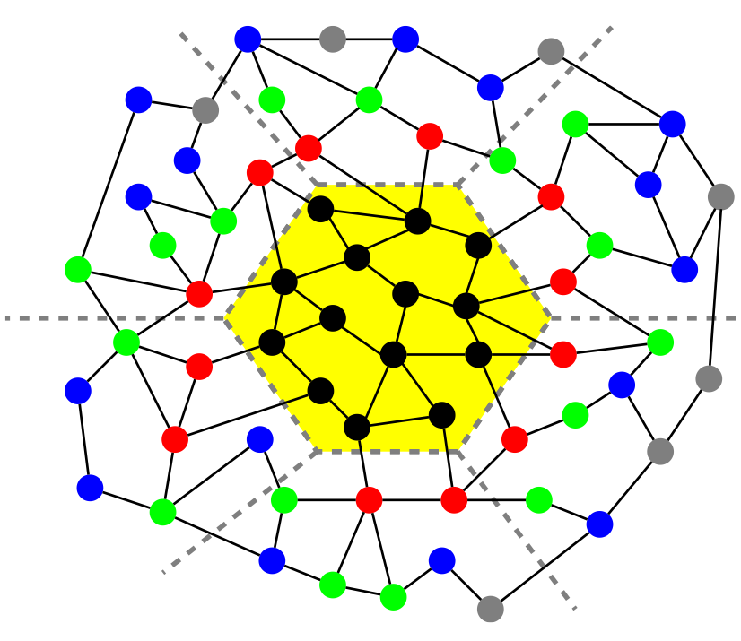
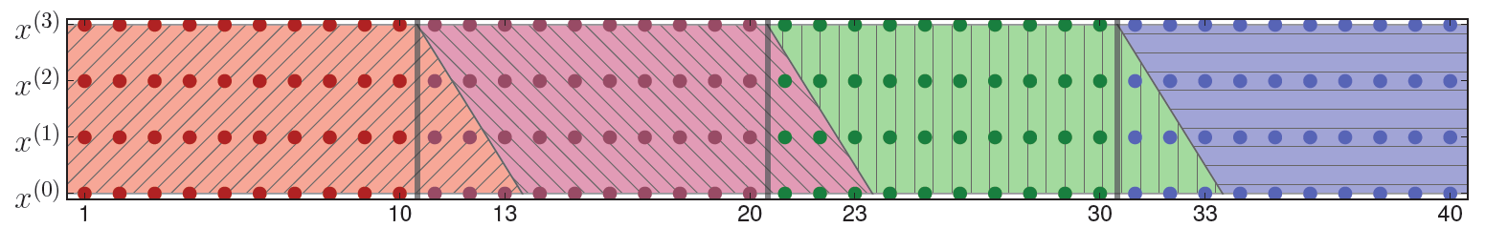
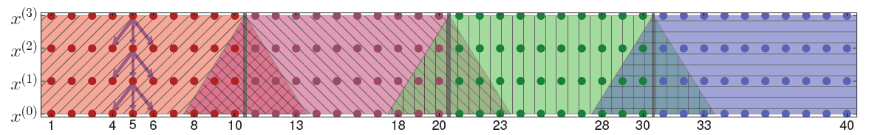
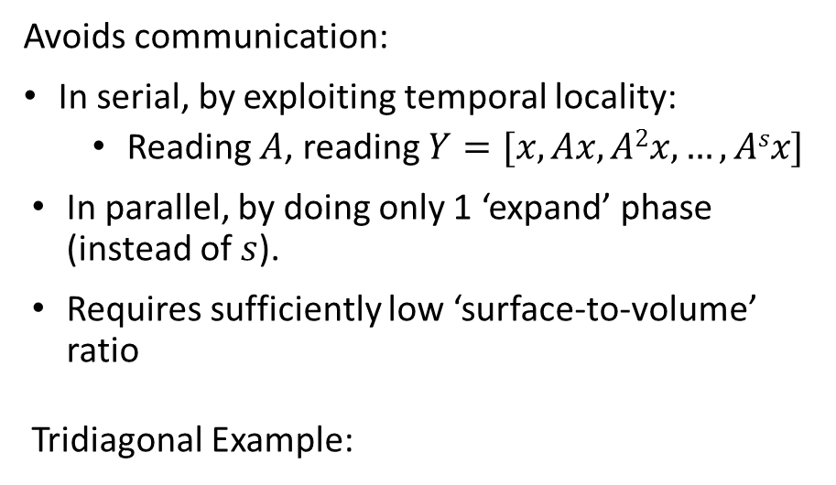
The matrix powers kernele Matrix Powers
Avoids communication:
In serial, by exploiting temporal locality:
  Reading $A$, reading $Y=[x, Ax, A2x, …, Asx]$
In parallel, by doing only 1 ‘expand’ phase (instead of $s$).
Requires sufficiently low ‘surface-to-volume’ ratio
Tridiagonal Example:
black = local elements
red = 1-level dependencies
green = 2-level dependencies
blue = 3-level dependencies
Also works for general graphs!
A³v
A²v
Av
v
Sequential
Parallel
A³v
A²v
Av
v

Slide 10
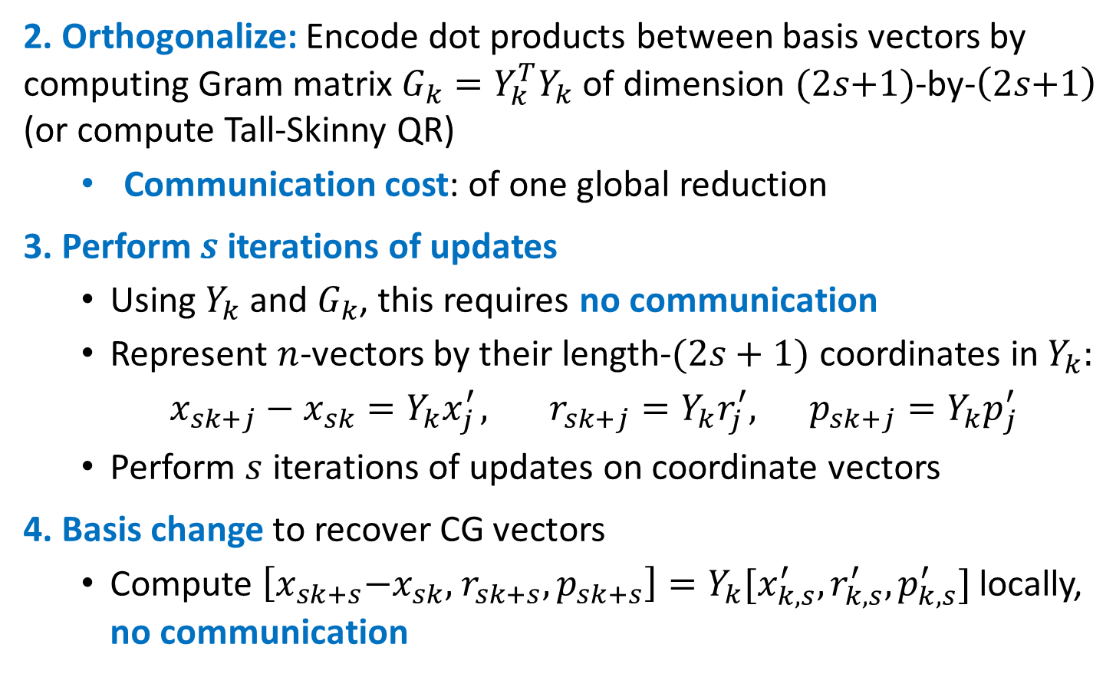
CA-CG overview
2. Orthogonalize: Encode dot products between basis vectors by computing Gram matrix $G_{k}=Y_{k}^{T}Y_{k}$ of dimension $(2s\text{+}1)$-by-$\left(2s\text{+}1\right)$ (or compute Tall-Skinny QR)
  Communication cost: of one global reduction
3. Perform $s$ iterations of updates
  Using $Y_{k}$ and $G_{k}$, this requires no communication
  Represent $n$-vectors by their length-$(2s+1)$ coordinates in$Y_{k}:$
  $x_{sk+j}−x_{sk}=Y_{k}x_{j }^{′}, r_{sk+j}=Y_{k}r_{j}^{′}, p_{sk+j}=Y_{k}p_{j}^{′}$
  Perform $s$ iterations of updates on coordinate vectors
4. Basis change to recover CG vectors
  Compute $\left[x_{sk+s}\text{−}x_{sk}\text{, }r_{sk+s}, p_{sk+s}\right]=Y_{k}{[x}_{k,s}^{′},r_{k,s}^{′},p_{k,s}^{′}]$ locally, no communication

Slide 11






No communication in inner loop!
CA-CG
Compute $Y_{k}$ such that $A{\underline{Y}}_{k}=Y_{k}B_{k}$
CG
Compute $G_{k}=Y_{k}^{T}Y_{k}$
for $j=1,…,s$ do
for $j=1,…,s$ do
$$α_{sk+j−1}=\frac{r_{sk+j−1}^{T}r_{sk+j−1}}{p_{sk+j−1}^{T}Ap_{sk+j−1}}$$
$$x_{sk+j}=x_{sk+j−1}+α_{sk+j−1}p_{sk+j−1}$$
$$r_{sk+j}=r_{sk+j−1}−α_{sk+j−1}Ap_{sk+j−1}$$
$$β_{sk+j}=\frac{r_{sk+j}^{T}r_{sk+j}}{r_{sk+j−1}^{T}r_{sk+j−1}}$$
$$p_{sk+j}=r_{sk+j}\text{+}β_{sk+j}p_{sk+j−1}$$
$$α_{sk+j−1}=\frac{r_{k,j−1}^{′T}G_{k}r_{k,j−1}^{′}}{p_{k,j−1}^{′T}G_{k}B_{k}p_{k,j−1}^{′}}$$
$$x_{k,j}^{′}=x_{k,j−1}^{′}+α_{sk+j−1}p_{k,j−1}^{′}$$
$$r_{k,j}^{′}=r_{k,j−1}^{′}−α_{sk+j−1}B_{k}p_{k,j−1}^{′}$$
$$β_{sk+j}=\frac{r_{k,j}^{′T}G_{k}r_{k,j}^{′}}{r_{k,j−1}^{′T}G_{k}r_{k,j−1}^{′}}$$
$$p_{k,j}^{′}=r_{k,j}^{′}+β_{sk+j}p_{k,j−1}^{′}$$
end for
end for
$$\left[x_{sk+s}\text{−}x_{sk}\text{, }r_{sk+s}, p_{sk+s}\right]=Y_{k}{[x}_{k,s}^{′},r_{k,s}^{′},p_{k,s}^{′}]$$

Slide 12
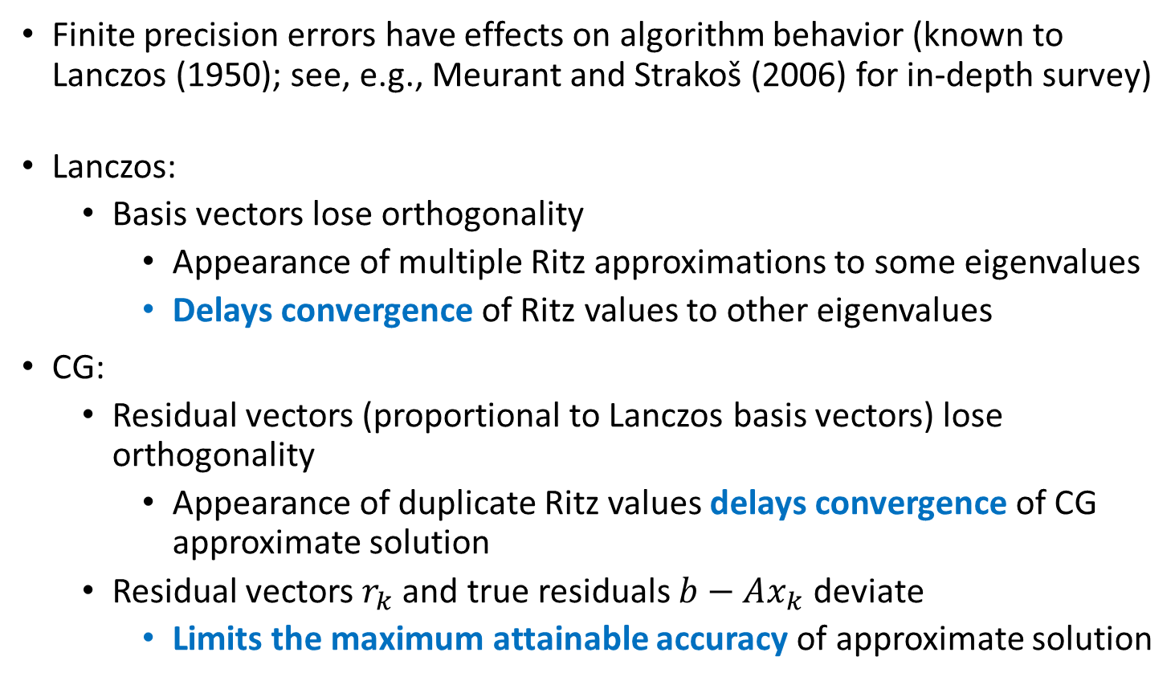
Krylov methods in finite precision
Finite precision errors have effects on algorithm behavior (known to Lanczos (1950); see, e.g., Meurant and Strakoš (2006) for in-depth survey)
Lanczos:
  Basis vectors lose orthogonality
    Appearance of multiple Ritz approximations to some eigenvalues
    Delays convergence of Ritz values to other eigenvalues
CG:
  Residual vectors (proportional to Lanczos basis vectors) lose orthogonality
    Appearance of duplicate Ritz values delays convergence of CG approximate solution
  Residual vectors $r_{k}$ and true residuals $b−Ax_{k}$ deviate
    Limits the maximum attainable accuracy of approximate solution

Slide 13
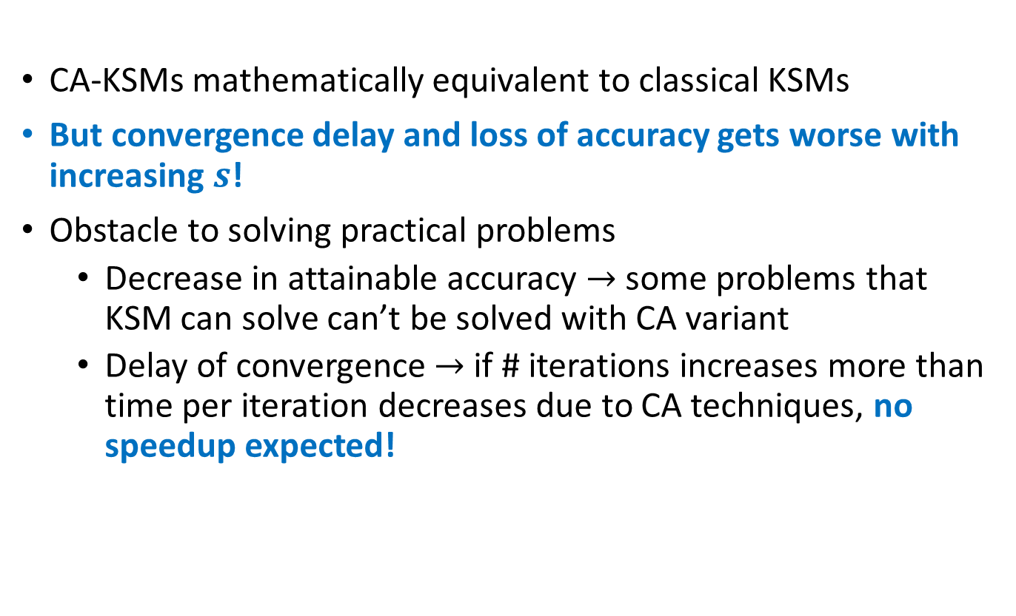
CA-Krylov methods in finite precision
CA-KSMs mathematically equivalent to classical KSMs
But convergence delay and loss of accuracy gets worse with increasing $s$!
Obstacle to solving practical problems
  Decrease in attainable accuracy $→$ some problems that KSM can solve can’t be solved with CA variant
  Delay of convergence $→$ if # iterations increases more than time per iteration decreases due to CA techniques, no speedup expected!

Slide 14
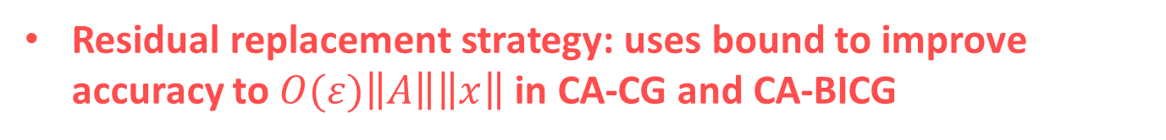
This raises the questions…
For CA-KSMs,
How bad can the effects of roundoff error be?
For solving linear systems:
Bound on maximum attainable accuracy for CA-CG and CA-BICG
And what can we do about it?
Residual replacement strategy: uses bound to improve accuracy to $O(ε)\left\|A\right\|\left\|x\right\|$ in CA-CG and CA-BICG

Slide 15
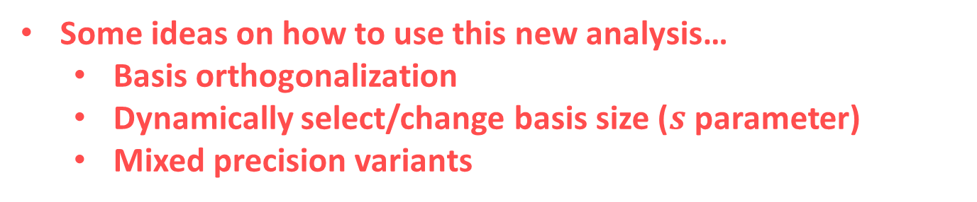
This raises the questions…
For CA-KSMs,
How bad can the effects of roundoff error be?
For eigenvalue problems:
Extension of Chris Paige’s analysis of Lanczos to CA variants:
Bounds on local rounding errors in CA-Lanczos
Bounds on accuracy and convergence of Ritz values
  Loss of orthogonality → convergence of Ritz values
And what can we do about it?
Some ideas on how to use this new analysis…
  Basis orthogonalization
  Dynamically select/change basis size ($s$ parameter)
  Mixed precision variants

Slide 16
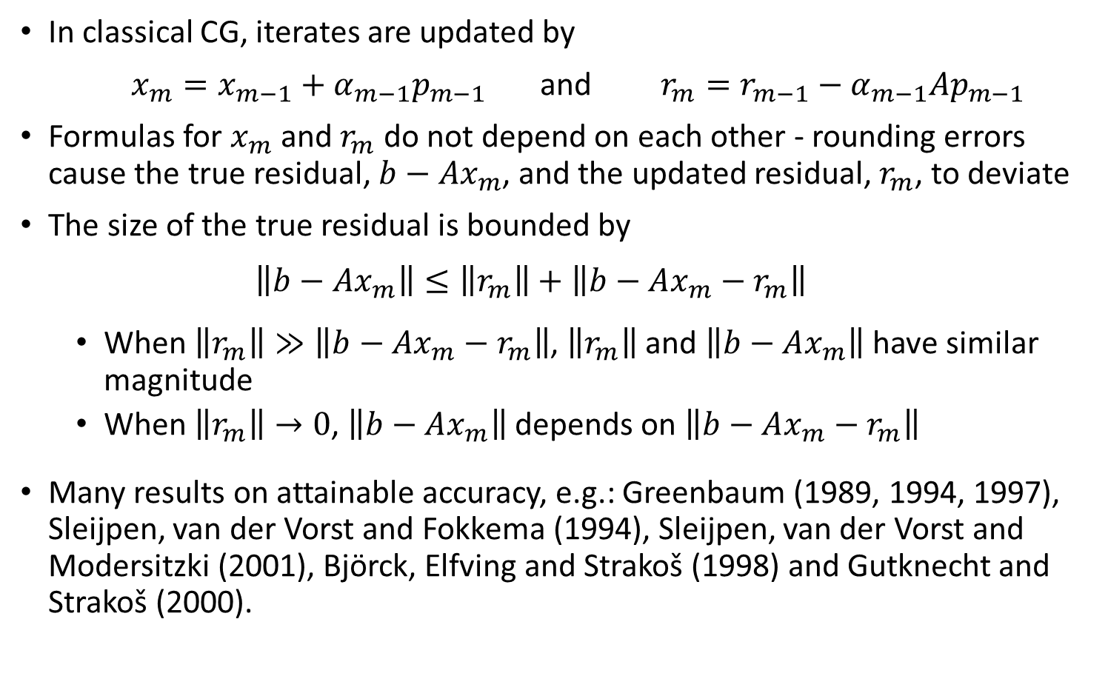
Maximum attainable accuracy of CG
In classical CG, iterates are updated by
$x_{m}=x_{m−1}+α_{m−1}p_{m−1}$ and $r_{m}=r_{m−1}−α_{m−1}Ap_{m−1}$
Formulas for $x_{m}$ and $r_{m}$ do not depend on each other - rounding errors cause the true residual, ${b−Ax}_{m}$, and the updated residual, $r_{m}$, to deviate
The size of the true residual is bounded by
  $$\left\|b−Ax_{m}\right\|≤\left\|r_{m}\right\|+\left\|b−Ax_{m}−r_{m}\right\|$$
  When $\left\|r_{m}\right\|≫\left\|b−Ax_{m}−r_{m}\right\|$, $\left\|r_{m}\right\|$ and $\left\|b−Ax_{m}\right\|$ have similar magnitude
  When $\left\|r_{m}\right\|→0$, $\left\|b−Ax_{m}\right\|$ depends on $\left\|b−Ax_{m}−r_{m}\right\|$
Many results on attainable accuracy, e.g.: Greenbaum (1989, 1994, 1997), Sleijpen, van der Vorst and Fokkema (1994), Sleijpen, van der Vorst and Modersitzki (2001), Björck, Elfving and Strakoš (1998) and Gutknecht and Strakoš (2000).
Notes:
The size of $\left\|b−Ax_{m}−r_{m}\right\|$, determines the maximum attainable accuracy
Write the true residual as ${b−Ax}_{m}=r_{m}+\left(b−Ax_{m}−r_{m}\right)$

Slide 17
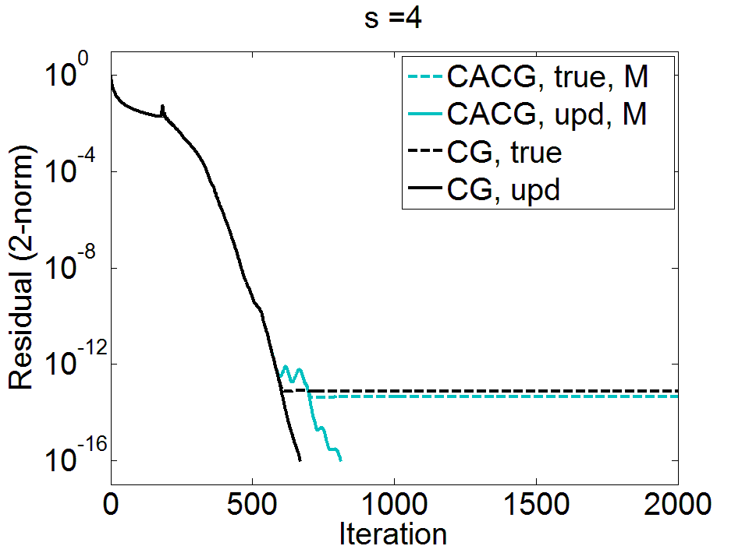
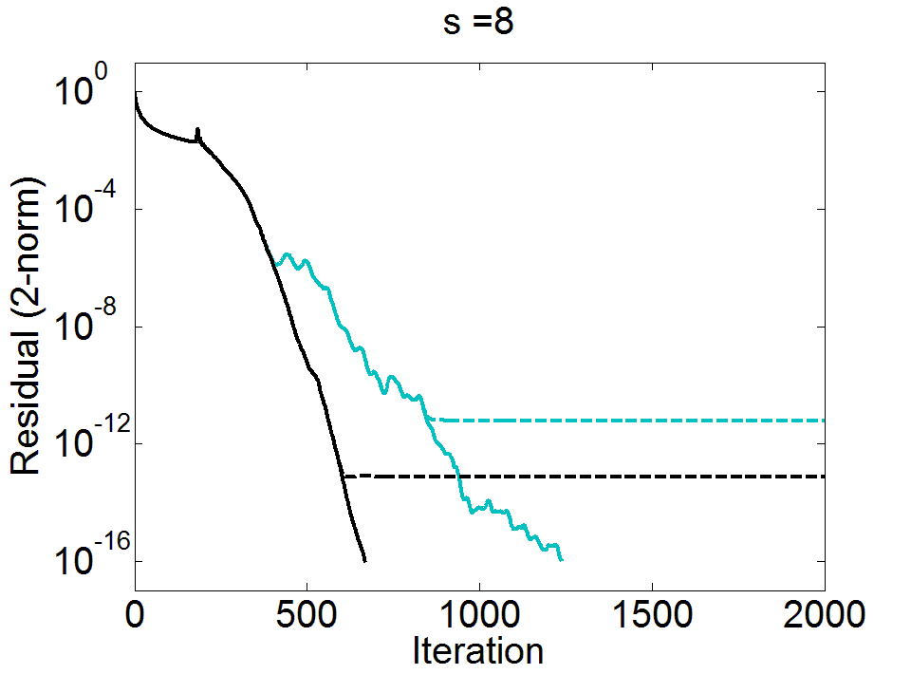
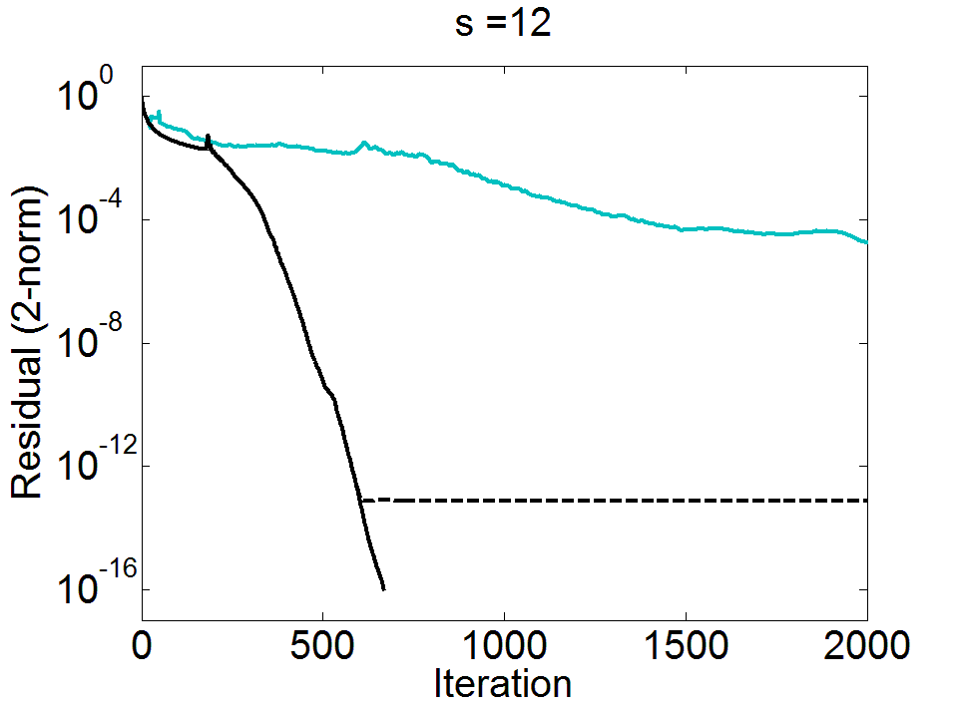
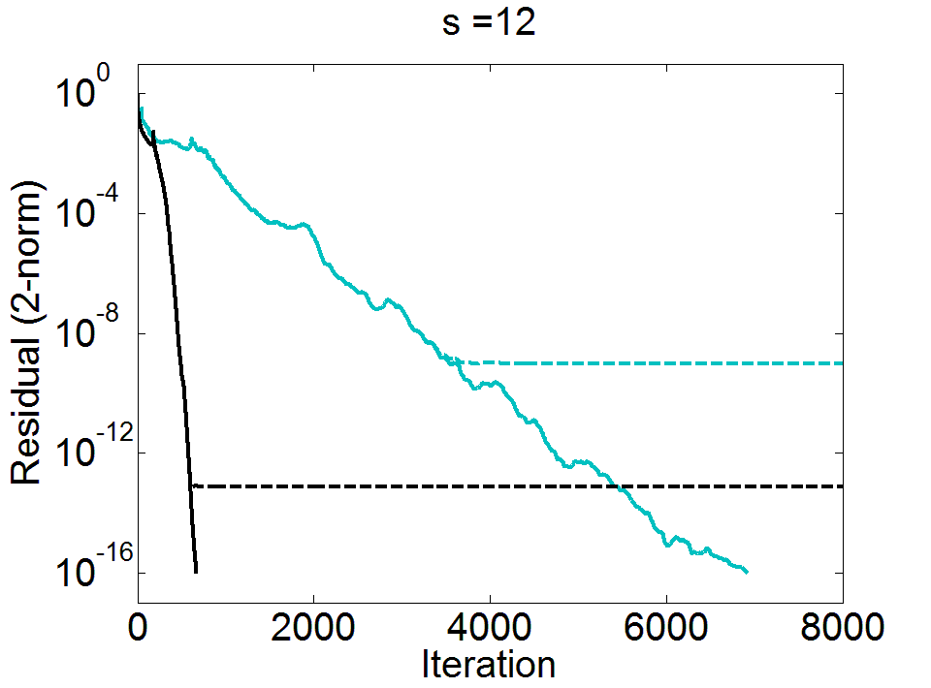
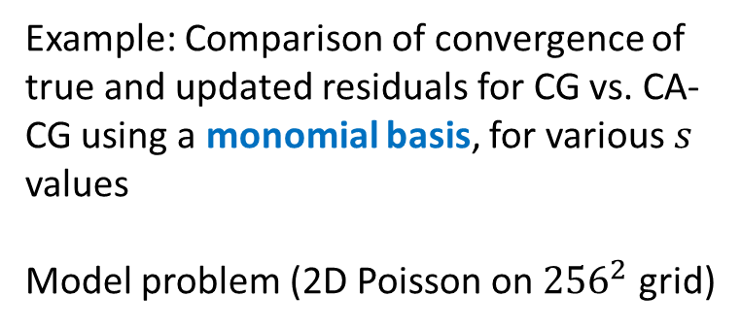
Example: Comparison of convergence of true and updated residuals for CG vs. CA-CG using a monomial basis, for various $s$ values
Model problem (2D Poisson on ${256}^{2}$ grid)

Slide 18
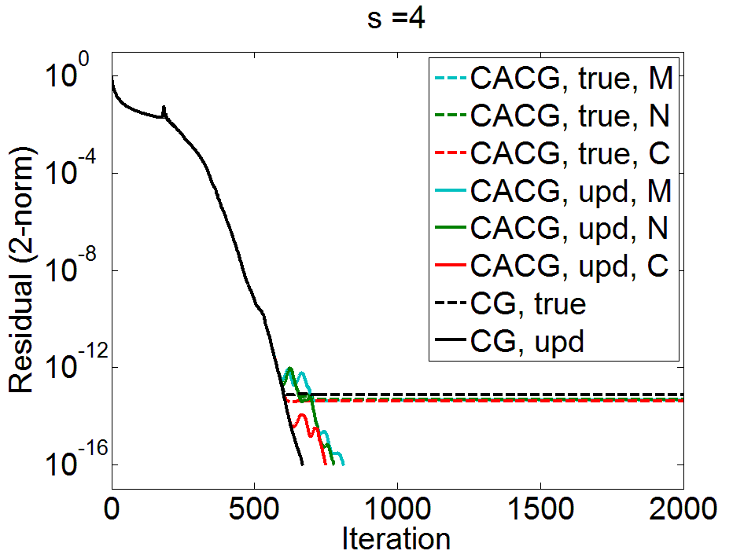
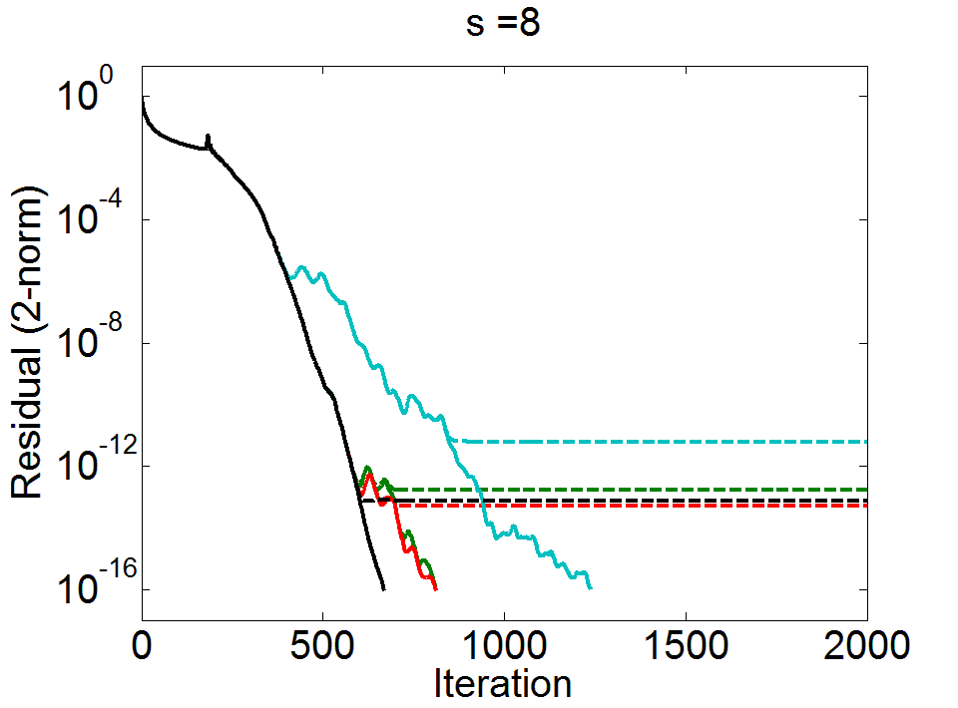
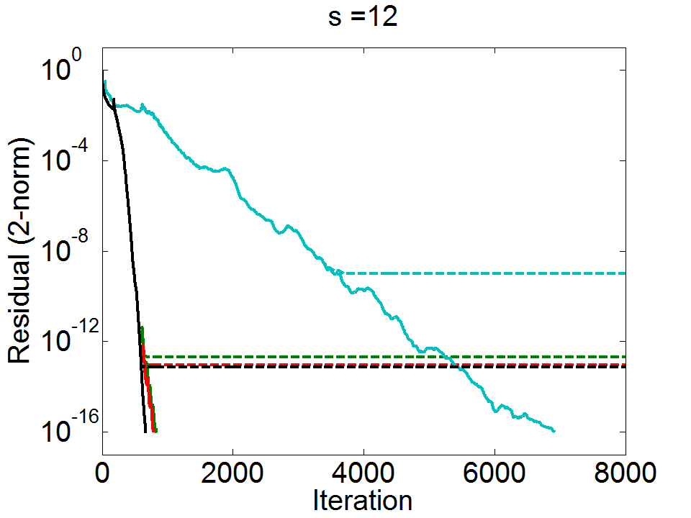
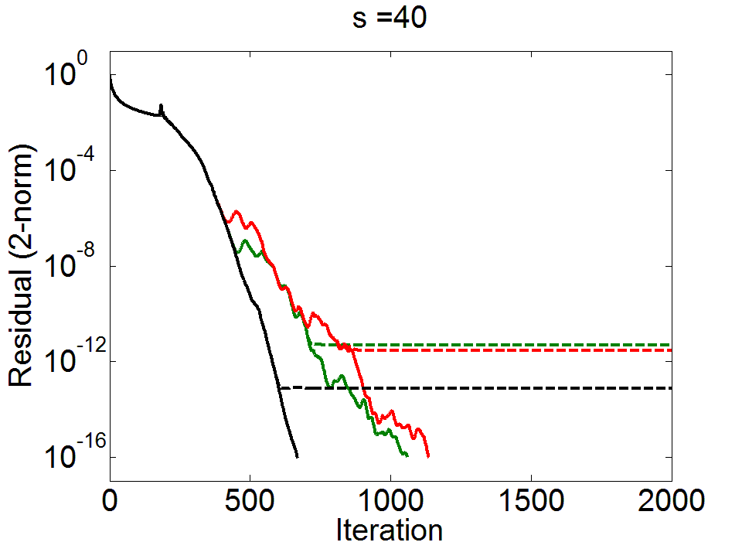
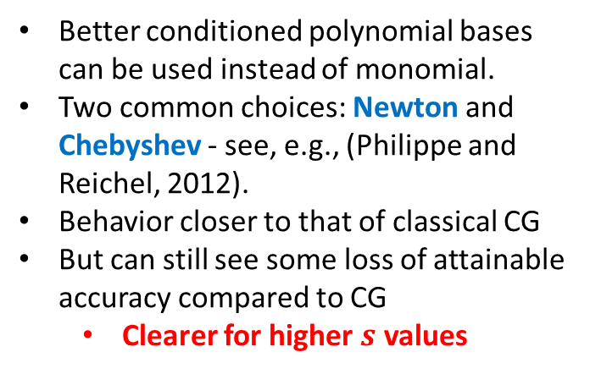
Better conditioned polynomial bases can be used instead of monomial.
Two common choices: Newton and Chebyshev - see, e.g., (Philippe and Reichel, 2012).
Behavior closer to that of classical CG
But can still see some loss of attainable accuracy compared to CG
  Clearer for higher $s$ values

Slide 19
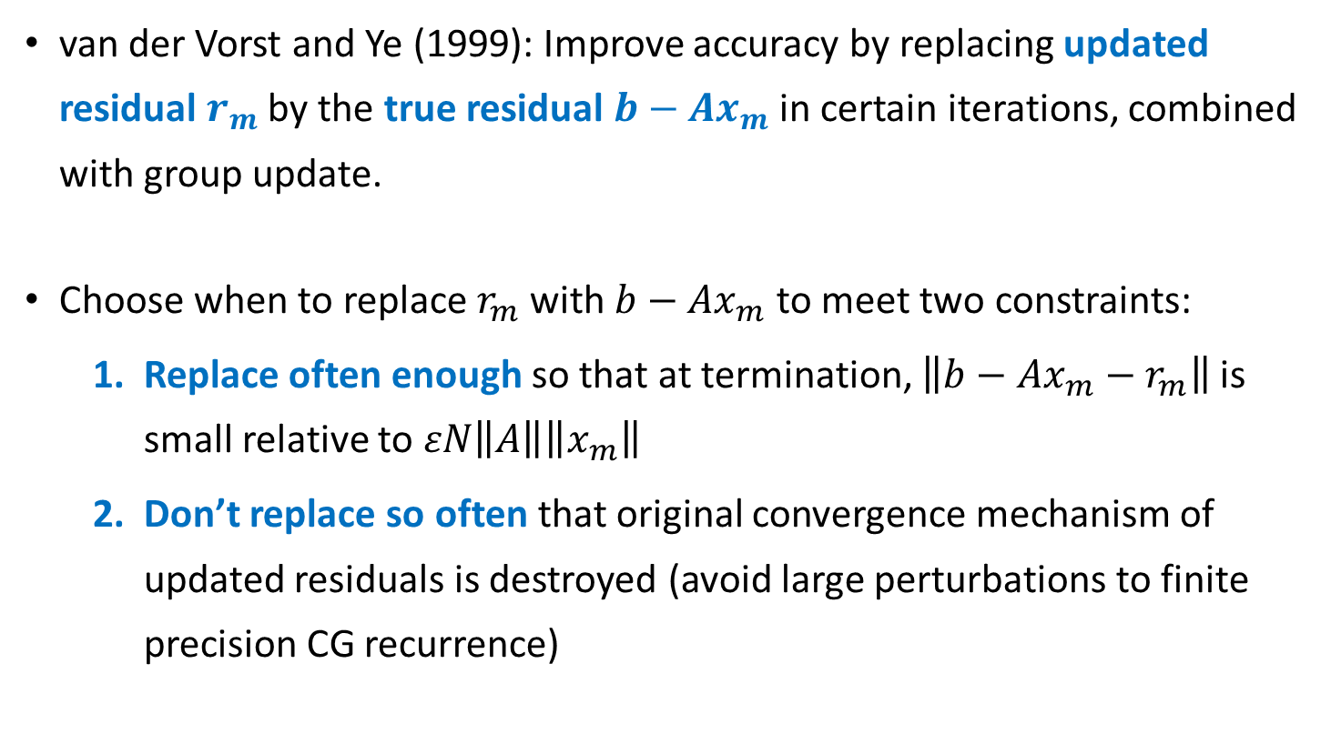
Residual replacement strategy for CG
van der Vorst and Ye (1999): Improve accuracy by replacing updated residual $r_{m}$ by the true residual $b−Ax_{m}$ in certain iterations, combined with group update.
Choose when to replace $r_{m}$ with $b−Ax_{m}$ to meet two constraints:
  Replace often enough so that at termination, $\left\|b−Ax_{m}−r_{m}\right\|$ is small relative to $εN\left\|A\right\|\left\|x_{m}\right\|$
  Don’t replace so often that original convergence mechanism of updated residuals is destroyed (avoid large perturbations to finite precision CG recurrence)

Slide 20
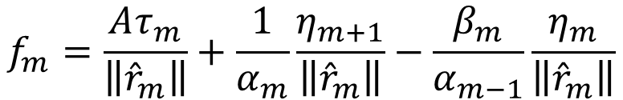
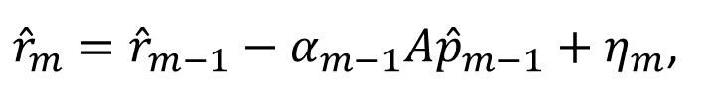
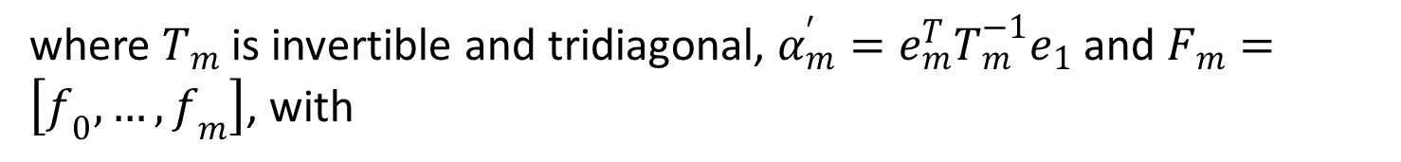




Residual replacement condition for CG
Tong and Ye (2000): In finite precision classical CG, in iteration $n$, the computed residual and search direction vectors satisfy
${\hat{r}}_{m}={\hat{r}}_{m−1}−α_{m−1}A{\hat{p}}_{m−1}+η_{m}$,
$${\hat{p}}_{m}={\hat{r}}_{m}+β_{m}{\hat{p}}_{m−1}+τ_{m}$$
Then in matrix form,
$$AZ_{m}=Z_{m}T_{m}−\frac{1}{α_{m}^{′}}\frac{{\hat{r}}_{m+1}}{\left\|{\hat{r}}_{0}\right\|}e_{m+1}^{T}+F_{m}$$
$$Z_{m}=\left[\frac{{\hat{r}}_{0}}{\left\|{\hat{r}}_{0}\right\|},…,\frac{{\hat{r}}_{m}}{\left\|{\hat{r}}_{m}\right\|}\right]$$
with
where $T_{m}$ is invertible and tridiagonal, $α_{m}^{′}=e_{m}^{T}T_{m}^{−1}e_{1}$ and $F_{m}=\left[f_{0},…,f_{m}\right]$, with
$$f_{m}=\frac{Aτ_{m}}{\left\|{\hat{r}}_{m}\right\|}+\frac{1}{α_{m}}\frac{η_{m+1}}{\left\|{\hat{r}}_{m}\right\|}−\frac{β_{m}}{α_{m−1}}\frac{η_{m}}{\left\|{\hat{r}}_{m}\right\|}$$

Slide 21

Residual replacement condition for CG
Tong and Ye (2000): If sequence ${\hat{r}}_{m}$ satisfies
$AZ_{m}=Z_{m}T_{m}−\frac{1}{α_{m}^{′}}\frac{{\hat{r}}_{m+1}}{\left\|{\hat{r}}_{0}\right\|}e_{m+1}^{T}+F_{m}$, $f_{m}=\frac{Aτ_{m}}{\left\|{\hat{r}}_{m}\right\|}+\frac{1}{α_{m}}\frac{η_{m+1}}{\left\|{\hat{r}}_{m}\right\|}−\frac{β_{m}}{α_{m−1}}\frac{η_{m}}{\left\|{\hat{r}}_{m}\right\|}$
then
$$\left\|{\hat{r}}_{m+1}\right\|≤\left(1+𝒦_{m}\right)\min_{ρ∈𝒫_{m},ρ\left(0\right)=1}{‖ρ\left(A+ΔA_{m}\right) {\hat{r}}_{1}‖}$$
where $𝒦_{m}=\left\|\left(AZ_{m}−F_{m}\right)T_{m}^{−1}\right\|‖Z_{m+1}^{+}‖$ and $ΔA_{m}=−F_{m}Z_{m}^{+}$.
As long as ${\hat{r}}_{m}$ satisfies recurrence, bound on its norm holds regardless of how it is generated
Can replace ${\hat{r}}_{m}$ by $fl(b−Ax_{m})$ and still expect convergence whenever
$η_{m}=fl\left(b−Ax_{m}\right)−{\hat{r}}_{m−1}−α_{m−1}A{\hat{p}}_{m−1}$
is not too large relative to $\left\|{\hat{r}}_{m}\right\|$ and $\left\|{\hat{r}}_{m−1}\right\|$ (van der Vorst & Ye, 1999).
Notes:
Even if perturbation $F_{m}$ is in magnitude much larger than $ε$, $‖r_{m+1}‖$ may not be significantly affected

Slide 22



Residual replacement strategy for CG
(van der Vorst and Ye, 1999): Use computable bound for $\left\|b−Ax_{m}−r_{m}\right\|$ to update $d_{m}$, an estimate of error $η_{m}$, in each iteration:
$d_{m}=d_{m−1}+ε\left(\left\|r_{m}\right\|+N\left\|A\right\|\left\|x_{m}\right\|\right)$,
Set threshold $\hat{ε}$, replace whenever $d_{m}/\left\|r_{m}\right\|$ reaches threshold
Pseudo-code for residual replacement with group update for CG:
if $d_{m−1}≤\hat{ε}\left\|r_{m−1}\right\| and { d}_{m}>\hat{ε}\left\|r_{m}\right\| and{ d}_{m}>1.1d_{init}$
$z=z+x_{m}$
$x_{m}=0$
$r_{m}=b−Az$
$d_{init}={ d}_{m}=ε\left(N\left\|A\right\|\left\|z\right\|+\left\|r_{m}\right\|\right)$
end
group update of approximate solution
set residual to true residual
Assuming a bound on condition number of $A$, if updated residual converges to $O(ε)\left\|A\right\|\left\|x\right\|$, true residual reduced to $O(ε)\left\|A\right\|\left\|x\right\|$

Slide 23


Sources of roundoff error in CA-CG
Computing the $s$-step Krylov basis:
$A{\underline{\hat{Y}}}_{k}={\hat{Y}}_{k}B_{k}+∆_{Y_{k}}$
Updating coordinate vectors in the inner loop:
${\hat{x}}_{k,j}^{′}={\hat{x}}_{k,j−1}^{′}+{\hat{q}}_{k,j−1}^{′}+ξ_{k,j}$
${\hat{r}}_{k,j}^{′}=r_{k,j−1}^{′}−B_{k} {\hat{q}}_{k,j−1}^{′}+η_{k,j}$
with ${\hat{q}}_{k,j−1}^{′}=\text{fl}({\hat{α}}_{sk+j−1}{\hat{p}}_{k,j−1}^{′})$
Recovering CG vectors for use in next outer loop:
${\hat{x}}_{sk+j}={\hat{Y}}_{k}{\hat{x}}_{k,j}^{′}+{\hat{x}}_{sk}+φ_{sk+j}$
${\hat{r}}_{sk+j}={\hat{Y}}_{k}{\hat{r}}_{k,j}^{′}+ψ_{sk+j}$
Error in computing $s$-step basis
Error in updating coefficient vectors
Error in
basis change

Slide 24


Maximum attainable accuracy of CA-CG
We can write the deviation of the true and updated residuals in terms of these errors:
$$b\text{−}A{\hat{x}}_{sk+j}\text{−}{\hat{r}}_{sk+j}=b\text{−}Ax_{0}\text{−}r_{0}$$
$$−\sum_{ℓ=0}^{k−1}{\left[Aφ_{sℓ+s}+ψ_{sℓ+s}+\sum_{i=1}^{s}{\left[{{A\hat{Y}}_{ℓ}ξ}_{ℓ,i}+{\hat{Y}}_{ℓ}η_{ℓ,i}−Δ_{Y_{ℓ}}{\hat{q}}_{ℓ,i−1}^{′}\right]}\right]}$$
$$−{Aφ}_{sk+j}−ψ_{sk+j}−\sum_{i=1}^{j}{\left[{{A\hat{Y}}_{k}ξ}_{k,i}+{\hat{Y}}_{k}η_{k,i}−Δ_{Y_{k}}{\hat{q}}_{k,i−1}^{′}\right]}$$
Using standard rounding error results, this allows us to obtain an upper bound on $\left\|b\text{−}A{\hat{x}}_{sk+j}\text{−}{\hat{r}}_{sk+j}\right\|$.
Notes:
This can easily be translated into a norm-wise upper bound using the corresponding upper bounds on the error terms.
We later show one possible way this bound can be used to improve accuracy
(a residual replacement strategy)

Slide 25




A computable bound
We extend van der Vorst and Ye’s residual replacement strategy to CA-CG
Making use of the bound for $\left\|b\text{−}A{\hat{x}}_{sk+j}\text{−}{\hat{r}}_{sk+j}\right\|$ in CA-CG, update error estimate $d_{sk+j}$ by:
Extra computation all lower order terms, communication increased by at most factor of 2.
$O(s^{3})$ flops per $s$ iterations; $≤$1 reduction per $s$ iterations
$O(n+s^{3})$ flops per $s$ iterations; no communication
Estimated only once
$d_{sk+j}≡d_{sk+j−1}$
$+ε\left[\left(4\text{+}N′\right)\left(\left\|A\right\| \left\|\left|{\hat{Y}}_{k}\right|\text{∙}\left|{\hat{x}}_{k,j}^{′}\right|\right\|+\left\|\left|{\hat{Y}}_{k}\right|\text{∙}\left|B_{k}\right|\text{∙}\left|{\hat{x}}_{k,j}^{′}\right|\right\|\right)+\left\|\left|{\hat{Y}}_{k}\right|\text{∙}\left|{\hat{r}}_{k,j}^{′}\right|\right\|\right]$
$+ε\left\{\begin{aligned}\left\|A\right\|\left\|{\hat{x}}_{sk+s}\right\|\text{+}\left(2\text{+}2N^{′}\right)\left\|A\right\|\left\|\left|{\hat{Y}}_{k}\right|\text{∙}\left|{\hat{x}}_{k,s}^{′}\right|\right\|\text{+}N^{′}\left\|\left|{\hat{Y}}_{k}\right|\text{∙}\left|{\hat{r}}_{k,s}^{′}\right|\right\|, \\ 0,\end{aligned}\right.$
$$j=s$$
otherwise
where $N^{′}=\max\left(N, 2s+1\right).$

Slide 26


Residual replacement for CA-CG
Use the same replacement condition as van der Vorst and Ye (1999):
$$d_{sk+j−1}≤\hat{ε}\left\|r_{sk+j−1}\right\| and { d}_{sk+j}>\hat{ε}\left\|r_{sk+j}\right\| and{ d}_{sk+j}>1.1d_{init}$$
(possible we could develop a better replacement condition based on perturbation in finite precision CA-CG recurrence)
Pseudo-code for residual replacement with group update for CA-CG:
if $d_{sk+j−1}≤\hat{ε}\left\|r_{sk+j−1}\right\| and { d}_{sk+j}>\hat{ε}\left\|r_{sk+j}\right\| and{ d}_{sk+j}>1.1d_{init}$
$z=z+Y_{k} x_{k,j}^{′}+x_{sk}$
$x_{sk+j}=0$
$r_{sk+j}=b−Az$
$d_{init}={ d}_{sk+j}=ε\left(\left(1+2N′\right)\left\|A\right\|\left\|z\right\|+\left\|r_{sk+j}\right\|\right)$
$p_{sk+j}=Y_{k}p_{k,j}^{′}$
break from inner loop and begin new outer loop
end
Notes:
where $\hat{ε}≈\sqrt{ε}$ is a tolerance parameter, and we initially set
$d_{init}=ε\left(N′\left\|A\right\|\left\|x_{0}\right\|+\left\|r_{0}\right\|\right)$.

Slide 28



Residual Replacement Indices
Total Number of Reductions
 | CACG Mono. | CACG Newt. | CACG Cheb. | CG
s=4 | 354 | 353 | 365 | 355
s=8 | 224, 334, 401, 517 | 340 | 353
s=12 | 135, 2119 | 326 | 346
 | CACG Mono. | CACG Newt. | CACG Cheb. | CG
s=4 | 203 | 196 | 197 | 669
s=8 | 157 | 102 | 99
s=12 | 557 | 68 | 71
# replacements small compared to total iterations → RR doesn’t significantly affect communication savings!
Can have both speed and accuracy!
In addition to attainable accuracy, convergence rate is incredibly important in practical implementations
Convergence rate depends on basis

Slide 29




consph8, FEM/Spheres (from UFSMC)
$n=8.3⋅{10}^{4}$, $nnz=6.0⋅{10}^{6}$, $κ\left(A\right)=9.7⋅{10}^{3}$, $\left\|A\right\|=9.7$
Before
After
# Replacements
Class. | 2
M | 12
N | 2
C | 2
$$s=8$$
# Replacements
Class. | 2
M | 0
N | 4
C | 3
$s=$12

Slide 30




xenon1, materials (from UFSMC)
$n=4.9⋅{10}^{4}$, $nnz=1.2⋅{10}^{6}$, $κ\left(A\right)=3.3⋅{10}^{4}$, $\left\|A\right\|=3.2$
Before
After
# Replacements
Class. | 2
M | 1
N | 1
C | 1
$$s=4$$
# Replacements
Class. | 2
M | 5
N | 2
C | 1
$$s=8$$

Slide 31

Preconditioning for CA-KSMs
Tradeoff: speed up convergence, but increase time per iteration due to communication!
  For each specific app, must evaluate tradeoff between preconditioner quality and sparsity of the system
Good news: many preconditioners allow communication-avoiding approach
    Block Jacobi – block diagonals
    Sparse Approx. Inverse (SAI) – same sparsity as $A$; recent work for CA-BICGSTAB by Mehri (2014)
    Polynomial preconditioning (Saad, 1985)
    HSS preconditioning for banded matrices (Hoemmen, 2010), (Knight, C., Demmel, 2014)
    CA-ILU(0) – recent work by Moufawad and Grigori (2013)
    Deflation for CA-CG (C., Knight, Demmel, 2014), based on Deflated CG of (Saad et al., 2000); for CA-GMRES (Yamazaki et al., 2014)

Slide 32







Deflated CA-CG, model problem
Monomial Basis,
$s=4$
Monomial Basis,
$s=8$
Monomial Basis,
$s=10$
Matrix: 2D Laplacian(512), $N=262,144$. Right hand side set such that true solution has entries $x_{i}=1/\sqrt{n}$. Deflated CG algorithm (DCG) from (Saad et al., 2000).

Slide 33





Eigenvalue problems: CA-Lanczos
Problem: 2D Poisson, $n=256$, $\left\|A\right\|=7.93$, with random starting vector
As $s$ increases, both convergence rate and accuracy to which we can find approximate eigenvalues within $n$ iterations decreases.
Notes:
Not counting duplicates

Slide 34




Eigenvalue problems: CA-Lanczos
Problem: 2D Poisson, $n=256$, $\left\|A\right\|=7.93$, with random starting vector
Improved by better-conditioned bases, but still see decreased convergence rate and accuracy as$s$grows.

Slide 35




Paige’s Lanczos convergence analysis
$$A{\hat{V}}_{m}={\hat{V}}_{m}{\hat{T}}_{m}+{\hat{β}}_{m+1}{\hat{v}}_{m+1}e_{m}^{T}+δ{\hat{V}}_{m}$$
${\hat{V}}_{m}=\left[{\hat{v}}_{1}, …, {\hat{v}}_{m}\right]$, ${δ\hat{V}}_{m}=\left[δ{\hat{v}}_{1}, …, δ{\hat{v}}_{m}\right]$, ${\hat{T}}_{m}=\left[\begin{matrix}{\hat{α}}_{1} & {\hat{β}}_{2} & & \\ {\hat{β}}_{2} & ⋱ & ⋱ & \\ & ⋱ & ⋱ & {\hat{β}}_{m} \\ & & {\hat{β}}_{m} & {\hat{α}}_{m} \end{matrix}\right]$
for $i∈\{1, …, m\}$,
${\left\|δ{\hat{v}}_{i}\right\|}_{2}≤ε_{1}σ$
${\hat{β}}_{i+1}\left|{\hat{v}}_{i}^{T}{\hat{v}}_{i+1 }\right|≤2ε_{0}σ$
$\left|{\hat{v}}_{i+1}^{T}{\hat{v}}_{i+1}−1 \right|≤{ε_{0}}/2$
$$\left|{\hat{β}}_{i+1 }^{2}+{\hat{α}}_{i}^{2}+{\hat{β}}_{i}^{2}− {\left\|A{\hat{v}}_{i}\right\|}_{2}^{2}\right|≤4i\left(3ε_{0}+ε_{1}\right)σ^{2}$$
Classic Lanczos rounding error result of Paige (1976):
where $σ≡{\left\|A\right\|}_{2}$, $θσ≡{\left\|\left|A\right|\right\|}_{2}$, $ε_{0}≡2ε\left(n+4\right)$, and $ε_{1}≡2ε\left(Nθ+7\right)$
$$ε_{0}=O\left(εn\right)$$
$$ε_{1}=O\left(εNθ\right)$$
→ These results form the basis for Paige’s influential results in (Paige, 1980).

Slide 36




CA-Lanczos convergence analysis
Let $Γ≡\max_{ℓ≤k}{ {\left\|Y_{ℓ}^{+}\right\|}_{2}∙{\left\|\left|Y_{ℓ}\right|\right\|}_{2}≤\left(2s\text{+}1\right)∙\max_{ℓ≤k} κ\left(Y_{ℓ}\right)}.$
for $i∈\{1, …, m\text{=}sk\text{+}j\}$,
${\left\|δ{\hat{v}}_{i}\right\|}_{2}≤ε_{1}σ$
${\hat{β}}_{i+1}\left|{\hat{v}}_{i}^{T}{\hat{v}}_{i+1 }\right|≤2ε_{0}σ$
$\left|{\hat{v}}_{i+1}^{T}{\hat{v}}_{i+1}−1 \right|≤{ε_{0}}/2$
$\left|{\hat{β}}_{i+1 }^{2}+{\hat{α}}_{i}^{2}+{\hat{β}}_{i}^{2}− {\left\|A{\hat{v}}_{i}\right\|}_{2}^{2}\right|≤4i\left(3ε_{0}+ε_{1}\right)σ^{2}$
For CA-Lanczos,
we have:
$$ε_{0}≡2ε\left(n\text{+}11s\text{+}15\right) Γ^{2}=O\left(εnΓ^{2}\right)\text{,}$$
$ε_{1}≡2ε\left(\left(\text{N}\text{+}2s\text{+}5\right)θ+\left(4s\text{+}9\right)τ\text{ + }10s\text{+}16\right)Γ=O\left(εNθΓ\right)$,
where $σ≡{\left\|A\right\|}_{2},$ $θσ≡{\left\|\left|A\right|\right\|}_{2}$, $τσ≡\max_{ℓ≤k}{{\left\|\left|B_{ℓ}\right|\right\|}_{2}}$
(vs. $O\left(εn\right)$ for Lanczos)
(vs. $O\left(εNθ\right)$ for Lanczos)

Slide 37

The amplification term
Our definition of amplification term before was
    $Γ≡\max_{ℓ≤k}{ {\left\|Y_{ℓ}^{+}\right\|}_{2}∙{\left\|\left|Y_{ℓ}\right|\right\|}_{2}≤\left(2s\text{+}1\right)∙\max_{ℓ≤k} κ\left(Y_{ℓ}\right)}$
where we want ${\left\|\left|Y\right||y′|\right\|}_{2}≤Γ{\left\|Yy′\right\|}_{2}$ to hold for the computed basis $Y$ and any coordinate vector $y′$ in every iteration.
Better, more descriptive estimate for $Γ$ updated possible w/tighter bounds; requires some light bookkeeping
Example: for bounds on ${\hat{β}}_{i+1}\left|{\hat{v}}_{i}^{T}{\hat{v}}_{i+1 }\right|$ and $\left|{\hat{v}}_{i+1}^{T}{\hat{v}}_{i+1}−1 \right|$, we can use the definition
$$Γ_{k,j}= \max_{x∈\{{\hat{w}}_{k,j}^{′}, {\hat{u}}_{k,j}^{′},{\hat{v}}_{k,j}^{′},{\hat{v}}_{k,j−1}^{′}\}}{\frac{{\left\|\left|{\hat{Y}}_{k}\right|\left|x\right|\right\|}_{2}}{{\left\|{\hat{Y}}_{k}x\right\|}_{2}}}$$

Slide 38




Local Rounding Errors, Classical Lanczos
$${\hat{β}}_{i+1}\left|{\hat{v}}_{i}^{T}{\hat{v}}_{i+1 }\right|$$
$$\left|{\hat{v}}_{i+1}^{T}{\hat{v}}_{i+1}−1 \right|$$
Measured value
Upper bound (Paige 1976)
Problem: 2D Poisson, $n=256$, $\left\|A\right\|=7.93$, with random starting vector

Slide 39



Local Rounding Errors, CA-Lanczos, monomial basis, $s=8$
$${\hat{β}}_{i+1}\left|{\hat{v}}_{i}^{T}{\hat{v}}_{i+1 }\right|$$
$$\left|{\hat{v}}_{i+1}^{T}{\hat{v}}_{i+1}−1 \right|$$
Measured value
Upper bound
$Γ$ value
Problem: 2D Poisson, $n=256$, $\left\|A\right\|=7.93$, with random starting vector

Slide 40


Local Rounding Errors, CA-Lanczos, Newton basis, $s=8$
$${\hat{β}}_{i+1}\left|{\hat{v}}_{i}^{T}{\hat{v}}_{i+1 }\right|$$
$$\left|{\hat{v}}_{i+1}^{T}{\hat{v}}_{i+1}−1 \right|$$
Measured value
Upper bound
$Γ$ value
Problem: 2D Poisson, $n=256$, $\left\|A\right\|=7.93$, with random starting vector

Slide 41


Local Rounding Errors, CA-Lanczos, Chebyshev basis, $s=8$
$${\hat{β}}_{i+1}\left|{\hat{v}}_{i}^{T}{\hat{v}}_{i+1 }\right|$$
$$\left|{\hat{v}}_{i+1}^{T}{\hat{v}}_{i+1}−1 \right|$$
Measured value
Upper bound
$Γ$ value
Problem: 2D Poisson, $n=256$, $\left\|A\right\|=7.93$, with random starting vector

Slide 42

Paige’s results for classical Lanczos
Using bounds on local rounding errors in Lanczos, Paige showed that
  The computed Ritz values always lie between the extreme eigenvalues of $A$ to within a small multiple of machine precision.
  At least one small interval containing an eigenvalue of $A$ is found by the $n$th iteration.
  The algorithm behaves numerically like Lanczos with full reorthogonalization until a very close eigenvalue approximation is found.
  The loss of orthogonality among basis vectors follows a rigorous pattern and implies that some Ritz values have converged.
Do the same statements hold for CA-Lanczos?

Slide 43

Results for CA-Lanczos
…but
The answer is YES!
Only if:
  $Y_{ℓ}$ is numerically full rank for $0≤ℓ≤k$ and
  $ε_{0}≡2ε\left(n\text{+}11s\text{+}15\right) Γ^{2}≤\frac{1}{12}$
    i.e., $Γ^{2}≤{\left(24ε\left(n+11s+15\right)\right)}^{−1}$
  Otherwise, e.g., can lose orthogonality due to computation with rank-deficient basis
How can we use this bound on $Γ$ to design a better algorithm?

Slide 44

Ideas based on CA-Lanczos analysis
Explicit basis orthogonalization
  Compute TSQR on $Y_{k}$ in outer loop, use$Q$ factor as basis
  Get $Γ=1$ for only one reduction
Dynamically changing basis size
  Run incremental condition estimate when computing $s$-step basis; stop when $Γ^{2}≤{\left(24ε\left(n+11s′+15\right)\right)}^{−1}$ is reached. Use this basis of size $s^{′}≤s$ in this outer loop.
Mixed precision
  For inner products, use precision $ε^{(0)}$ such that
  $$ε^{(0)}≤{\left(24Γ^{2}\left(n+11s+15\right)\right)}^{−1}$$
  For SpMVs, use precision $ε^{(1)}$ such that
  $$ε^{(1)}≤{\left(4Γ\left(\text{N}\text{+}2s\text{+}5\right)θ+\left(4s\text{+}9\right)τ\text{ + }10s\text{+}16\right)}^{−1}$$

Slide 45
Summary
For high performance iterative methods, both time per iteration and number of iterations required are important.
CA-KSMs offer asymptotic reductions in time per iteration, but can have the effect of increasing number of iterations required (or causing instability)
For CA-KSMs to be practical, must better understand finite precision behavior (theoretically and empirically), and develop ways to improve the methods
  Ongoing efforts in: finite precision convergence analysis for CA-KSMs, selective use of extended precision, development of CA preconditioners, other new techniques.

Slide 46
Thank you! contact: erin@cs.berkeley.edu http://www.cs.berkeley.edu/~ecc2z/

