Slide 1
MS76: Communication-Avoiding Algorithms - Part I of II
4:00-4:25 Communication-Avoiding Algorithms: Challenges and New Results
Erin C. Carson
4:30-4:55 Communication-Optimal Loop Nests
Nicholas Knight
5:00-5:25 Communication Lower Bounds for Matricized-Tensor Times Khatri-Rao Product
Grey Ballard, Nicholas Knight, Kathryn Rouse
5:30-5:55 Matrix Multiplication, a Little Faster
Oded Schwartz and Elaye E. Karstadt

Slide 2
MS93: Communication-Avoiding Algorithms - Part II of II
Friday, July 14, 4:00 PM - 6:00 PM, Spirit of Pittsburgh B
4:00-4:25 Communication-Avoiding Primal and Dual Methods for Regularized Least-Squares
Aditya Devarakonda, Kimon Fountoulakis, James Demmel, and Michael Mahoney
4:30-4:55 Communication-Avoiding Sparse Inverse Covariance Matrix Estimation
Penporn Koanantakool, Sang-Yun Oh, Dmitriy Morozov, Aydin Buluc, and Leonid Oliker, Katherine Yelick
5:00-5:25 Black-box Communication Optimal Low Rank Approximations
Alan Ayala, Laura Grigori
  5:30-5:55 Performance of S-step and Pipelined Krylov Methods
  Ichitaro Yamazaki, Mark Hoemmen, Jack J. Dongarra, Piotr Luszczek

Slide 3
Communication-Avoiding Algorithms:
Challenges and New Results
Erin Carson
New York University
SIAM Annual Meeting 2017
Pittsburgh, PA, USA

Slide 4
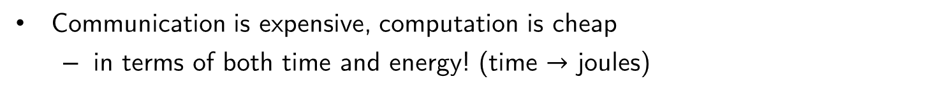
What is communication?
Runtime of an algorithm is the sum of
  #flops x (time/flop)
  #words moved x (1/bandwidth)
  #messages x latency
computation
communication
Sequential
Parallel
CPU Cache
CPU DRAM
CPU DRAM
DRAM
CPU DRAM
CPU DRAM
Communication is expensive, computation is cheap
  in terms of both time and energy! (time $→$ joules)
Notes:
“Also, data movement will cost more than flops (even on the chip). Limited amounts of memory and low memory/flop ratios will make processing virtually free. In fact, the amount of memory is relatively decreasing, scaling far worse than computation. This is a challenge that’s not being addressed and it’s not going to get less expensive by 2018.”
-Horst Simon, Interview with HPCWire, May 15, 2013

Slide 5
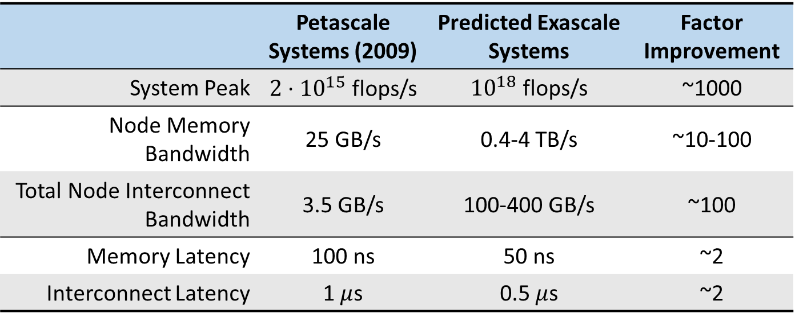
Future exascale systems
 | Petascale Systems (2009) | Predicted Exascale Systems | Factor Improvement
System Peak | $2⋅{10}^{15}$ flops/s | ${10}^{18}$ flops/s | ~1000
Node Memory Bandwidth | 25 GB/s | 0.4-4 TB/s | ~10-100
Total Node Interconnect Bandwidth | 3.5 GB/s | 100-400 GB/s | ~100
Memory Latency | 100 ns | 50 ns | ~2
Interconnect Latency | 1 $μ$s | 0.5 $μ$s | ~2
*Sources: from P. Beckman (ANL), J. Shalf (LBL), and D. Unat (LBL)
Gaps between communication/computation cost only growing larger in future systems
Avoiding communication will be essential for applications at exascale!

Slide 6
Motivation for CA Algorithms
This problem will not be solved (in the foreseeable future) in hardware
Needs to be addressed higher in the computing stack - at the algorithm level
A paradigm shift in the way the numerical algorithms are designed is required
  We can't only think about computational complexity, we must also think about communication complexity
Communication-avoiding algorithms:
  Minimize communication volume (total words moved)
  Minimize number of messages
  Minimize over multiple levels of memory/parallelism
  Allow redundant computations

Slide 7
Work in CA algorithms
For numerical linear algebra computations…
  Prove lower bounds on communication cost
  Design new (stable) algorithms that attain these lower bounds
  Implement algorithms on various machines, for various applications

Slide 8
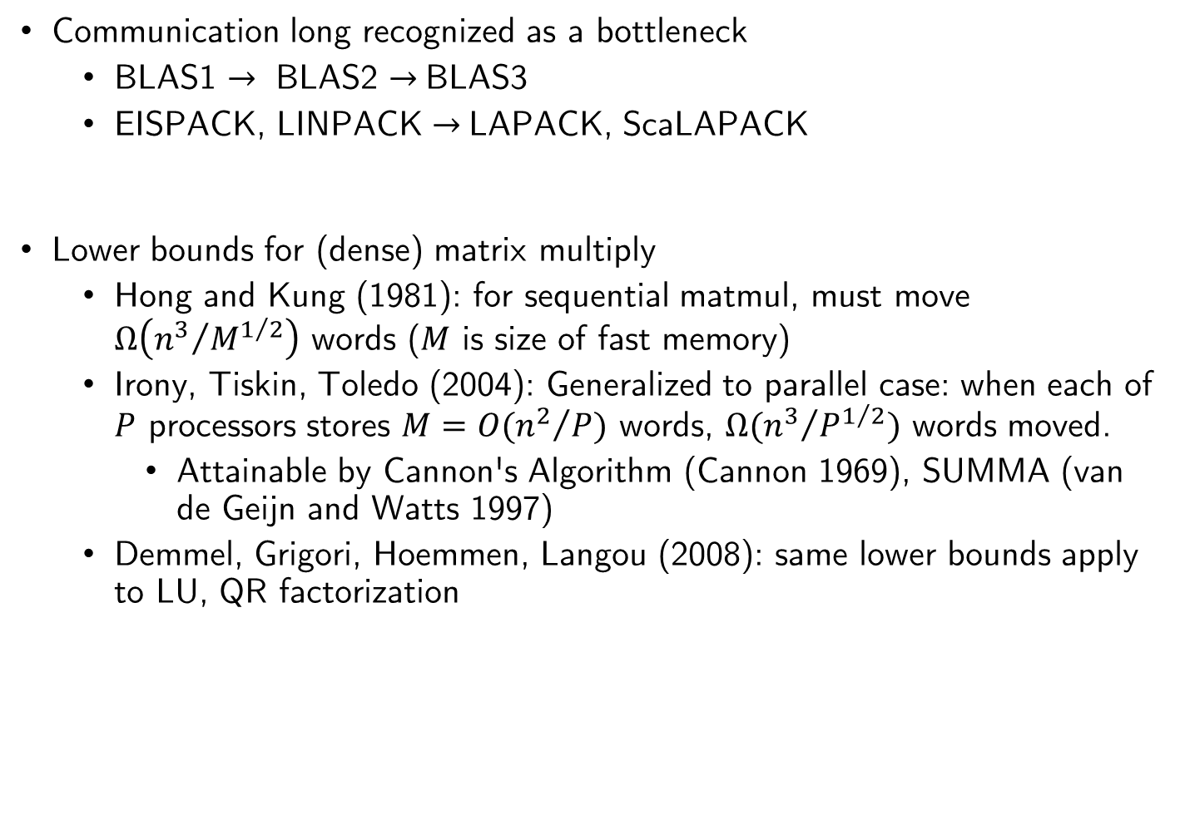
Brief History: Dense Linear Algebra
Communication long recognized as a bottleneck
  BLAS1 $→$ BLAS2 $→$BLAS3
  EISPACK, LINPACK $→$LAPACK, ScaLAPACK
Lower bounds for (dense) matrix multiply
  Hong and Kung (1981): for sequential matmul, must move $Ω\left({n^{3}}/{M^{1/2}}\right)$ words ($M$ is size of fast memory)
  Irony, Tiskin, Toledo (2004): Generalized to parallel case: when each of $P$ processors stores $M=O({n^{2}}/P)$ words, $Ω({n^{3}}/{P^{1/2}})$ words moved.
    Attainable by Cannon's Algorithm (Cannon 1969), SUMMA (van de Geijn and Watts 1997)
  Demmel, Grigori, Hoemmen, Langou (2008): same lower bounds apply to LU, QR factorization

Slide 9
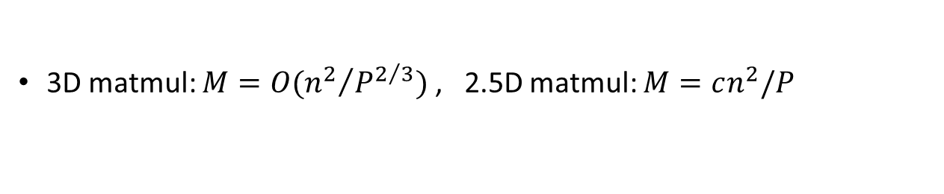
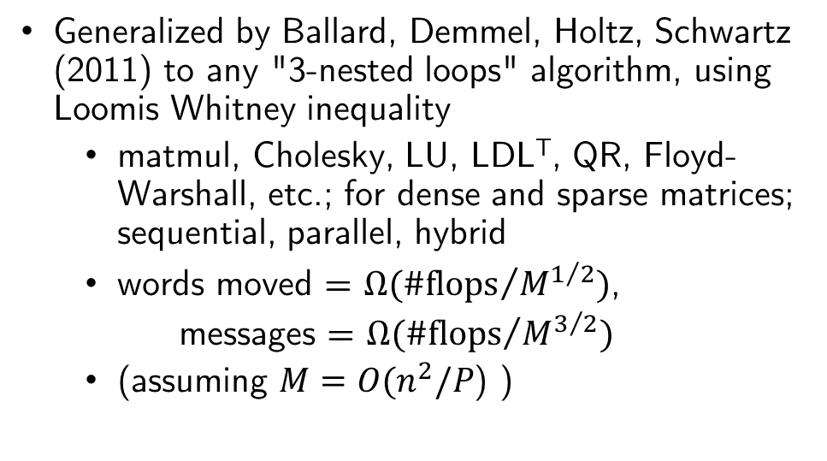
Generalization: 3 nested loops
Generalized by Ballard, Demmel, Holtz, Schwartz (2011) to any "3-nested loops" algorithm, using Loomis Whitney inequality
  matmul, Cholesky, LU, LDL^{T}, QR, Floyd-Warshall, etc.; for dense and sparse matrices; sequential, parallel, hybrid
  words moved = $Ω({\#\text{flops}}/{M^{1/2}})$,
  messages = $Ω({\#\text{flops}}/{M^{3/2}})$
  (assuming $M=O(n^{2}/P$) )
x
y
z
z
y
x
Algorithm | Minimizes # words moved | Minimizes # words moved and # messages
Cholesky | ScaLAPACK | ScaLAPACK
LU | ScaLAPACK | CALU (Grigori, Demmel, Xiang, 2008), (Khabou, Demmel, Grigori, Gu, 2012)
QR | ScaLAPACK | CAQR (Demmel, Grigori, Hoemmen, Langou, 2008), (Ballard et al., 2014)
  3D matmul: $M=O({n^{2}}/{P^{2/3}})$ , 2.5D matmul: $M=cn^{2}/P$

Slide 10



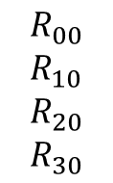
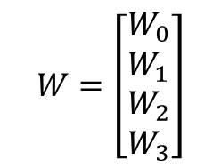
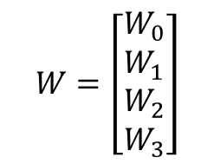

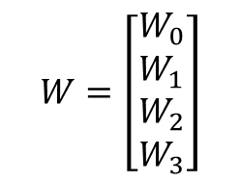









Tall-Skinny QR
TSQR: QR factorization of a tall skinny matrix using Householder transformations
QR decomposition of m x b matrix W, m >> b
  P processors, block row layout
Classic Parallel Algorithm
  Compute Householder vector for each column
  Number of messages ∝ b log P
Communication Avoiding Algorithm
  Reduction operation, with QR as operator
  Number of messages ∝ log P
Parallel
$$W=\left[\begin{matrix}W_{0} \\ W_{1} \\ W_{2} \\ W_{3}\end{matrix}\right]$$
$$\begin{matrix}R_{00} \\ R_{10} \\ R_{20} \\ R_{30}\end{matrix}$$
$$R_{01}$$
$$R_{02}$$
$$R_{11}$$
Sequential
$$W=\left[\begin{matrix}W_{0} \\ W_{1} \\ W_{2} \\ W_{3}\end{matrix}\right]$$
$$R_{00}$$
$$R_{01}$$
$$R_{02}$$
$$R_{03}$$
Dual Core
$$W=\left[\begin{matrix}W_{0} \\ W_{1} \\ W_{2} \\ W_{3}\end{matrix}\right]$$
$$\begin{matrix}R_{00} \\ R_{01}\end{matrix}$$
$$R_{01}$$
$$R_{02}$$
$$R_{11}$$
$$R_{03}$$
$$R_{11}$$

Slide 11
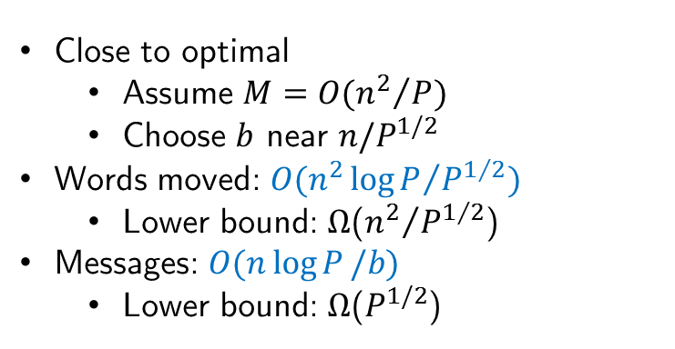
CAQR
Demmel, Grigori, Hoemmen, Langou (2008)
TSQR on panels
Performing trailing matrix update is complicated - Q factor represented implicitly
  Can reconstruct Householder vectors from Tall-Skinny QR (TSQR-HR) (Ballard, Demmel, Grigori, Jacquelin, Knight, Nyugen, 2015)
Close to optimal
    Assume $M=O({n^{2}}/P)$
    Choose $b$ near $n/P^{1/2}$
  Words moved: $O({n^{2}\log{P}}/{P^{1/2}})$
      Lower bound: $Ω$(${n^{2}}/{P^{1/2}}$)
  Messages: $O(n\log{P}/b)$
      Lower bound: $Ω$($P^{1/2}$)
step 0
step 1
step 2
As stable as Householder QR
TSQR/CAQR implemented in
Intel MKL library
GNU Scientific Library
ScaLAPACK
Spark for data mining
Recent work (Ayala, Claeys, Grigori)
Talk tomorrow in Part II (MS93)
Comm.-optimal low-rank approximation of matrices arising from boundary element problems
Uses CAQR factorization

Slide 12
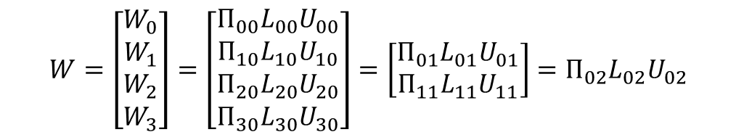
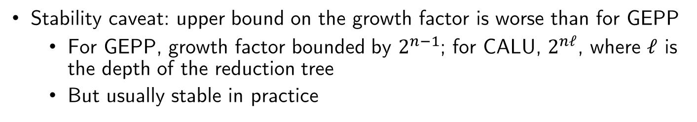

Tall-Skinny LU
Similar idea as in TSQR; uses tournament pivoting
Step 1: preprocessing: select a set of b good pivot rows
  Reduction operation with GEPP being the operator used to select pivot rows at each node of the reduction tree
  Like in TSQR, shape of reduction tree depends on underlying architecture
Step 2: permute the b pivot rows into the first b positions in the panel; perform LU factorization with no pivoting
$$W=\left[\begin{matrix}W_{0} \\ W_{1} \\ W_{2} \\ W_{3}\end{matrix}\right]=\left[\begin{matrix}Π_{00}L_{00}U_{00} \\ Π_{10}L_{10}U_{10} \\ Π_{20}L_{20}U_{20} \\ Π_{30}L_{30}U_{30}\end{matrix}\right]=\left[\begin{matrix}Π_{01}L_{01}U_{01} \\ Π_{11}L_{11}U_{11}\end{matrix}\right]=Π_{02}L_{02}U_{02}$$
$$Π_{2}^{T}Π_{1}^{T}Π_{0}^{T}W=LU$$
Stability caveat: upper bound on the growth factor is worse than for GEPP
  For GEPP, growth factor bounded by $2^{n−1}$; for CALU, $2^{nℓ}$, where $ℓ$ is the depth of the reduction tree
  But usually stable in practice

Slide 13
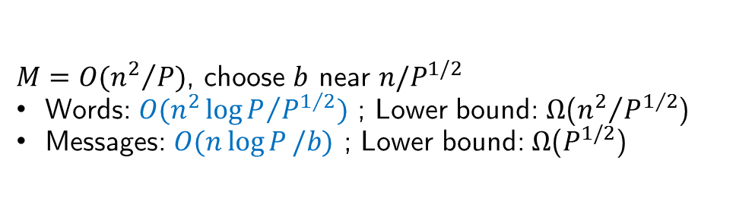
CALU
(Grigori, Demmel, Xiang, 2008), (Khabou, Demmel, Grigori, Gu, 2012)
Assume 2D grid of P processors, using a 2D block cyclic layout with square blocks of size b
  For ib = 1 to n-1 step b
    1. Find permutation for current panel using TSLU
    2. Apply all row permutations (pdlaswp)
    - broadcast pivot information along the rows of the grid
    3. Compute panel factorization (dtrsm)
    4. Compute block row of U (pdtrsm)
    - broadcast right diagonal part of L of current panel
    5. Update trailing matrix (pdgemm)
    - broadcast right block column of L
    - broadcast down block row of U
  $M=O({n^{2}}/P)$, choose $b$ near $n/P^{1/2}$
  Words: $O({n^{2}\log{P}}/{P^{1/2}})$ ; Lower bound: $Ω$(${n^{2}}/{P^{1/2}}$)
  Messages: $O(n\log{P}/b)$ ; Lower bound: $Ω$($P^{1/2}$)
CALU implemented in
Cray’s libsci
To be implemented in LAPACK/ScaLAPACK

Slide 14
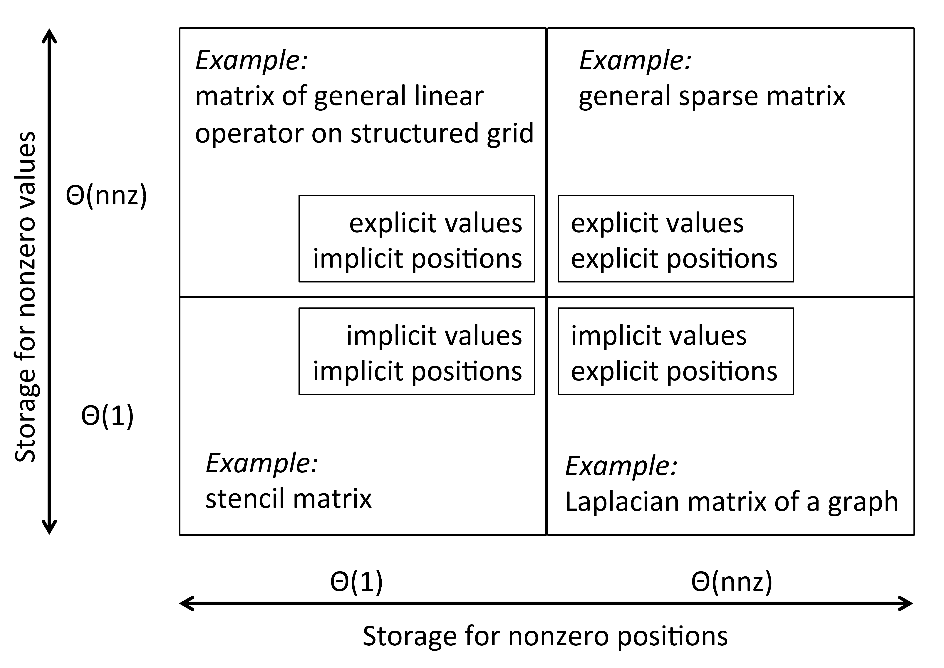
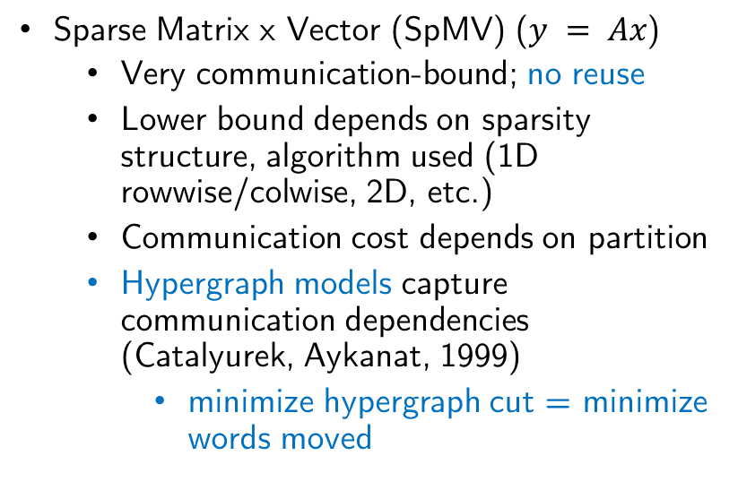
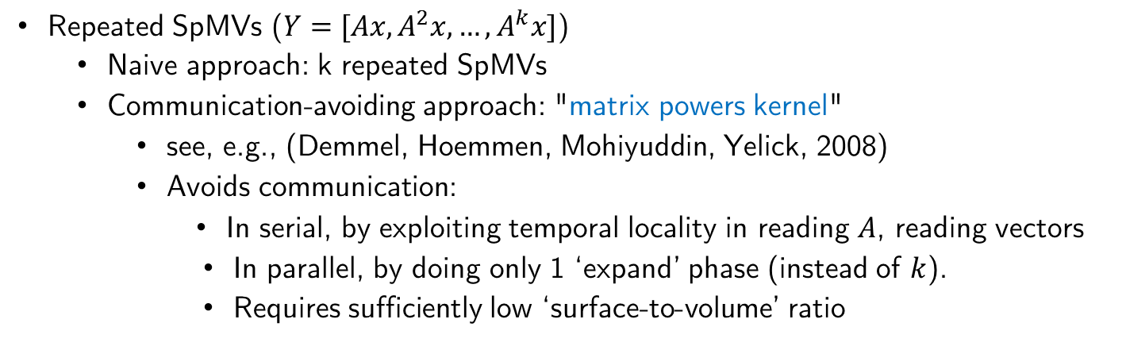
Sparse Matrix Computations
Sparse Matrix x Vector (SpMV) ($y = Ax$)
  Very communication-bound; no reuse
  Lower bound depends on sparsity structure, algorithm used (1D rowwise/colwise, 2D, etc.)
  Communication cost depends on partition
  Hypergraph models capture communication dependencies (Catalyurek, Aykanat, 1999)
    minimize hypergraph cut = minimize words moved
Repeated SpMVs ($Y=[Ax,A^{2}x,…,A^{k}x]$)
  Naive approach: k repeated SpMVs
  Communication-avoiding approach: "matrix powers kernel"
    see, e.g., (Demmel, Hoemmen, Mohiyuddin, Yelick, 2008)
    Avoids communication:
      In serial, by exploiting temporal locality in reading $A$, reading vectors
      In parallel, by doing only 1 ‘expand’ phase (instead of $k$).
      Requires sufficiently low ‘surface-to-volume’ ratio

Slide 15
Parallel Matrix Powers Kernel
Example: tridiagonal matrix, s = 3, n = 40, p = 4
Naïve algorithm:
s messages per neighbor
Matrix powers optimization:
1 message per neighbor

Slide 16
Sparse Matrix Computations
Sparse matrix x sparse matrix
  (Ballard, Druinsky, Knight, Schwartz, 2016)
  Fine-grained and coarse-grained hypergraph models for sparse matrix-matrix multiplication
  Identifying a communication-optimal algorithm for particular input matrices is equivalent to solving a hypergraph partitioning problem
Sparse matrix x dense matrix
  Building block of an increasing number of applications in many areas such as machine learning and graph algorithms
  (Koanantakool, Azad, Buluc, Morozov, Oh, Oliker, Yelick, 2016)
  Communication lower bounds
  New communication-avoiding algorithms based on 1.5D decomposition
    Outperform 2D and 3D variants in both theory and practice

Slide 17
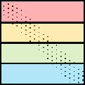
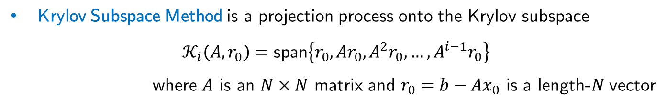
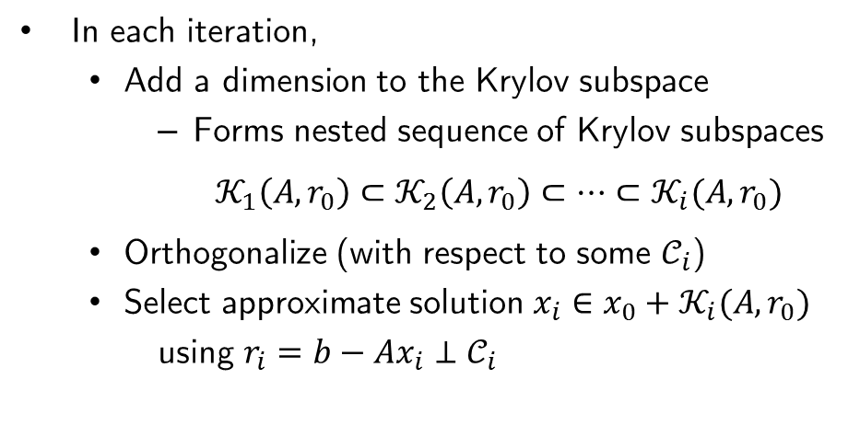


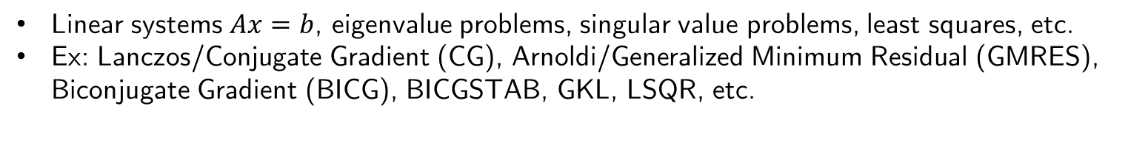
Krylov subspace methods
Krylov Subspace Method is a projection process onto the Krylov subspace
$𝒦_{i}\left(A,r_{0}\right)=\text{span}\left\{r_{0}, Ar_{0}, A^{2}r_{0}, …, A^{i−1}r_{0}\right\}$
  where $A$ is an $N×N$ matrix and $r_{0}=b−Ax_{0}$ is a length-$N$ vector
Linear systems $Ax=b$, eigenvalue problems, singular value problems, least squares, etc.
Ex: Lanczos/Conjugate Gradient (CG), Arnoldi/Generalized Minimum Residual (GMRES), Biconjugate Gradient (BICG), BICGSTAB, GKL, LSQR, etc.
In each iteration,
    Add a dimension to the Krylov subspace
      Forms nested sequence of Krylov subspaces
    $𝒦_{1}\left(A,r_{0}\right)⊂𝒦_{2}\left(A,r_{0}\right)⊂⋯⊂𝒦_{i}(A,r_{0})$
    Orthogonalize (with respect to some $𝒞_{i}$)
    Select approximate solution $x_{i}∈x_{0}+𝒦_{i}(A,r_{0})$
    using $r_{i}=b−Ax_{i}⊥𝒞_{i}$
$$×$$
$$×$$
SpMV
orthogonalize

Slide 18
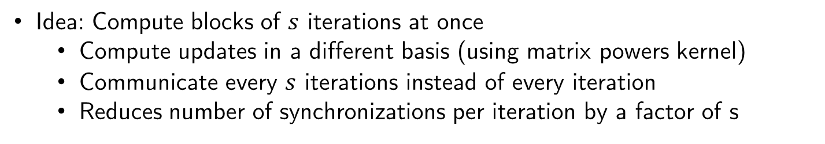
Communication-avoiding (s-step) KSMs
  Idea: Compute blocks of $s$ iterations at once
    Compute updates in a different basis (using matrix powers kernel)
    Communicate every $s$ iterations instead of every iteration
    Reduces number of synchronizations per iteration by a factor of s
An idea rediscovered many times…
First related work: s-dimensional steepest descent, least squares
  Khabaza (‘63), Forsythe (‘68), Marchuk and Kuznecov (‘68)
Flurry of work on s-step Krylov methods in ‘80s/early ‘90s: see, e.g., Van Rosendale (1983); Chronopoulos and Gear (1989)
Another approach: "pipelined" Krylov subspace methods
  Reduce the cost of synchronization by enabling overlapping of All-Reduces and other computations
Recent work (Yamazaki, Hoemmen, Dongarra, Luszczek)
Talk tomorrow in Part II (MS93)
Performance comparison of s-step and pipelined Krylov subspace methods
New approach that combines these two techniques
Notes:
4096 processes, each process is 6 way multithreaded
Hopper is a Cray XE6
Mention also many other approaches which give speedups, like pipelined Krylov methods

Slide 19

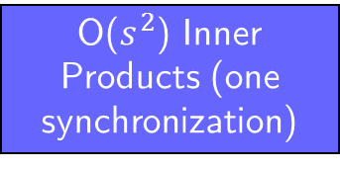
CA-CG (s-step CG)
$$r_{0}=b−Ax_{0}, p_{0}=r_{0}$$
for $k=0$:nmax/$s$
Compute $𝒴_{k}$ and $ℬ_{k}$ such that $A{\underline{𝒴}}_{k}=𝒴_{k}ℬ_{k}$ and
span($𝒴_{k}$) = $𝒦_{s+1}\left(A, p_{sk}\right)+𝒦_{s}\left(A, r_{sk}\right)$
$𝒢_{k}=𝒴_{k}^{T}𝒴_{k}$
${x_{0}^{′}=0, r}_{0}^{′}=e_{s+2}, p_{0}^{′}=e_{1}$
for $j=1:s$
$α_{sk+j−1}=\frac{r_{j−1}^{′T}𝒢_{k}r_{j−1}^{′}}{p_{j−1}^{′T}𝒢_{k}ℬ_{k}p_{j−1}^{′}}$
$x_{j}^{′}=x_{j−1}^{′}+α_{sk+j−1}p_{j−1}^{′}$
$r_{j}^{′}=r_{j−1}^{′ }−α_{sk+j−1}ℬ_{k}p_{j−1}^{′}$
$β_{sk+j}=\frac{r_{j}^{′T}𝒢_{k}r_{j}^{′}}{r_{j−1}^{′T}𝒢_{k}r_{j−1}^{′}}$
$p_{j}^{′}=r_{j}^{′}+β_{sk+j}p_{j−1}^{′}$
end
${[x}_{s\left(k+1\right)}−x_{sk}, r_{s\left(k+1\right)},p_{s\left(k+1\right)}]=𝒴_{k}[x_{s}^{′}, r_{s}^{′}, p_{s}^{′}]$
end
Outer Loop
Compute basis
(Matrix powers)
O($s^{2}$) Inner Products (one synchronization)
Inner Loop
Local Vector Updates (no comm.)
s times
End Inner Loop
Inner Outer Loop

Slide 20
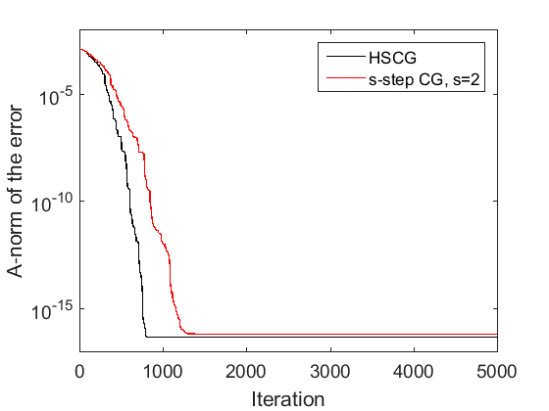
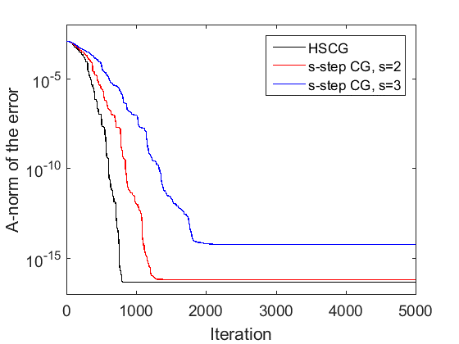
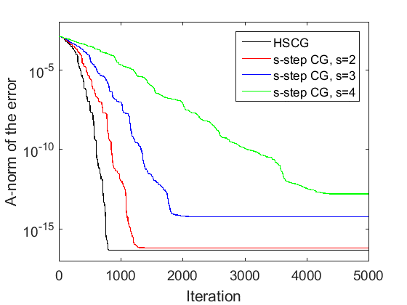
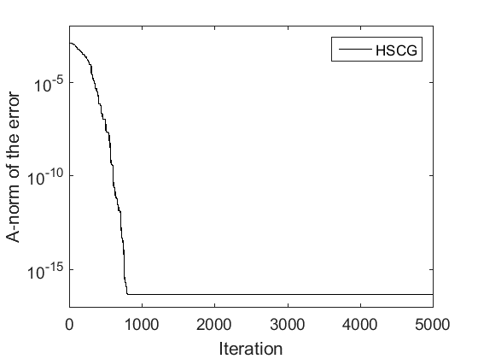
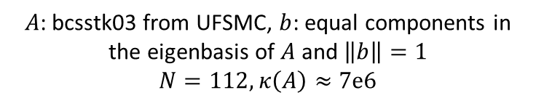
CA-CG (s-step CG)
s-step CA-CG with monomial basis ($𝒴=[p_{i},Ap_{i},…,A^{s}p_{i},r_{i},Ar_{i},…A^{s−1}r_{i}]$)
Changes to how the recurrences are computed can exacerbate finite precision effects of convergence delay and loss of accuracy!
$A$: bcsstk03 from UFSMC, $b$: equal components in the eigenbasis of $A$ and $\left\|b\right\|=1$
$$N=112, κ\left(A\right)≈7e6$$

Slide 21
Optimizing CA iterative solvers
CA variants are designed to reduce the time/iteration
But what we really want to minimize is the runtime, subject to some constraint on accuracy,
runtime = (time/iteration) x (# iterations)
Known that attainable accuracy and convergence rate in CA Krylov subspace methods depends on conditioning of the generated s-step bases
  (C. and Demmel, 2014), (C. and Demmel, 2015), (Philippe and Reichel, 2012)
Using finite precision analysis, can develop ways to improve numerical behavior while still avoiding communication in each iteration
  e.g., residual replacement (C. and Demmel, 2014), adaptive basis size (C. 2016)
To reduce communication, can also focus on reducing the number of iterations
  Preconditioning
    Challenging to implement in a CA way, but sometimes possible, e.g., ILU (Grigori, Moufawad, 2015), SPAI (Dehnavi, Demmel, Fernández, 2014), DD (Yamazaki, Rajamanickam, Boman, Hoemmen, Heroux, Tomov, 2014)
  Enlarged basis methods (Grigori, Moufawad, Nataf, 2016), (Al Daas, Grigori, Hénon, Ricoux, 2017)
Notes:
shown for both pipelined and s-step methods that can attain faster time/iteration for practical problems
but this is not the whole story
to optimize the total runtime, we must consider both time/iteration and number of iterations (ie convergence rate)

Slide 22
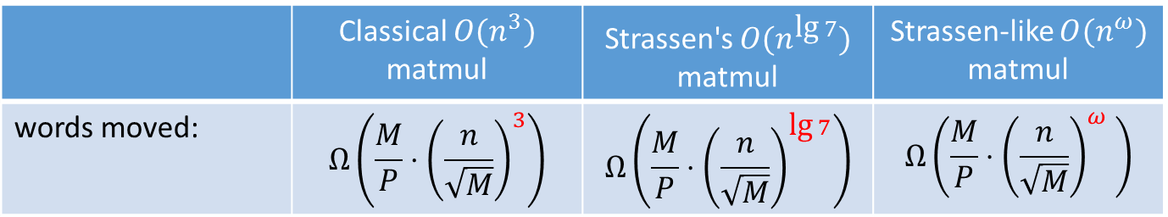
Extensions: Strassen's Matmul
Ballard, Demmel, Holtz, Schwartz (2011 SPAA, 2012 JACM, 2014 CACM)
 | Classical $O(n^{3})$ matmul | Strassen's $O(n^{\text{lg} 7})$ matmul | Strassen-like $O(n^{ω})$ matmul
words moved: | $$Ω\left(\frac{M}{P}⋅{\left(\frac{n}{\sqrt{M}}\right)}^{3}\right)$$ | $$Ω\left(\frac{M}{P}⋅{\left(\frac{n}{\sqrt{M}}\right)}^{\text{lg} 7}\right)$$ | $$Ω\left(\frac{M}{P}⋅{\left(\frac{n}{\sqrt{M}}\right)}^{ω} \right)$$
New communication-optimal parallelization of Strassen’s algorithm
Outperforms all previous matrix multiplication algorithms
Recent work: (Schwartz and Karstadt)
4th talk in this MS
New faster version of Strassen's alg.
Communication costs, parallelization, extension to other Strassen-like algorithms
(Strong scaling on a Cray XT4)

Slide 23
Extensions: Tensor Computations
For tensor contractions, generalized lower bounds apply
  Cyclops Tensor Framework (Solomonik, Matthews, Hammond, Stanton, Demmel, 2014)
    A massively parallel tensor contraction framework for coupled-cluster computations
    Avoids communication by exploiting replication, dynamically selecting a parallel decomposition with the least communication cost
Recent work (Ballard, Knight, Rouse)
  3rd talk in this MS!
  Matricized-tensor times Khatri-Rao product (MTTKRP)
    Bottleneck in CANDECOMP/PARAFAC decomposition of a tensor
  Communication lower bounds for sequential and parallel memory models, communication costs of existing algorithms

Slide 24
Extension: Machine Learning Algorithms
CA-SVMs (You, Demmel, Czechowski, Song, Vuduc, 2015)
Recent work (Devarakonda, Fountoulakis, Demmel, Mahoney)
Talk tomorrow in Part II (MS93)
Communication-avoiding primal and dual block coordinate descent methods for regularized least-squares
Extends results on CA-KSMs
Recent work (Koanantakool, Oh, Morozov, Buluc, Oliker, Yelick)
Talk tomorrow in Part II (MS93)
Communication-Avoiding Sparse Inverse Covariance Matrix Estimation
Main bottleneck: iterative sparse-dense matmul
For the first time, enables analyzing high-dimensional data sets with millions of variables and arbitrary underlying graph structures
Experimental results using 3D brain fMRI data sets

Slide 25
Generalization: Arbitrary Nested Loops
Beyond Linear Algebra: Affine Array References
  e.g., A(i + 2j; 3k + 4)
(Christ, Demmel, Knight, Scanlon, Yelick, 2013); (Knight, 2015)
Extend previous lower bounds to larger class of programs
Lower bounds are computable - proof via Hölder-Brascamp-Lieb (HBL) theory
Matching upper bounds (i.e., optimal algorithms) in special cases: linear algebra, tensor contraction, direct N–body, database join, etc. (when array references pick a subset of the loop indices)
Ongoing work addresses attainability in the general case
Recent work (Knight)
  2nd talk in this MS!
  Application of HBL theory to Convolutional Neural Networks (CNNs)

Slide 26
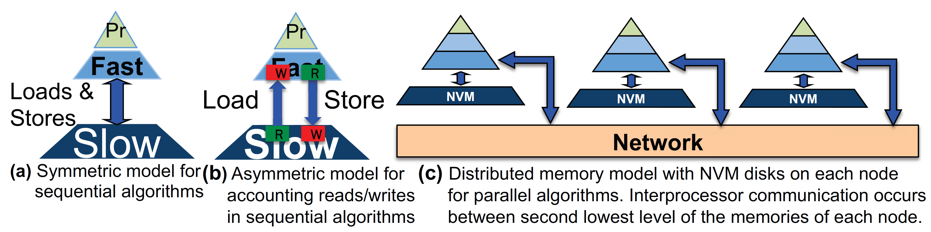
Generalization: Write-Avoiding Algorithms
(C., Demmel, Grigori, Knight, Koanantakool, Schwartz, Simhadri, 2016)
Writes can be much more expensive than reads in some current and emerging storage devices such as nonvolatile memories.
“communication-avoiding” (CA): minimize the sum of reads and writes
"write-avoiding" (WA): CA and also do asymptotically fewer writes than reads
Some CA algorithms are also WA
  Matrix multiply, Cholesky, TRSM, direct N-body
For some algorithms, WA algorithm cannot exist (#writes must be within a constant factor of the total # of reads and writes; "bounded reuse")
  Strassen matmul, Cooley-Tukey FFT, cache oblivious (CO) algorithms for classical linear algebra (no WACO algs!)

Slide 27
Lots of speedups…
Up to 12x faster for 2.5D matmul on 64K core IBM BG/P
Up to 3x faster for tensor contractions on 2K core Cray XE/6
Up to 6.2x faster for All-Pairs-Shortest-Path on 24K core Cray CE6
Up to 2.1x faster for 2.5D LU on 64K core IBM BG/P
Up to 11.8x faster for direct N-body on 32K core IBM BG/P
Up to 13x faster for Tall Skinny QR on Tesla C2050 Fermi NVIDIA GPU
Up to 6.7x faster for symeig(band A) on 10 core Intel Westmere
Up to 2x faster for 2.5D Strassen on 38K core Cray XT4
Up to 4.2x faster for MiniGMG benchmark bottom solver, using CA-BICGSTAB (2.5x for overall solve), 2.5x / 1.5x for combustion simulation code
Up to 42x for Parallel Direct 3-Body
These and many more recent papers available at bebop.cs.berkeley.edu
Notes:
Up to 12x faster for 2.5D matmul on 64K core IBM BG/P (Solomonik, Demmel)
Up to 3x faster for tensor contractions on 2K core Cray XE/6
Up to 6.2x faster for All-Pairs-Shortest-Path on 24K core Cray CE6
Up to 2.1x faster for 2.5D LU on 64K core IBM BG/P
Up to 11.8x faster for direct N-body on 32K core IBM BG/P
Up to 13x faster for Tall Skinny QR on Tesla C2050 Fermi NVIDIA GPU
Up to 6.7x faster for symeig(band A) on 10 core Intel Westmere
Up to 2x faster for 2.5D Strassen on 38K core Cray XT4
Up to 4.2x faster for MiniGMG benchmark bottom solver, using CA-BICGSTAB (2.5x for overall solve), 2.5x / 1.5x for combustion simulation code (Williams et al, 2014)
Up to 42x for Parallel Direct 3-Body (Koanantakool and Yelick, 2014)

Slide 28
Thank you!
erinc@cims.nyu.edu
math.nyu.edu/~erinc

