Slide 1
Communication-Avoiding Krylov Subspace Methods in Finite Precision
Erin Carson and James Demmel
U.C. Berkeley
Bay Area Scientific Computing Day
December 11, 2013

Slide 2
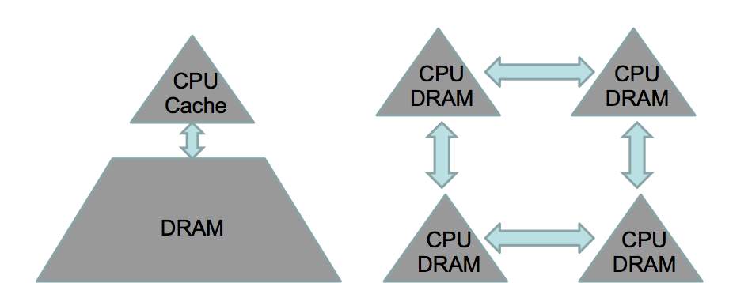
What is Communication?
Algorithms have two costs: communication and computation
Communication : moving data between levels of memory hierarchy (sequential), between processors (parallel)
sequential comm.
parallel comm.
On modern computers, communication is expensive, computation is cheap
Flop time << 1/bandwidth << latency
Communication bottleneck a barrier to achieving scalability
Communication is also expensive in terms of energy cost
To achieve exascale, we must redesign algorithms to avoid communication
Notes:
“Also, data movement will cost more than flops (even on the chip). Limited amounts of memory and low memory/flop ratios will make processing virtually free. In fact, the amount of memory is relatively decreasing, scaling far worse than computation. This is a challenge that’s not being addressed and it’s not going to get less expensive by 2018.”
-Horst Simon, Interview with HPCWire, May 15, 2013

Slide 3
Krylov Subspace Iterative Methods
Methods for solving linear systems, eigenvalue problems, singular value problems, least squares, etc.
Best choice when $A$ is very large and very sparse, stored implicitly, or only approximate answer needed
Based on projection onto the expanding Krylov subspace
$$𝒦_{m}\left(A, v\right)=\text{span}\{v,Av,…,A^{m−1}v\}$$
Used in numerous application areas
Image/contour detection, modal analysis, solving PDEs - combustion, climate, astrophysics, etc…
Named among “Top 10” algorithmic ideas of the 20th century
Along with FFT, fast multipole, quicksort, Monte Carlo, simplex method, etc. (SIAM News, Vol.33, No. 4, 2000)

Slide 4
Communication Bottleneck in KSMs
To carry out the projection process, in each iteration, we
Add a dimension to the Krylov subspace $𝒦_{m}$
Requires Sparse Matrix-Vector Multiplication (SpMV)
Parallel: communicate vector entries with neighbors
Sequential: read $A$ (and $n$-vectors) from slow memory
2. Orthogonalize
Vector operations (inner products, axpys)
Parallel: global reduction
Sequential: multiple reads/writes to slow memory
SpMV
orthogonalize
Dependencies between communication-bound kernels in each iteration limit performance!

Slide 5
Example: Classical Conjugate Gradient (CG)
$\text{Given}\text{: }\text{initial} approximation x_{0}$ for solving $Ax=b$
Let $p_{0}=r_{0}=b−Ax_{0}$
for $m=0, 1, …,$ until convergence do
$α_{m}=\frac{r_{m}^{T}r_{m}}{p_{m}^{T}Ap_{m}}$
$x_{m+1}=x_{m}+α_{m}p_{m}$
$r_{m+1}=r_{m}−α_{m}Ap_{m}$
$β_{m+1}=\frac{r_{m+1}^{T}r_{m+1}}{r_{m}^{T}r_{m}}$
$p_{m+1}=r_{m+1}+β_{m+1}p_{m}$
end for
SpMVs and dot products require communication in each iteration

Slide 6
Communication-Avoiding KSMs
CA-KSMs, based on $s$-step formulations, reduce communication by $O(s)$
First instance: s-step CG by Van Rosendale (1983); for thorough overview see thesis of Hoemmen (2010)
Main idea: Unroll iteration loop by a factor of $s$. By induction,
$x_{sk+j}−x_{sk}, r_{sk+j}, p_{sk+j}∈𝒦_{s+1}\left(A, p_{sk}\right)+𝒦_{s}\left(A, r_{sk}\right)$ for $j∈\left\{0,…,s−1\right\}$
1. Compute basis $V_{k}$ for $𝒦_{s+1}\left(A, p_{sk}\right)+𝒦_{s}\left(A, r_{sk}\right)$ upfront
If $A^{s}$ is well partitioned, requires reading $A$/communicating vectors only once (via matrix powers kernel)
2. Orthogonalize: Encode dot products between basis vectors
with Gram matrix $G_{k}=V_{k}^{T}V_{k}$ (or compute Tall-Skinny QR)
Communication cost of one global reduction
3. Perform s iterations of updates
Using $V_{k}$ and $G_{k}$, this requires no communication
Represent $n$-vectors by their coordinates in$V_{k}:$
$x_{sk+j}−x_{sk}=V_{k}x_{j }^{′}, r_{sk+j}=V_{k}r_{j}^{′}, p_{sk+j}=V_{k}p_{j}^{′}$
Outer loop:
Communication step
Inner loop:
Computation steps, no communication!
Notes:
Latency reduced by O(s) in parallel case, but bandwidth+flops might actually increase
Latency and bandwidth reduced by O(s) in sequential case, assuming that nnz > o(n) …which means that reading A is the dominant cost (more expensive than reading/writing the length n basis vector outputs. If nnz(A) is o(n), then need the streaming version to reduce BW asymptotically, otherwise just avoids latency.

Slide 7
Example: CA-Conjugate Gradient
$\text{Given}\text{: }\text{initial} approximation x_{0}$ for solving $Ax=b$
Let $p_{0}=r_{0}=b−Ax_{0}$
for $k=0, 1, …,$ until convergence do
Compute $V_{k}$ such that $AV_{k}=V_{k}B_{k}$, compute $G_{k}=V_{k}^{T}V_{k}$
Let $x_{0}^{′}=0_{2s+1}, r_{0}^{′}=e_{s+2}, p_{0}^{′}=e_{1}$
for $j=0,…,s−1$ do
$α_{sk+j}=\frac{{\left(r_{j}^{′}\right)}^{T}G_{k}r_{j}^{′}}{{\left(p_{j}^{′}\right)}^{T}G_{k}B_{k}p_{j}^{′}}$
$x_{j+1}^{′}=x_{j}^{′}+α_{sk+j}p_{j}^{′}$
$r_{j+1}^{′}=r_{j}^{′}−α_{sk+j}B_{k}p_{j}^{′}$
$β_{sk+j+1}=\frac{{\left(r_{j+1}^{′}\right)}^{T}G_{k}r_{j+1}^{′}}{{\left(r_{j}^{′}\right)}^{T}G_{k}r_{j}^{′}}$
$p_{j+1}^{′}=r_{j+1}^{′}+β_{sk+j+1}p_{j}^{′}$
end for
Compute $x_{sk+s}=V_{k}x_{s}^{′}+x_{sk}$, $r_{sk+s}=V_{k}r_{s}^{′}$, $p_{sk+s}=V_{k}p_{s}^{′}$
end for
via CA Matrix Powers Kernel
Global reduction to compute G
Local computations within inner loop require no communication!

Slide 8
Behavior of CA-KSMs in Finite Precision
Runtime = (time per iteration) x (number of iterations until convergence)
Communication-avoiding approach can reduce time per iteration by O(s)
But how do convergence rates compare to classical methods?
CA-KSMs are mathematically equivalent to classical KSMs, but can behave much differently in finite precision!
Roundoff errors have two discernable effects:
Delay of convergence $→$ if # iterations increases more than time per iteration decreases due to CA techniques, no speedup expected
Decrease in attainable accuracy due to deviation of the true residual, $b−Ax_{i}$, and the updated residual, $r_{i}$ $→$ some problems that KSM can solve can’t be solved with CA variant
Roundoff error bounds generally grow with increasing $s$
Obstacles to the practical use of CA-KSMs
Notes:
Roundoff error bounds generally grow with increasing $s$
Ideally, would like to select $s$ based solely on performance constraints
Trends suggest communication will only become more expensive -> higher $s$ values beneficial

Slide 9
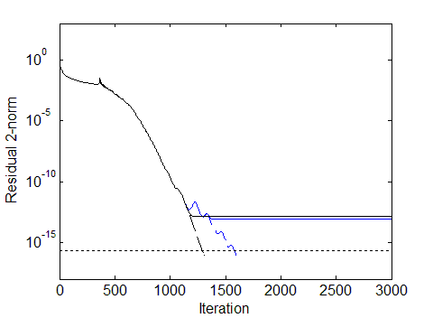
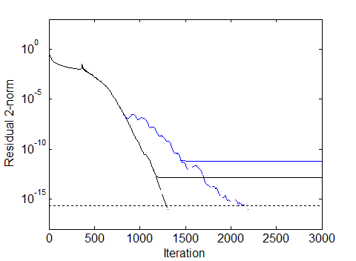
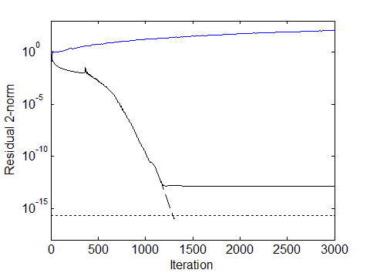
CA-CG Convergence, s = 4
CA-CG Convergence, s = 8
Slower convergence due to roundoff
Loss of accuracy due to roundoff
CA-CG Convergence, s = 16
CG true
CG updated
CA-CG (monomial) true
CA-CG (monomial) updated
At s = 16, monomial basis is rank deficient! Method breaks down!
Model Problem: 2D Poisson (5 pt stencil),
n = 262K, nnz = 1.3M, cond(A) $≈$ 10^4
0

Slide 10
Improving Convergence Rate and Accuracy
We will discuss two techniques for alleviating the effects of roundoff:
Improve convergence by using better-conditioned polynomial bases
Use a residual replacement strategy to improve attainable accuracy

Slide 11
Choosing a Polynomial Basis
Recall: in each outer loop of CA-CG, we compute bases for some Krylov subspace, $𝒦_{m}\left(A, v\right)=\text{span}\{v,Av,…,A^{m−1}v\}$
Simple loop unrolling leads to the choice of monomials $\left\{v, Av, …, A^{s}v\right\}$
Monomial basis condition number can grow exponentially with $s$ - expected (near) linear dependence of basis vectors for modest $s$ values
Recognized early on that this negatively affects convergence (Chronopoulous & Swanson, 1995)
Improve basis condition number to improve convergence: Use different polynomials to compute a basis for the same subspace.
Two choices based on spectral information that usually lead to well-conditioned bases:
Newton polynomials
Chebyshev polynomials

Slide 12
Newton Basis
The Newton basis can be written
$\left\{v, \left(A−θ_{1}\right)v,\left(A−θ_{2}\right) \left(A−θ_{1}\right)v, …,\left(A−θ_{s}\right)…\left(A−θ_{1}\right)v\right\}$
where${ \{θ}_{1},…,θ_{s}\}$ are chosen to be approximate eigenvalues of $A$, ordered according to Leja ordering:
$$θ_{1}={argmax}_{z∈L_{0}}\left|z\right| θ_{j+1}={argmax}_{z∈L_{j}}\prod_{i=0}^{j}{\left|z−z_{i}\right|}$$
where $L_{j}≡\left\{θ_{j+1},θ_{j+2},…,θ_{s}\right\}$.
In practice: recover Ritz (Petrov) values from the first few iterations, iteratively refine eigenvalue estimates to improve basis
Used by many to improve s-step variants: e.g., Bai, Hu, and Reichel (1991), Erhel (1995), Hoemmen (2010)

Slide 13
Chebyshev Basis
Chebyshev polynomials frequently used because of minimax property:
Over all real polynomials of degree $m$ on interval $I$, the Chebyshev polynomial of degree $m$ minimizes the maximum absolute value on $I$
Given ellipse enclosing spectrum of $A$ with foci at $d±c$, we can generate the scaled and shifted Chebyshev polynomials as:
${\tilde{τ}}_{j}\left(z\right)=\frac{τ_{j}\left(\frac{d−z}{c}\right)}{τ_{j}\left(\frac{d}{c}\right)}$
where ${\left\{τ_{j}\right\}}_{j≥0}$ are the Chebyshev polynomials of the first kind
In practice, we can estimate $d$ and $c$ parameters from Ritz values recovered from the first few iterations
Used by many to improve s-step variants: e.g., de Sturler (1991), Joubert and Carey (1992), de Sturler and van der Vorst (2005)

Slide 14
CA-CG Convergence, s = 4
CA-CG Convergence, s = 8
CA-CG Convergence, s = 16
CG true
CG updated
CA-CG (monomial) true
CA-CG (monomial) updated
Model Problem: 2D Poisson (5 pt stencil),
n = 262K, nnz = 1.3M, cond(A) $≈$ 10^4
0

Slide 15
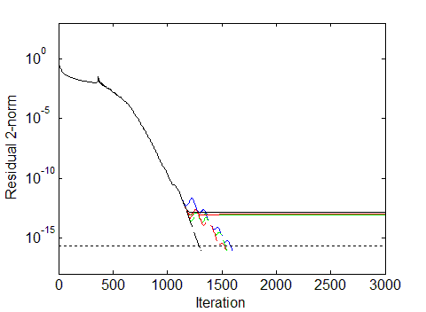
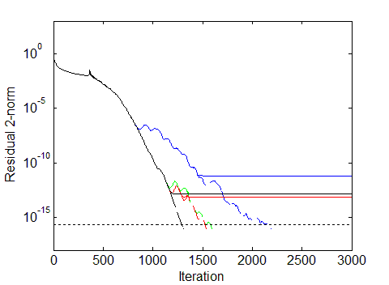
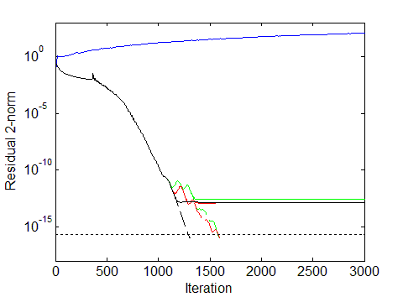
CA-CG Convergence, s = 4
CA-CG Convergence, s = 8
Better basis choice allows higher s values
CA-CG Convergence, s = 16
CG true
CG updated
CA-CG (monomial) true
CA-CG (monomial) updated
CA-CG (Newton) true
CA-CG (Newton) updated
CA-CG (Chebyshev) true
CA-CG (Chebyshev) updated
But can still see loss of accuracy
Model Problem: 2D Poisson (5 pt stencil),
n = 262K, nnz = 1.3M, cond(A) $≈$ 10^4

Slide 16
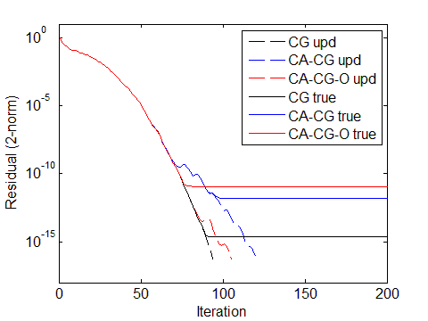
Explicit Orthogonalization
Use communication-avoiding TSQR to orthogonalize matrix powers output
Matrix powers kernel outputs basis $V_{k}$ such that $AV_{k}=V_{k}B_{k}$
Use TSQR to compute $V_{k}=Q_{k}R_{k}$ (one reduction)
Use orthogonal basis $Q_{k}$ instead of $V_{k}$:$AQ_{k}=Q_{k}{\tilde{B}}_{k}$ with ${\tilde{B}}_{k}=R_{k}B_{k}R_{k}^{−1}$
Gram matrix computation unnecessary since $Q_{k}^{T}Q_{k}=I$
Example: small model problem, 2D Poisson with $n=400$, CA-CG with monomial basis and $s=8$
Monomial Basis, s=8
Can improve convergence rate of updated residual
But can cause loss of accuracy

Slide 17
Accuracy in Finite Precision
In classical CG, iterates are updated by
$x_{i}=x_{i−1}+q_{i−1}$ and $r_{i}=r_{i−1}−Aq_{i−1}$
Formulas for $x_{i}$ and $r_{i}$ do not depend on each other - rounding errors cause the true residual, ${b−Ax}_{i}$, and the updated residual, $r_{i}$, to deviate
The size of the deviation of residuals, $\left\|b−Ax_{i}−r_{i}\right\|$, determines the maximum attainable accuracy
Write the true residual as ${b−Ax}_{i}=r_{i}−\left(b−Ax_{i}−r_{i}\right)$
Then the size of the true residual is bounded by
$$\left\|b−Ax_{i}\right\|≤\left\|r_{i}\right\|+\left\|b−Ax_{i}−r_{i}\right\|$$
When $\left\|r_{i}\right\|≫\left\|b−Ax_{i}−r_{i}\right\|$, $\left\|r_{i}\right\|$ and $\left\|b−Ax_{i}\right\|$ have similar magnitude
But when $\left\|r_{i}\right\|→0$, $\left\|b−Ax_{i}\right\|$ depends on $\left\|b−Ax_{i}−r_{i}\right\|$
First bound on maximum attainable accuracy for classical KSMs given by Greenbaum (1992)
We have applied a similar analysis to upper bound the maximum attainable accuracy in finite precision CA-KSMs

Slide 18
Sources of Roundoff in CA-KSMs
Computing the $s$-step Krylov basis:
$A{\hat{V}}_{k}={\hat{V}}_{k}B_{k}+∆_{V_{k}}$
Updating coordinate vectors in the inner loop:
${\hat{x}′}_{k,j}={\hat{x}′}_{k,j−1}+{\hat{q}′}_{k,j−1}+ξ_{k,j}$
${\hat{r}′}_{k,j}={\hat{r}′}_{k,j−1}−B_{k}{\hat{q}′}_{k,j−1}+η_{k,j}$
Recovering CG vectors for use in next outer loop:
${\hat{x}}_{sk+j}={\hat{V}}_{k}{\hat{x}′}_{k,j}+{\hat{x}}_{sk}+φ_{sk+j}$
${\hat{r}}_{sk+j}={\hat{V}}_{k}{\hat{r}′}_{k,j}+ψ_{sk+j}$
Error in computing $s$-step basis
Error in updating coefficient vectors
Error in
basis change

Slide 19
Bound on Maximum Attainable Accuracy
We can write the deviation of the true and updated residuals in terms of these errors:
$$b−A{\hat{x}}_{sk+j}−{\hat{r}}_{sk+j}=b−Ax_{0}−r_{0}$$
$$−\sum_{ℓ=0}^{k−1}{\left[Aφ_{sℓ+s}+ψ_{sℓ+s}−Δ_{V_{ℓ}}{\hat{x}′}_{ℓ,s}+{\hat{V}}_{ℓ}\sum_{i=1}^{s}{\left({B_{ℓ}ξ}_{ℓ,i}+η_{ℓ,i}\right)}\right]}$$
$$−{\hat{V}}_{k}\sum_{i=1}^{j}{\left({B_{k}ξ}_{k,i}+η_{k,i}\right)}+Δ_{V_{k}}{\hat{x}′}_{k,j}−{Aφ}_{sℓ+j}−ψ_{sℓ+j}$$
This can easily be translated into a computable upper bound
Next: using this bound to improve accuracy in a residual replacement strategy
Notes:
This can easily be translated into a norm-wise upper bound using the corresponding upper bounds on the error terms.
We later show one possible way this bound can be used to improve accuracy
(a residual replacement strategy)

Slide 20
Residual Replacement Strategy
Based on Van der Vorst and Ye (1999) for classical KSMs
Idea: Replace updated residual $r_{m}$ with true residual $b−Ax_{m}$ at certain iterations to reduce size of their deviation (thus improving attainable accuracy)
Result: When the updated residual converges to level $O(ε)\left\|A\right\|\left\|x\right\|$, a small number of replacement steps can reduce true residual to level $O(ε)\left\|A\right\|\left\|x\right\|$
We devise an analogous strategy for CA-CG and CA-BICG based on derived bound on deviation of residuals
Computing estimates for quantities in bound has negligible cost → residual replacement strategy does not asymptotically increase communication or computation!
To appear in SIMAX
Notes:
Using a computable upper bound on deviation of residuals, choose replacement iterations to meet two constraints:
Deviation must not grow so large that attainable accuracy is limited
Replacement must not perturb Lanczos recurrence such that convergence deteriorates

Slide 21
CA-CG Convergence, s = 4
CA-CG Convergence, s = 8
CA-CG Convergence, s = 16
CG true
CG updated
CA-CG (monomial) true
CA-CG (monomial) updated
CA-CG (Newton) true
CA-CG (Newton) updated
CA-CG (Chebyshev) true
CA-CG (Chebyshev) updated
Model Problem: 2D Poisson (5 pt stencil),
n = 262K, nnz = 1.3M, cond(A) $≈$ 10^4

Slide 22
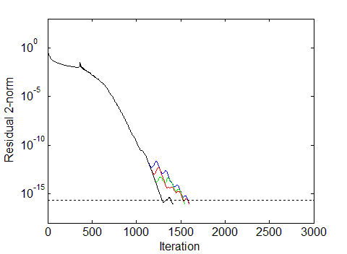
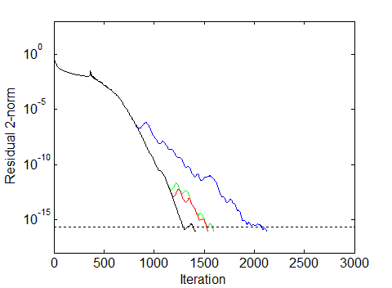
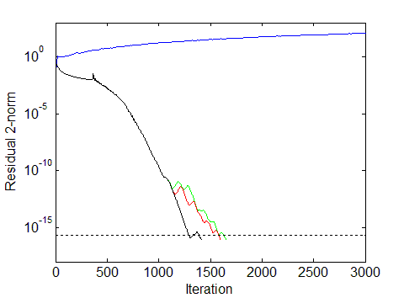
CA-CG Convergence, s = 4
CA-CG Convergence, s = 8
Maximum replacement steps (extra reductions) for any test: 8
CA-CG Convergence, s = 16
CG-RR true
CG-RR updated
CA-CG-RR (monomial) true
CA-CG-RR (monomial) updated
CA-CG-RR (Newton) true
CA-CG-RR (Newton) updated
CA-CG-RR (Chebyshev) true
CA-CG-RR (Chebyshev) updated
Residual Replacement can improve accuracy orders of magnitude for negligible cost
Model Problem: 2D Poisson (5 pt stencil),
n = 262K, nnz = 1.3M, cond(A) $≈$ 10^4

Slide 23
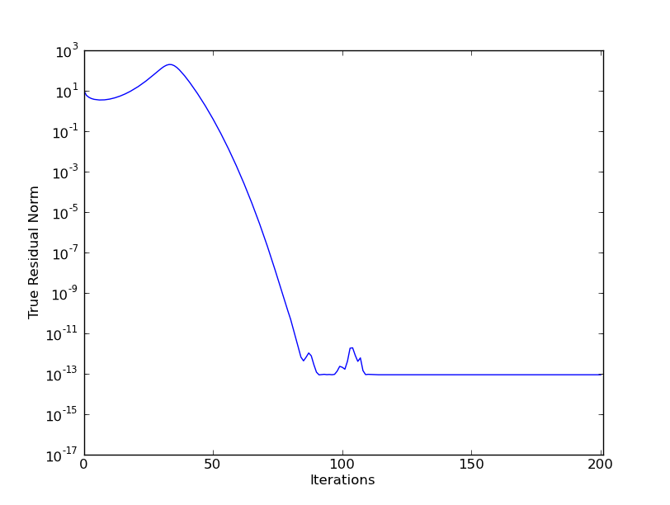
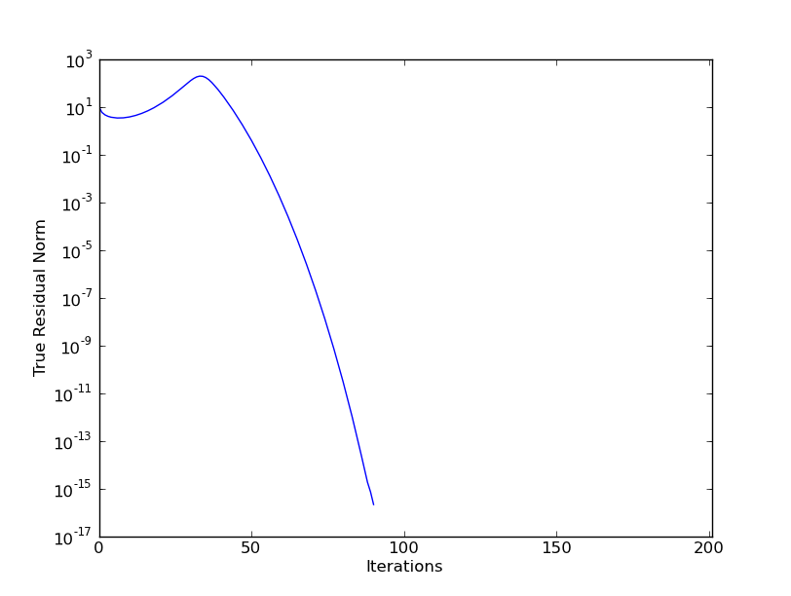
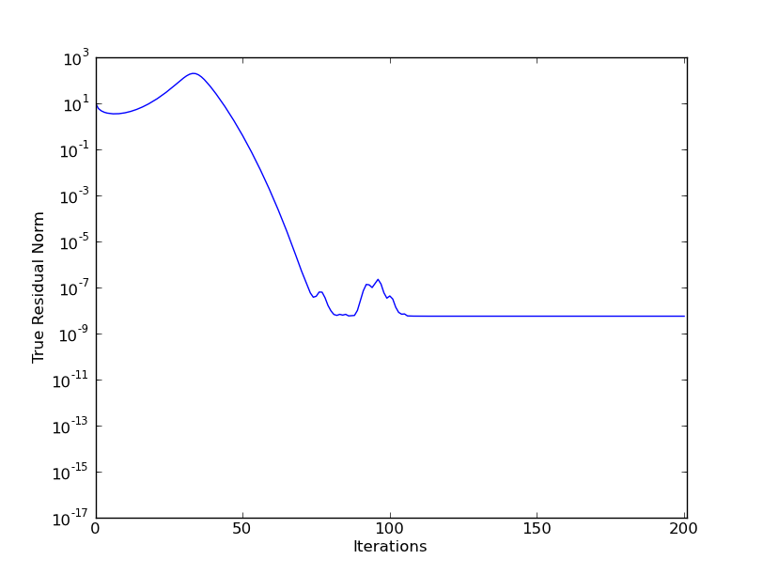
Ongoing Work: Using Extended Precision
Precision we choose affects both stability and convergence
Errors in $r_{i},p_{i},α_{i}, \text{and} β_{i}$ affect convergence rate (Lanczos process)
Errors in computing $r_{i}$ and $x_{i}$ affect accuracy (deviation of residuals)
CA-CG convergence (s = 2, monomial basis)
Precision:
10 decimal places
Precision:
15 decimal places
Precision:
20 decimal places
True Residual Norm
Iterations
Example: diag(linspace(1,1e6, 100)), random RHS

Slide 24
Summary and Open Problems
For high performance iterative methods, both time per iteration and number of iterations required are important.
CA-KSMs offer asymptotic reductions in time per iteration, but can have the effect of increasing number of iterations required (or causing instability)
We discuss two ways for reducing roundoff effects for linear system solvers: improving basis conditioning and residual replacement techniques
For CA-KSMs to be practical, must better understand finite precision behavior (theoretically and empirically), and develop ways to improve the methods
Ongoing efforts in: finite precision convergence analysis for CA-KSMs, selective use of extended precision, development of CA preconditioners, reorthogonalization for CA eigenvalue solvers, etc.

Slide 25
Backup Slides

Slide 26
Related Work: $s$-step methods
Authors | KSM | Basis | Precond? | Mtx Pwrs? | TSQR?
Van Rosendale, 1983 | CG | Monomial | Polynomial | No | No
Leland, 1989 | CG | Monomial | Polynomial | No | No
Walker, 1988 | GMRES | Monomial | None | No | No
Chronopoulos and Gear, 1989 | CG | Monomial | None | No | No
Chronopoulos and Kim, 1990 | Orthomin, GMRES | Monomial | None | No | No
Chronopoulos, 1991 | MINRES | Monomial | None | No | No
Kim and Chronopoulos, 1991 | Symm. Lanczos, Arnoldi | Monomial | None | No | No
Sturler, 1991 | GMRES | Chebyshev | None | No | No

Slide 27
Related Work: $s$-step methods
Authors | KSM | Basis | Precond? | Mtx Pwrs? | TSQR?
Joubert and Carey, 1992 | GMRES | Chebyshev | No | Yes* | No
Chronopoulos and Kim, 1992 | Nonsymm. Lanczos | Monomial | No | No | No
Bai, Hu, and Reichel, 1991 | GMRES | Newton | No | No | No
Erhel, 1995 | GMRES | Newton | No | No | No
de Sturler and van der Vorst, 2005 | GMRES | Chebyshev | General | No | No
Toledo, 1995 | CG | Monomial | Polynomial | Yes* | No
Chronopoulos and Swanson, 1990 | CGR, Orthomin | Monomial | No | No | No
Chronopoulos and Kinkaid, 2001 | Orthodir | Monomial | No | No | No

Slide 28
Current Work: Convergence Analysis of Finite Precision CA-KSMs
Based on analysis of Tong and Ye (2000) for classical BICG
Goal: bound the residual in terms of minimum polynomial of a perturbed matrix multiplied by amplification factor
Finite precision error analysis gives us Lanczos-type recurrence relation:
$$AZ_{k,j}=Z_{k,j}{\overline{𝒯}}_{k,j}−\frac{1}{{\overline{α}}_{sk+j}}\frac{{\underline{V}}_{k}{r^{′}}_{k,j+1}}{\left\|r_{0}\right\|}e_{sk+j+1}^{T}+{\overline{Δ}}_{k,j}$$
Using this, we can obtain the bound
$$\left\|{\underline{V}}_{k}{r^{′}}_{k,j+1}\right\|≤\left(1+K_{k,j}\right)\min_{ρ∈ℙ_{sk+j+1}, ρ\left(0\right)=1}\left\|ρ\left(A+δA_{k,j}\right)r_{0}\right\|$$
where $K_{k,j}=\left\|\left(AZ_{k,j}−{\overline{Δ}}_{k,j}\right){\overline{𝒯}}_{k,j}^{−1}W_{0}^{T}\right\|$ and $δA_{k,j}=−{\overline{Δ}}_{k,j}Z_{k,j}^{+}$
${\left(sk+j\right)}^{th}$ residual norm of exact GMRES applied to $A+δA_{k,j}$
amplification factor

Slide 29
Current: Convergence Analysis of CA-BICG in Finite Precision
How can we use this bound?
Given matrix $A$ and basis parameters, heuristically estimate maximum $s$ such that convergence rate is not significantly different than classical KSM
Use known bounds on polynomial condition numbers
Experiments to give insight on where extended precision should be used
Which quantities dominant bound, which are most important to compute accurately?
Explain convergence despite rank-deficient basis computed by matrix powers (i.e., columns of ${\underline{V}}_{k}$ are linearly dependent)
Tong and Ye show how to extend analysis for case where $Z_{k,j}$ has linearly dependent columns, explains convergence despite rank-deficient Krylov subspace

Slide 30
Residual Replacement Strategy
In finite precision classical CG, in iteration $n$, the computed residual and search direction vectors satisfy
$${\hat{r}}_{n}={\hat{r}}_{n−1}−α_{n−1}A{\hat{p}}_{n−1}+η_{n}$$
$${\hat{p}}_{n}={\hat{r}}_{n}+β_{n}{\hat{p}}_{n−1}+τ_{n}$$
Then in matrix form,
$$AZ_{n}=Z_{n}T_{n}−\frac{1}{α_{n}^{′}}\frac{{\hat{r}}_{n+1}}{\left\|{\hat{r}}_{0}\right\|}e_{n+1}^{T}+F_{n}$$
$$Z_{n}=\left[\frac{{\hat{r}}_{0}}{\left\|{\hat{r}}_{0}\right\|},…,\frac{{\hat{r}}_{n}}{\left\|{\hat{r}}_{n}\right\|}\right]$$
with
where $T_{n}$ is invertible and tridiagonal, $α_{n}^{′}=e_{n}^{T}T_{n}^{−1}e_{1}$ and $F_{n}=\left[f_{0},…,f_{n}\right]$, with
$$f_{n}=\frac{Aτ_{n}}{\left\|{\hat{r}}_{n}\right\|}+\frac{1}{α_{n}}\frac{η_{n+1}}{\left\|{\hat{r}}_{n}\right\|}−\frac{β_{n}}{α_{n−1}}\frac{η_{n}}{\left\|{\hat{r}}_{n}\right\|}$$
CA-CG
Using the term $η_{n}$ derived for the CG recurrence with residual replacement, we know we can replace the residual without affecting convergence when $η_{n}$ is not too large relative to $\left\|{\hat{r}}_{n}\right\|$ and $\left\|{\hat{r}}_{n−1}\right\|$ (Van der Vorst and Ye, 1999).

Slide 31
Residual Replacement Strategy
In iteration $n=sk+j+m$ of finite precision CA-CG, where $m$ was the last residual replacement step, we have
$${\hat{r}}_{sk+j+m}=r_{sk+j+m−1}−Aq_{sk+j+m−1}+η_{sk+j+m}^{CA}$$
where
$$\left\|η_{sk+j+m}^{CA}\right\|≤ε\left\|{\hat{r}}_{m}\right\|+ε\left(1+2N\right)\left\|A\right\|\left\|{\hat{x}}_{m}\right\|$$
$$+ε\sum_{ℓ=0}^{k−1}{\left[\left\|A\right\|\left(\left\|{\hat{x}′}_{sℓ}\right\|+N_{s}\left\|\left|{\hat{V}}_{ℓ}\right|\left|{\hat{x}′′}_{ℓ,s}\right|\right\|\right)+N_{s}\left\|\left|{\hat{\underline{V}}}_{ℓ}\right|\left|{\hat{r}′′}_{ℓ,s}\right|\right\|+\left\|\left|∆_{V_{ℓ}}\right|\left|{\hat{x}′′}_{ℓ,s}\right|\right\|\right]}$$
$$+ε\sum_{ℓ=0}^{k−1}{\sum_{i=1}^{s}{\left[\left(1+2N_{s}\right)\left\|\left|{\hat{\underline{V}}}_{ℓ}\right|\left|{\hat{\underline{B}}}_{ℓ}\right|\left|{{\hat{x}}^{′′}}_{ℓ,i}\right|\right\|+\left\|\left|{\hat{\underline{V}}}_{ℓ}\right|\left|{{\hat{r}}^{′′}}_{ℓ,i}\right|\right\|\right]}}$$
$$+ε\sum_{i=1}^{j}{\left[\left(1+2N_{s}\right)\left\|\left|{\hat{\underline{V}}}_{k}\right|\left|{\hat{\underline{B}}}_{k}\right|\left|{{\hat{x}}^{′′}}_{k,i}\right|\right\|+\left\|\left|{\hat{\underline{V}}}_{k}\right|\left|{{\hat{r}}^{′′}}_{k,i}\right|\right\|\right]}$$
$$+ε(2+N+N_{s})\left\|A\right\|\left\|\left|{\hat{\underline{V}}}_{k}\right|\left|{{\hat{x}}^{′′}}_{k,j}\right|\right\|$$
Assuming we have an estimate for $\left\|A\right\|$, we can compute all quantities in the bound without asymptotically increasing comm. or comp.

Slide 32
Residual Replacement Algorithm
Based on the perturbed Lanczos recurrence (see, e.g. Van der Vorst and Ye, 1999), we should replace the residual when
$$d_{sk+j−1}≤\hat{ε}\left\|r_{sk+j−1}\right\| and { d}_{sk+j}>\hat{ε}\left\|r_{sk+j}\right\| and{ d}_{sk+j}>1.1d^{init}$$
where $\hat{ε}$ is a tolerance parameter, chosen as $\hat{ε}=\sqrt{ε}$
We can write the pseudocode for residual replacement with group update:
if $d_{sk+j−1}≤\hat{ε}\left\|r_{sk+j−1}\right\| and { d}_{sk+j}>\hat{ε}\left\|r_{sk+j}\right\| and{ d}_{sk+j}>1.1d_{init}$
$z=z+{\hat{V}}_{k}{\hat{x}}_{k,j}^{′}+{\hat{x}}_{sk}$
$x_{sk+j}=0$
$r_{sk+j}=b−Az$
$d_{init}={ d}_{sk+j}=ε\left(\left(1+2N_{A}\right)\left\|A\right\|\left\|z\right\|+\left\|r_{sk+j}\right\|\right)$
break from inner loop
end
where we set $d_{init}=ε\left(N_{A} \left\|A\right\|\left\|x_{0}\right\|+\left\|r_{0}\right\|\right)$ at the start of the algorithm.

Slide 33
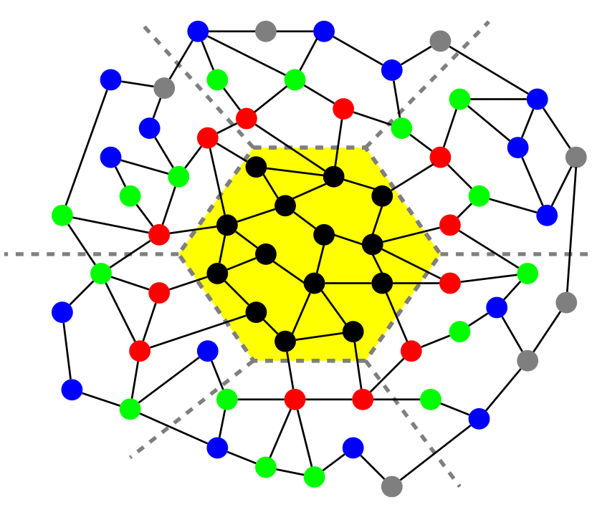
The Matrix Powers Kernel
Avoids communication:
In serial, by exploiting temporal locality:
Reading A
Reading V := [x, Ax, A²x, …, A^{s}x]
In parallel, by doing only 1 ‘expand’ phase (instead of s).
Tridiagonal Example:
black = local elements
red = 1-level dependencies
green = 2-level dependencies
blue = 3-level dependencies
Also works for general graphs!
A³v
A²v
Av
v
Sequential
Parallel
A³v
A²v
Av
v

Slide 34
Current: Multigrid Bottom-Solve Application
AMR applications that use geometric multigrid method
Issues with coarsening require switch from MG to BICGSTAB at bottom of V-cycle
At scale, MPI_AllReduce() can dominate the runtime; required BICGSTAB iterations grows quickly, causing bottleneck
Proposed: replace with CA-BICGSTAB to improve performance
Collaboration w/ Nick Knight and Sam Williams (FTG at LBL)
interpolation
restriction
bottom-solve
CA-BICGSTAB
Currently ported to BoxLib, next: CHOMBO (both LBL AMR projects)
BoxLib applications: combustion (LMC), astrophysics (supernovae/black hole formation), cosmology (dark matter simulations), etc.

Slide 35
Current: Multigrid Bottom-Solve Application
Challenges
Need only $≈2$ orders reduction in residual (is monomial basis sufficient?)
How do we handle breakdown conditions in CA-KSMs?
What optimizations are appropriate for matrix-free method?
Some solves are hard ($≈$100 iterations), some are easy ($≈$5 iterations)
Use “telescoping” $s:$ start with s=1 in first outer iteration, increase up to max each outer iteration
Cost of extra point-to-point amortized for hard problems
Preliminary results:
Hopper (1K^3, 24K cores): 3.5x in bottom-solve (1.3x total)
Edison (512^3, 4K cores): 1.6x bottom-solve (1.1x total)
Proposed:
Demonstrate CA-KSM speedups in other 2+ other HPC applications
Want apps which demonstrate successful use of strategies for stability, convergence, and performance derived in this thesis

Slide 36
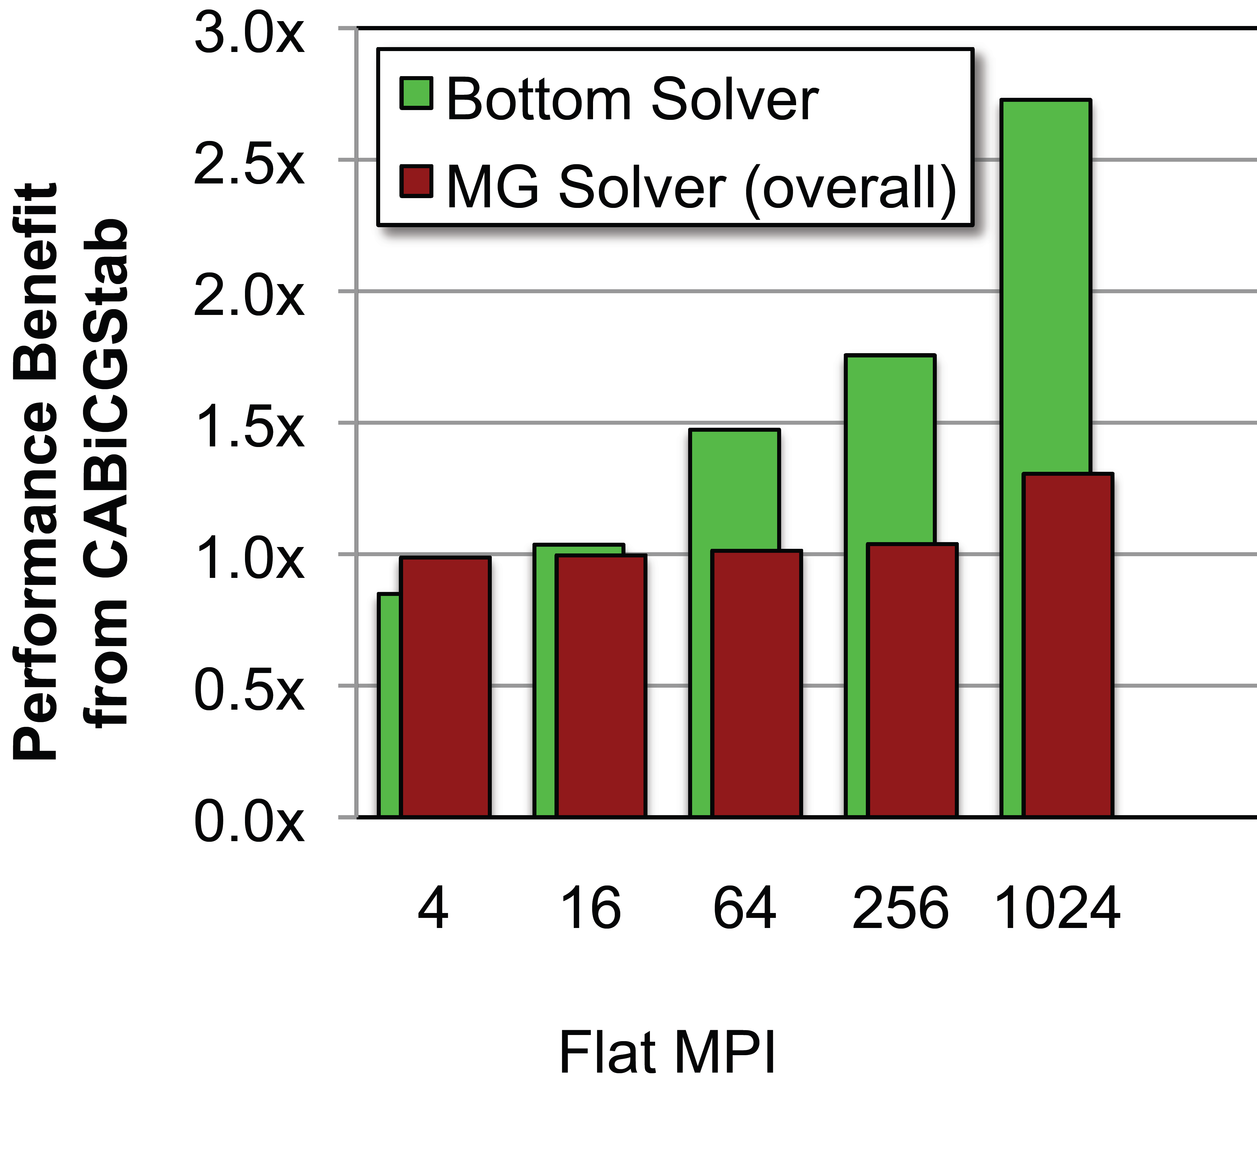
LMC-2D mac_project solve

