Slide 1
FOREX
Alexander Mačejovský

Slide 2
Basic facts
Trading of currency pairs
The largest financial market in terms of volume in the world by far
Decentralized (OTC) through licensed dealers
Global, non-stop outside weekends
Formed since 1970s after Bretton-Woods (fixed exchange rates) collapse

Slide 3
Motivations and significance
Foreign trade
Hedging against exchange rate changes
Speculation, carry trade
Impact on export/import costs -> trade balances -> GDP

Slide 4
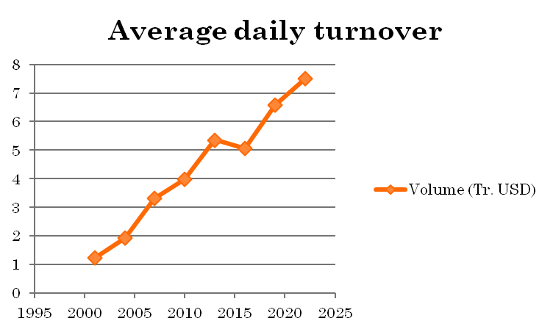
Size in turnover volume
Average daily turnovers in trillions of USD
FOREX vs Stock Exchanges (tr. USD)
FOREX | 7.510
Top 20 Stock Exch. | 0.169
NYSE | 0.048
Nasdaq | 0.042

Slide 5
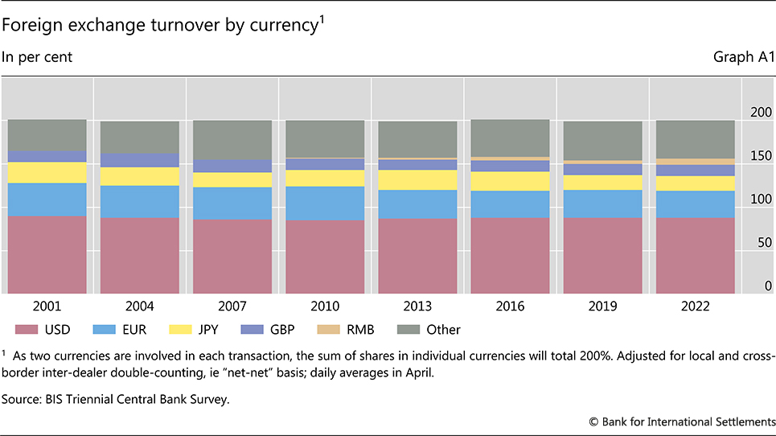
Most traded currencies
Currency | % share (2022)
USD | 88
EUR | 31
JPY | 17
GBP | 13
RMB | 7
Other | 44
Total | 200

Slide 6
Main participants
Rank | Name | Market share (2020)
1 | JP Morgan (US) | 10.78%
2 | UBS (CH) | 8.13%
3 | XTX Markets (GB) | 7.58%
4 | Deutsche Bank (DE) | 7.38%
5 | Citi (US) | 5.50%
6 | HSBC (GB) | 5.33%
7 | Jump Trading (US) | 5.23%
8 | Goldman Sachs (US) | 4.62%
9 | State Street Corporation (US) | 4.61%
10 | Bank of America Merrill Lynch (US) | 4.50%
Commercial Banks
Central Banks
Governments
Other financial institutions
Private companies
Individuals

Slide 7
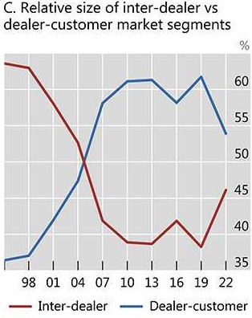
How it works
Interbank market
sellers
Broker
buyers
Trader
Trader
Broker
Trader
Trader
Broker

Slide 8
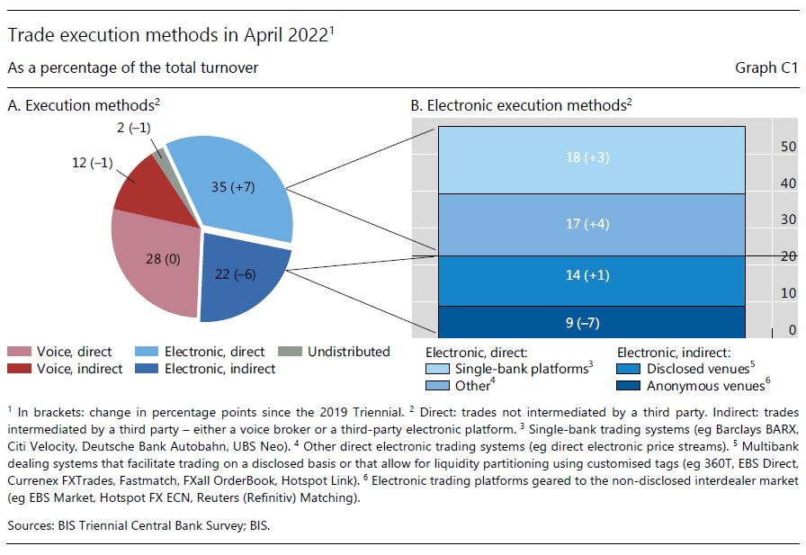
How it works
Communication between dealers:
Directly (phone, electronically)
Matching order systems
Electronic trading systems
others

Slide 9
How it works
Low spreads on the interbank market
Brokers offer their own prices and spreads to end clients
Larger spreads when liquidity is low

Slide 10
Geography
Many markets around the world
Prices aligned due to arbitrage
NZ/Aus, Asian, European and American sessions
Largest volume traded in London markets
Price usually quoted as London market price
UK | 38.1%
US | 19.4%
Singapore | 9.4%
Hong-Kong | 7.1%
Japan | 4.4%

Slide 11
Instruments
Instrument | % share
Spot | 28.03
FX swaps | 50.76
Outright forwards | 15.50
Options & other products | 4.05
Currency swaps | 1.65
Forex swaps – exchange now, reverse the same later
Spot contracts – cash, currently agreed price,
2 or 1 day delivery (swaps for roll-overs)
Forwards – generalization of the above to an agreed-upon delivery day

Slide 12
Forex scandal (2013)
Collusion of major banks to manipulate Forex prices
JPMorgan, Barclays, HSBC, Citibank, UBS, Bank of America and others
Investigation based on chatrooms (with names such as "The Cartel", "The Bandits’ Club", and "The Mafia") conversations between traders
Allegedly this lasted for more than a decade

Slide 13
Thank you for your attention!

